Slide 1
Biennial 2023-25
Budget Proposal
Oakland Police Commission

Slide 2
Timeline of Budget Discussion
2022
Commission experiences critical gaps in resources around staffing needs that would maximize operations and move the needle towards proactive, strategic transition in their growing work in oversight
Nov 2022
Commission discusses budget and staffing at November 5th Annual Retreat
Jan 2023
Further feedback on budget solicited from Commission on January 21st and 26th
Feb 2023
Budget Ad Hoc meets in February and shares preliminary proposal with Commission on February 23rd
Mar 2023
Preliminary proposal discussed with Mayor Thao. Budget Ad Hoc reports out on March 9th and continues to solicit Commission feedback. Budget Ad Hoc meets again prior to March 23rd meeting
Notes:
policy

Slide 3
Police Commission Role and Responsibilities
The Commission’s core role is to oversee and reform policing in Oakland to steward public safety and instill confidence in a just legal system. We carry out this mission through the following responsibilities:
Police Oversight in collaboration with the Community Police Review Agency (CPRA) and the Office of the Inspector General (OIG)
Police Reform through policy, culture change, and community engagement
Charter and Municipal Mandates as determined by the voters of Oakland
Negotiated Settlement Agreement compliance, sustainability, and transition

Slide 4
Measuring the Commission’s Success
Key indicators of the Commission’s success:
Charter and Municipal Code mandates fulfilled
Impact of policies reviewed and approved
Address racial disparities in policing practices
Mitigate police misconduct
Negotiated Settlement Agreement Tasks and Sustainability
Compliance with City Audit Report
Public forums and community engagement
Evaluation of inclusion and transparency
Staff recruitment, management, retention, and performance evaluation

Slide 5
Commission’s Greatest Challenges
Resources
NSA Transition
Capacity-Building
Stakeholder Engagement
Communications and Relationships
Sustainable and Long-Range Preparedness
Compliance and Proactivity

Slide 6
Budget Proposal Principles
Departments were instructed to adhere to the following principles in developing the budget proposals to embrace the opportunity and necessity for process improvements by:
Centering Equity – an intentional effort to prevent exacerbating racial disparities and to reduce racial disparities wherever possible
Valuing the City Workforce – prioritizing the wellbeing and professional development of our dedicated and talented workforce
Strategic Thinking – encouraging creative and innovative strategies to become a more efficient and effective City

Slide 7
Research and Analysis
Research, consultation, and analysis completed in developing this proposal:
Independent Monitoring Team (IMT) Organizational Structure
Oakland Equity Indicator Report¹
FY 2021-23 Service Impact Statements²
2022-23 Budget Priority Survey³
International City/County Management Association (ICMA)⁴
National Association for Civilian Oversight of Law Enforcement (NACOLE)⁵
OakDot Geographic Equity Toolbox⁶
City of Oakland Human Resources
City of Oakland Finance Department
Police Commission and Annual Retreat

Slide 8
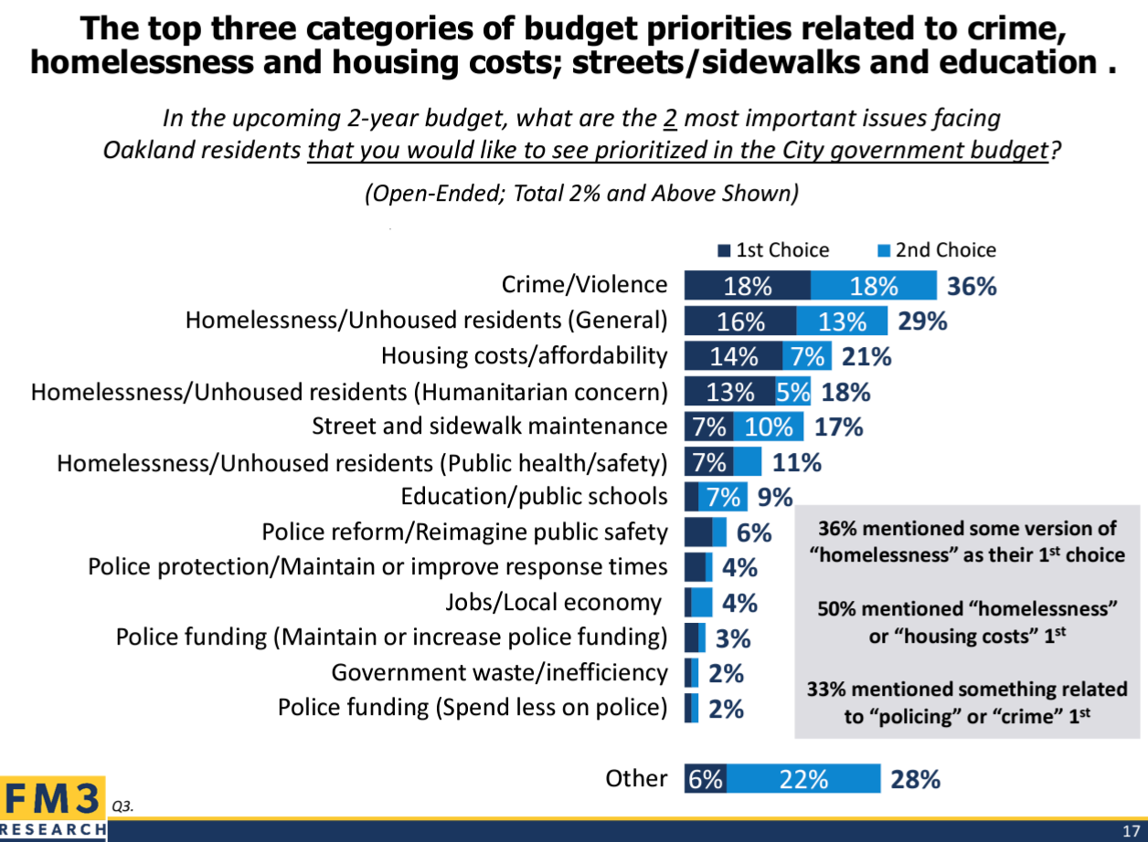
Community Survey
Entry Points of Crime & Violence:
Fireproofing & Putting Out Fires
Research shows that effective crime and violence prevention must be addressed comprehensively at each point of entry. Building community trust in the policing system is essential to this mission. With an investment in police, there must be commensurate support for the oversight and reform of policing in the City of Oakland. As a legislative body, we seek to advance policies that result in the most effective impact on police reform and reimagining public safety in Oakland.

Slide 9
Police Commission Budget Proposals
  Retain current budgeted positions:
    Chief of Staff: Commission liaison to City of Oakland relationships, oversees Commission Staff and support for ad hoc committees, manages Commission operations, meetings and strategic initiatives
    Administrative Analyst II: Performs duties related to calendar management, departmental recruiting, agenda distribution, budgets and contracts, and general administrative support as assigned
  Proposed addition of FTE positions:
  Senior Policy Analyst: Proactive policy research, design, implementation, analysis
  Program Analyst II: Interagency liaison between OPD, OPC, CPRA, and OIG to oversee monitoring and compliance post-NSA, including data analysis
  Public Information Officer I: Media relations, communications and social media strategy, community engagement and events
Third-party search firm funding to lead Chief of Police search
Notes:
internal

Slide 10
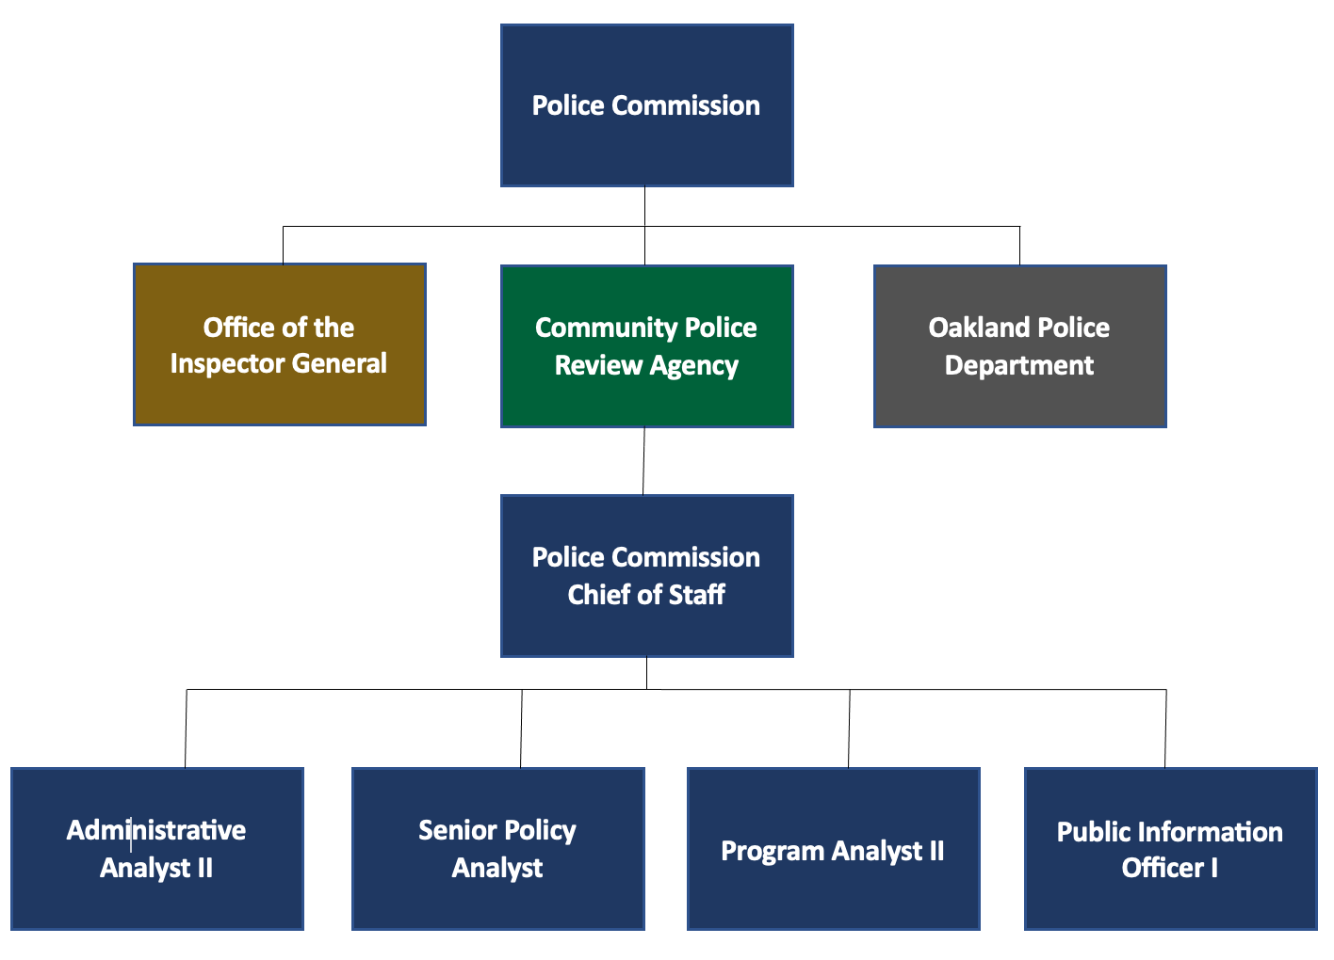
Police Commission Org Chart

Slide 11
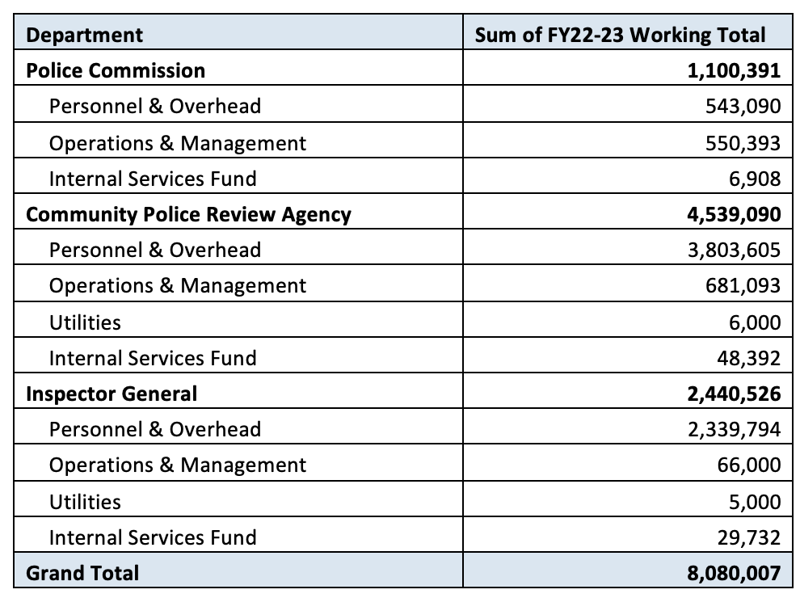
Addendum: FY22-23 Budget Working Totals
*Internal Services Fund is a mandatory fee calculated based on staff size

Slide 12
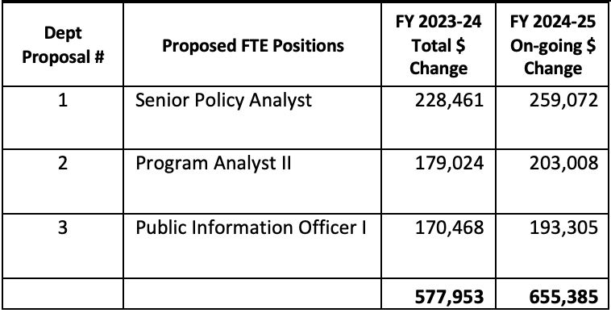
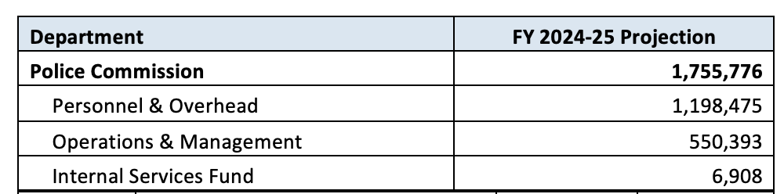
Addendum: Biennial 2023-25 Budget Proposals
Note: Proposed FTE positions are calculated at the highest end of the salary range with “full burden” (i.e. benefits etc.) and have been projected for FY24-25 to account for cost of a full year. FY 23-24 total change is lower based on anticipated hire date of 8/1/23. An estimate for the Chief search is not included.

Slide 13
End Notes
Oakland Equity Indicator Report: https://cao-94612.s3.amazonaws.com/documents/2018-Equity-Indicators-Full-Report.pdf#:~:text=The%20purpose%20of%20Oakland's%20Equity,for%20different%20groups%20over%20time
FY 2021-23 Service Impact Statements: https://stories.opengov.com/oaklandca/published/3fGcp45Oz
2022-23 Budget Priority Survey: https://oaklandside.org/wp-content/uploads/2023/02/View-Attachment-B.pdf
ICMA Conditions for Building Trust between Police and the Community: https://icma.org/articles/article/21-conditions-building-trust-between-police-and-community
NACOLE Community Oversight Paves the Road to Police Accountability: https://www.nacole.org/community_oversight_paves_the_road_to_police_accountability
OakDot Geographic Equity Toolbox: https://www.oaklandca.gov/resources/oakdot-geographic-equity-toolbox

