Slide 1
Hillside Project Lt. William Febel
CONFIDENTIAL TO MEMBERS OF THE OAKLAND POLICE DEPARTMENT and not for dissemination.

Slide 2
Project #35X-14-004
Opened – 01 Feb 2014 at 8603/8701 Hillside St.
Nature of the Problem:
The property was controlled by the Case Boys gang. Additionally, robbery, burglary, narcotics dealing and numerous other activities appeared to be based from the property.
Problem ID
Crime analysis: The property was consistently ranked among the top calls for service.
Stakeholders:
Local residents, Children attending Castlemont H.S., The Oakland Police Department, and the City of Oakland.
Sources of Problem:
Lack of ownership responsibility.
Highly defensible geographic location for crime.
Several failed previous attempts to rehabilitate the property.

Slide 3
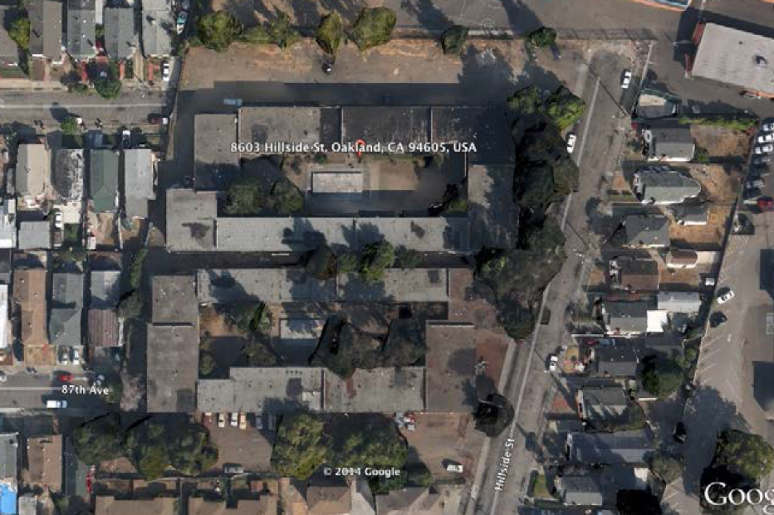
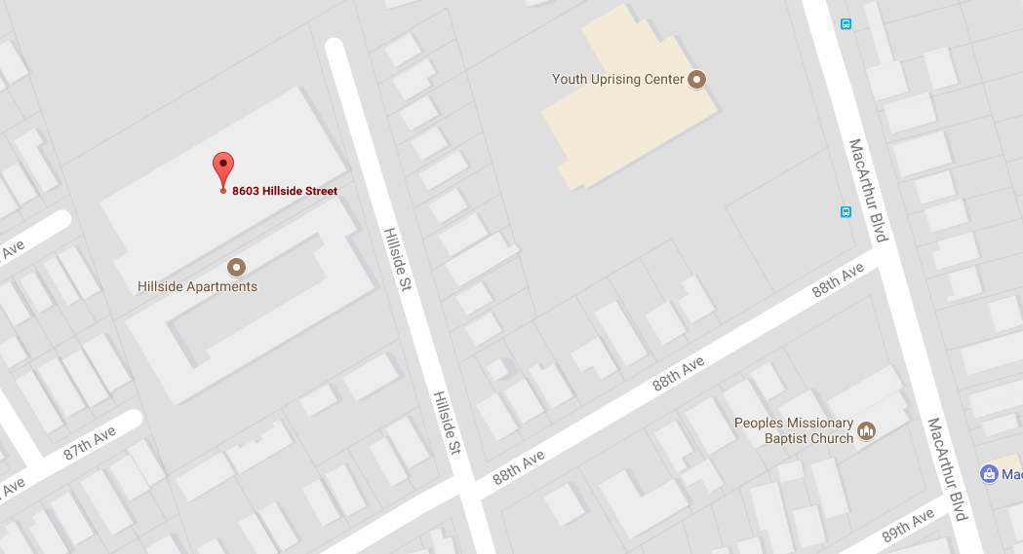
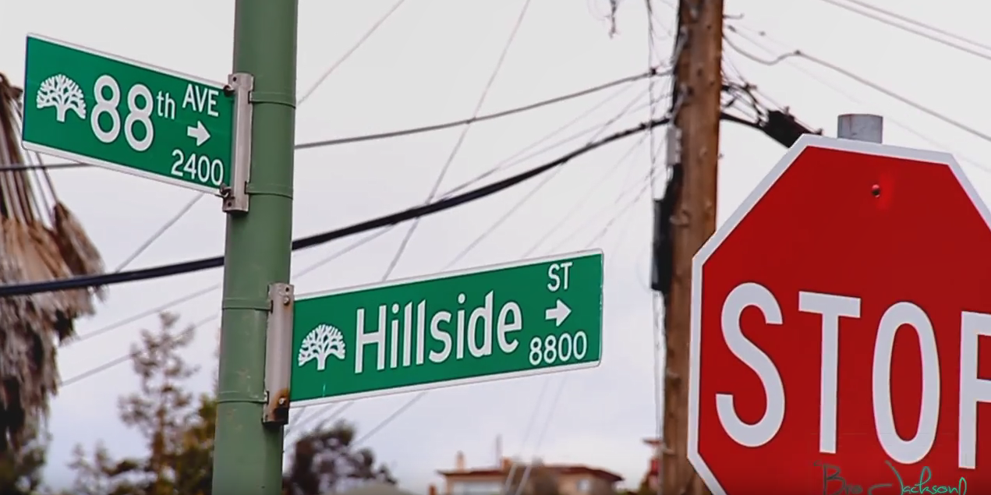
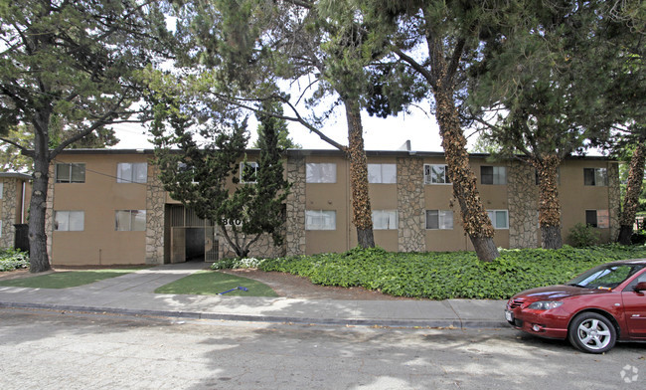
Macro Analysis
Geographically advantageous for criminal activity:
The property is located on a dead end that stretches two blocks
There is only one point of ingress and egress
Criminal elements had access to the rooftop proving a 360 degree overview
Any attempts at enforcement would have to use 88th Ave increasing the risk to officers from counter surveillance
The property was a former military housing project. As such there is no direct view onto the property. This provides suspects cover and concealment from law enforcement and rivals.
The property was built with several hallways connecting the buildings and parking lots. This easily allowed suspects to flee within the structure then into friendly units.
Excessive foliage provided concealment of view from W/B 8800 Hillside.
Abandoned automobiles lined the roadway and were used as contraband stash spots.

Slide 4
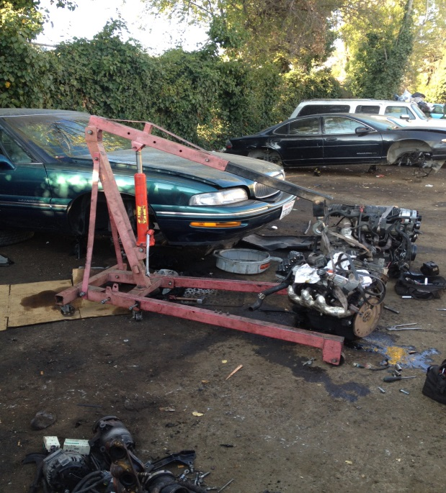
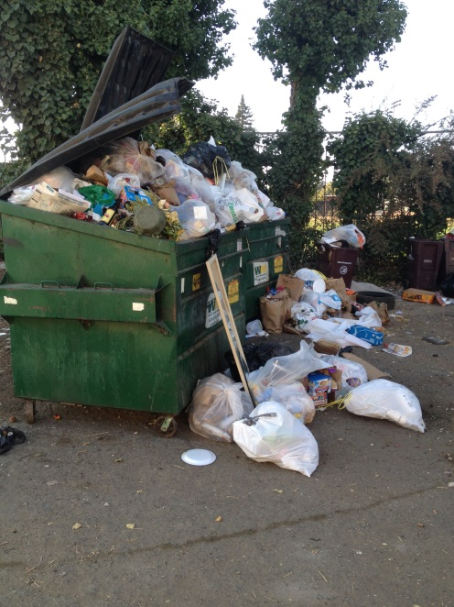
Micro Analysis
The property was being used as a staging point for numerous crimes…
Robbery
Burglary
Narcotic Sales
Extortion
Vehicle Theft
Chop Shop
Illegal Dumping
Illegal disposal of chemicals in local waterways
Aiding and abetting known felon(s)
And even unlicensed vending from a residence

Slide 5
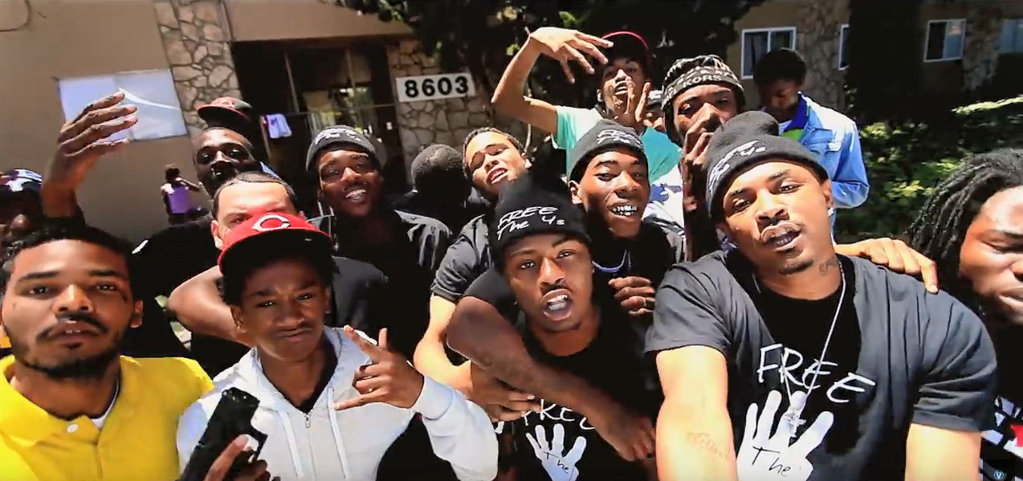
Micro Analysis Continued
Case Gang
The property was confirmed a Case Gang stronghold.
Case Gang is a known violent street gang attributed to numerous shootings, robberies, and murders throughout Oakland.
The gang does not have a true leader, but maintained highly influential members including “Frank Knitty”, DNI-Mike, and QB. Frank Knitty openly touted 8603 Hillside as his turf.
The gangs predominant source of income comes from robberies, burglaries, and pimping. Some of the members sell narcotics, but it is not a primary focus.
Case gang is commonly recognized throwing the “4” fingers in the air representing “400.” Their rival, ENT, throws up a “3”
www.youtube.com/watch?v=O-ckZI4xOBM

Slide 6
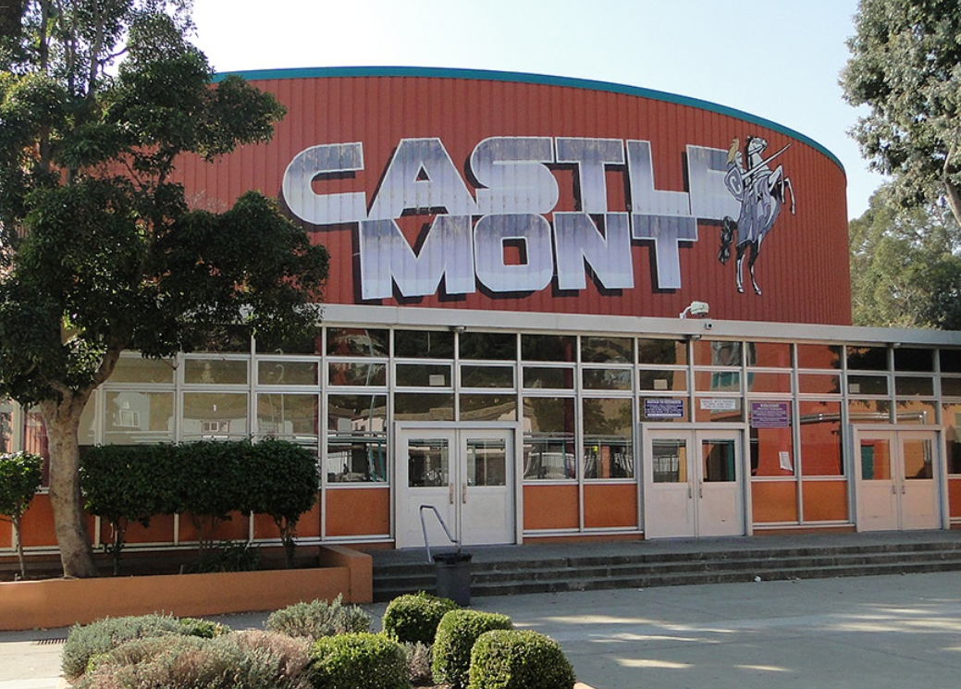
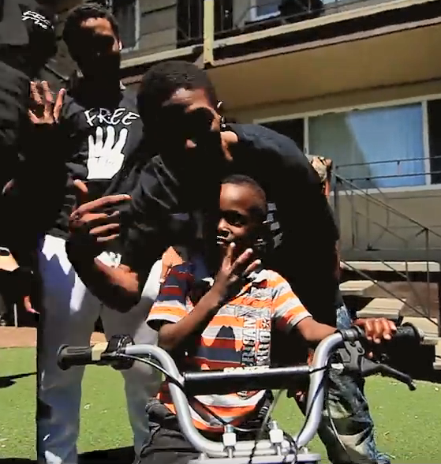
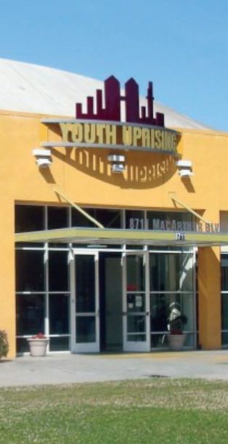
At Risk…
Case Gang is active to social media creating and disseminating videos throughout the internet.
It is known to law enforcement that these videos are used to accomplish numerous objectives including:
The taunting of rival gangs.
The intimidation of local stakeholders.
The recruitment of new members.
The above is particularly concerning given the vulnerability of east Oakland youth and the proximity of 8603 Hillside to two of east Oakland’s popular youth institutions.
Related links: KING JAMES "Charley" DNI MIKE - MY WAY DNI Mike – Prank gone wrong shooting

Slide 7
Opportunity Cost
There were over 1465 calls for service between 2012 & 2016:
8603 Hillside was associated with over 560 calls for service.
8701 Hillside was associated with over 700 calls for service.
88th and Hillside (Address used often by officers when making contacts in the area) was associated with over 140 calls for service.
Putting this into perspective… this was nearly the same number of calls for service as the Oakland Coliseum!
The property represented a tremendous drain on Oakland Police resources.

Slide 8
Project#35X-14-004 (Goals and Response)
8603/8701 Hillside St
Goal
25% reduction of calls for service
Response Activities
Increase enforcement (CRT/CF/Probation/Parole)
Case gang intelligence gathering
Auto abatement (ACRAT)
Conduct a CPTED inspection
Get city attorney involved
Get code enforcement involved
8

Slide 9
Response Strategy
Having gained a historical knowledge of the property, I developed the following response strategy:
Contact community members and residents to further develop our community partnership in addressing crime associated with the property.
Contact the owners and property management team to discuss our concerns regarding the quality of life and criminal activity on the property.
Conduct an updated Crime Prevention Through Environmental Design (CPTED) inspection to assist the owners in create a long term solution to deterring future criminal activities.
Contact the Oakland City Attorney’s office and advise them of the current and ongoing conditions on the property.
Implement a modern strategy of enforcement in an attempt to bypass the defenses of the property and make arrests of suspects involved in criminal activity (Intelligence Based Policing).
Collaborate with local enforcement agencies (FBI, ATF, Oakland Housing Authority, ABAT, Probation, and Parole) to gather additional resources to address criminal activities taking place on the property.

Slide 10
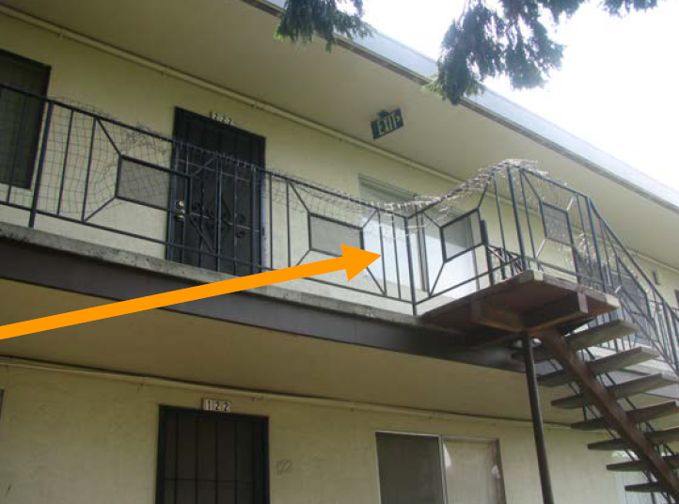
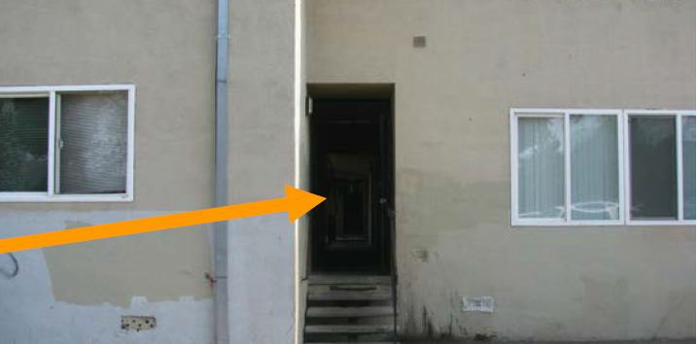
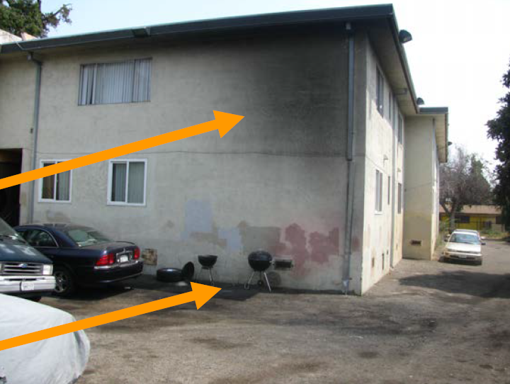
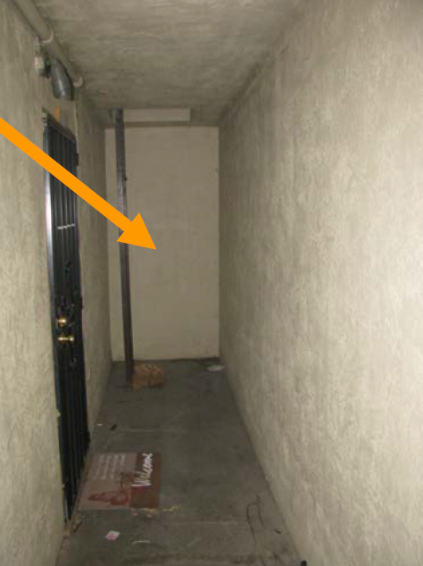
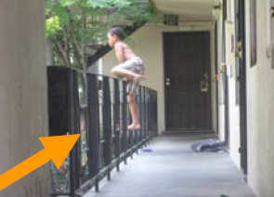
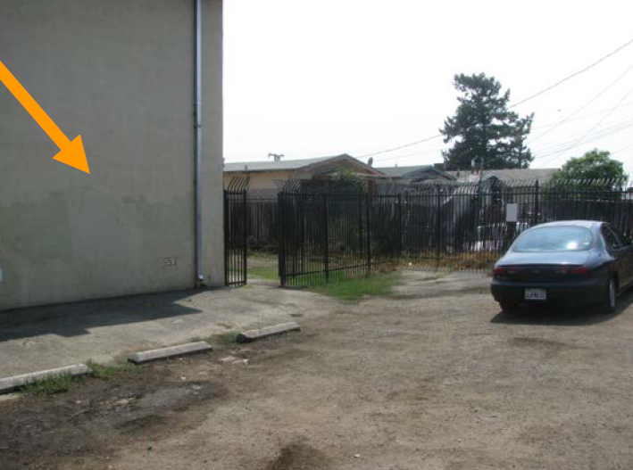
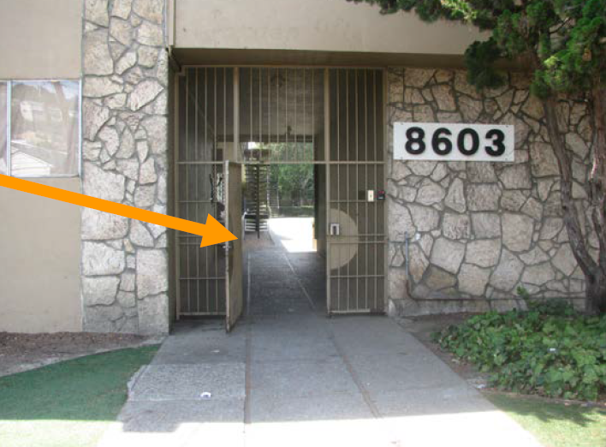
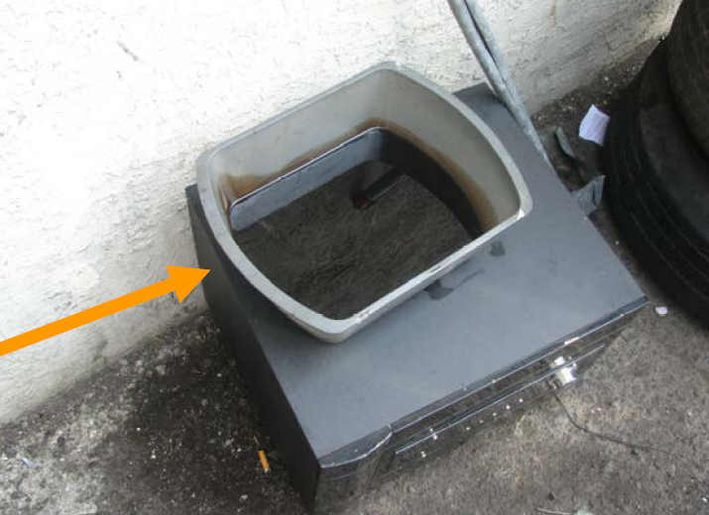
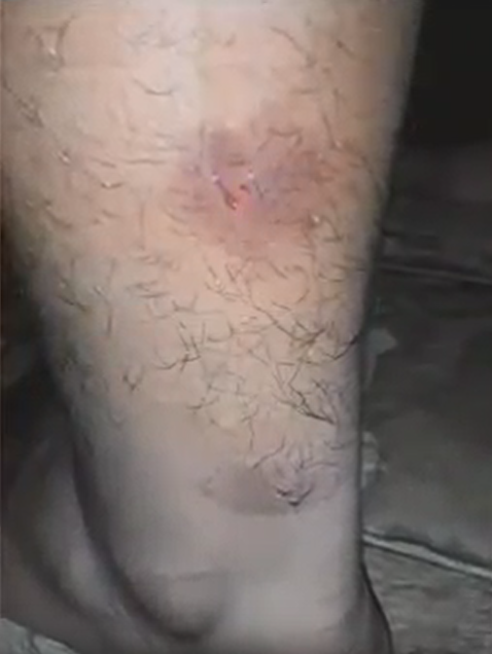
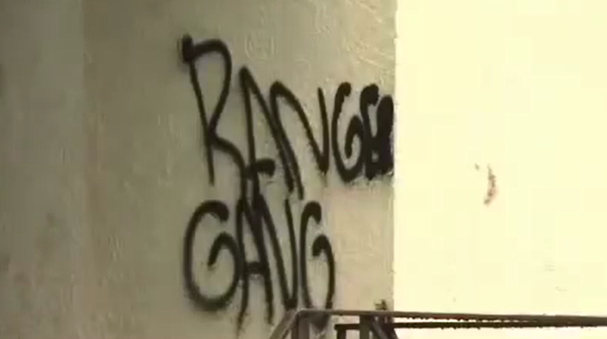
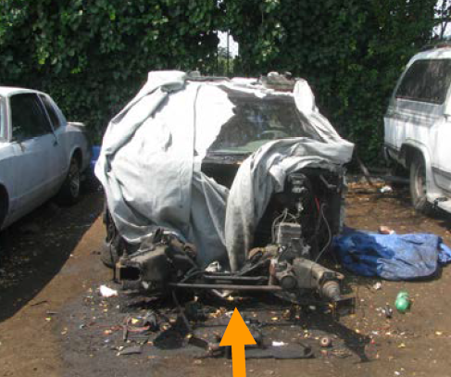
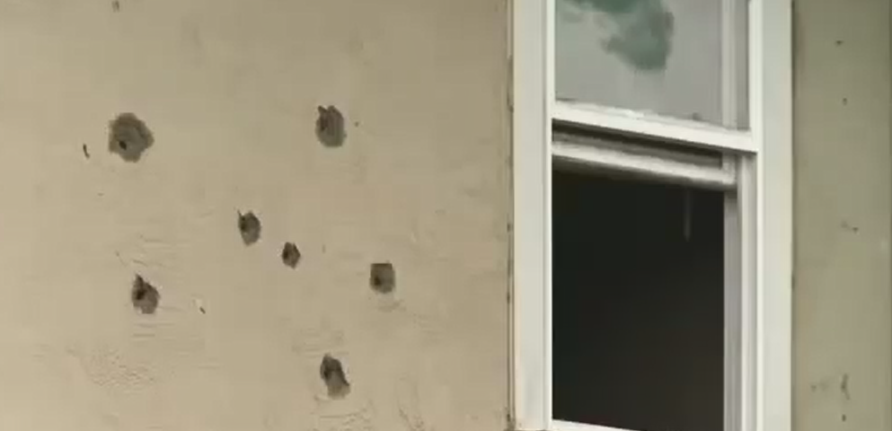
A Crime Prevention Through Environmental Design evaluation was conducted
The first inspection occurred in March of 2014 and the following were some, not all, of the deficiencies observed:
No security personnel.
Non-operational security entrances and gates.
Few security cameras (Possibly not operating) not placed in strategic locations.
Inadequate security lighting.
Graffiti (Gang indicia).
Roof top access to the property allowing suspects to see approaching authorities from several blocks away.
There was exposed wiring throughout the property.
Bullet holes throughout the property.
There were broken stair railings with exposed wire that created a hazard for children.
The property was littered with animal feces and trash in the common areas.
We discovered a dead animals on-site.
There was evidence of two fires that had occurred near the property roof line and no fire extinguishers.
There was evidence of marijuana grow equipment in the parking lot at 8701 Hillside St.
During our inspection numerous residents expressed concerns over an unabated insect infestation.
I quickly realized this project was not simply a criminal issue; it was a humanitarian issue.

Slide 11
Challenges
From Mar 2014 to Apr 2015, SRS5 units responded to the property and monitored the above conditions and noted the following issues (Among others) still existed:
The owner refused to update the surveillance cameras.
The physical barriers to the property were breached and the owner always had an excuse why they weren’t repaired.
Numerous abandoned autos still existed (Possible Chop Shop on site)
We were locating numerous stolen vehicles on the property. Officer Cooper followed one such vehicle into the parking lot of 8603 Hillside where the suspects fled into an unknown property leaving behind a loaded firearm in the stolen vehicle.
There was open air narcotic trafficking IFO the property. Several arrests were made, but the problem persisted.
Numerous robberies were occurring in the immediate area. The suspects were observed fleeing into the property. The victims of the robberies included local tenants and juveniles attending Castlemont H.S.
Several known Case gang members still loitered on, or about, the property.
Enforcement efforts were significantly encumbered by hostile tenants.
The owner refused to document and follow through on evictions of tenants in violation of the rental agreement.
During this time the previous management team was replaced because it was discovered the current team wasn’t permitted to operate in California and residents alleged the firm had embezzled rent money. The new management team was willing to communicate with OPD, however they refused any direct involvement in enforcement efforts out of fear of retaliation.

Slide 12
It was time for a Re-Assessment…
Despite the proactive outreach to the property owner, coupled with enforcement operations and security checks, I was unable to successfully alleviate the property of criminal activity. The property was actually showing increased signs of degradation.
Based on the lack of cooperation from the property owner, a re-assessment was conducted. It was determined at that time that the most likely outcome of success would be yielded from large scale Intelligence Based Policing enforcement utilizing partnerships with community leaders, Cease Fire, The City Attorney’s Office, and several law enforcement entities.
Upon conclusion of the re-assessment we elected to conduct a large scale operation at 8603/8701 Hillside St. Using OPD’s Cease Fire team, FBI, Probation, Parole, and GITF members, we gathered intelligence for our operations.
On 30 Jul 2014, with the assistance of several of the above agencies, I served a search warrant, and simultaneously conducted probation/parole compliance checks at both 8603/8701 Hillside St. During our operation suspected cocaine, suspected heroin, and evidence of narcotic trafficking activities were discovered and arrests were made. During the operation, a wanted home invasion suspect related to the Case gang was also discovered to be hiding out on the property at 8701 Hillside St.
At this time, in addition to numerous other violations, the property was in violation of 11570 HS (Nuisance drug property).
Based on the above, I worked diligently with City Attorney’s Lance Kennix and Scott Hugo to address the quality of life issues affecting the residents at the property.

Slide 13
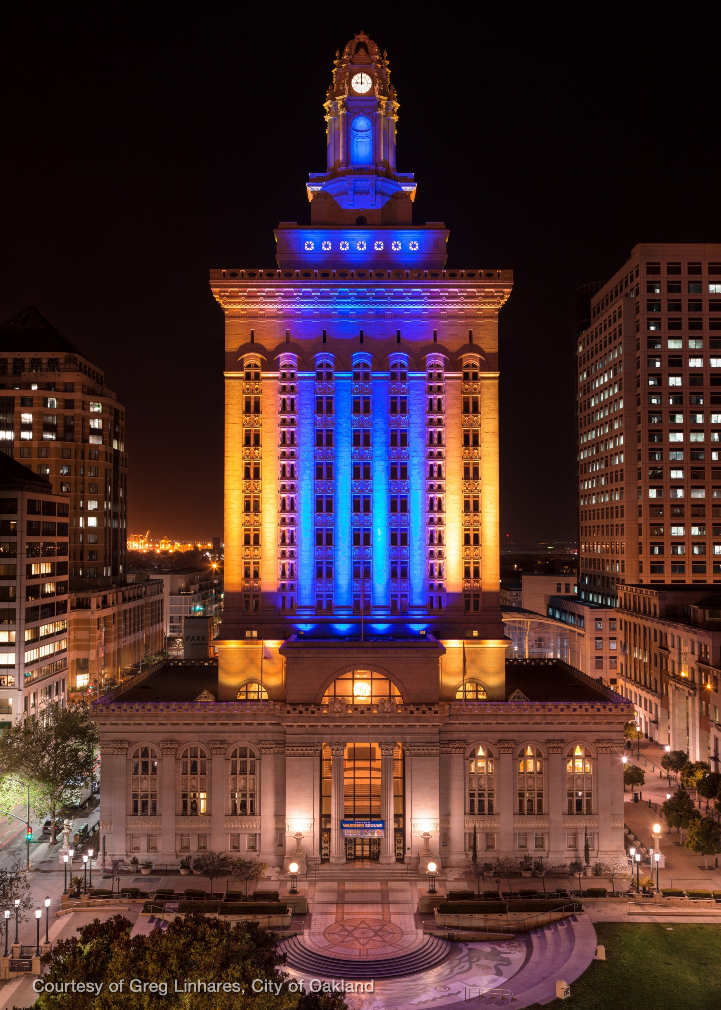
Working with the City Attorney
Over the next several months, we worked diligently with the City Attorney’s office regarding the dealing of narcotics, constant presence of gang members on or about the property, and the numerous habitability issues discovered with the property.
At that time the City Attorney’s Office felt our best leverage against the property owner was deplorable living conditions on the property. Based on the City Attorney’s advise we partnered with the following entities:
Alameda County Health Department
Alameda County Vector Control
City of Oakland Neighborhood Services Division
Oakland Fire Department
In February of 2015 City Attorney’s Lance Kennix and Scott Hugo successfully litigated a habitability lawsuit against the owners and the property management team ParaWest.
In addition to remedying all of the habitability issues, the property owner agreed to the following terms:
32 Cameras installed with remote access
One armed security guard from 6PM-6AM with response team available "As Needed“
Two separate armed guards available for back up within 10 minutes
Close up all entry holes in exterior fences
Make sure all perimeter doors are closing and locking
No auto repair allowed on the property
No cars parked in the back of the building
Coordinate with the Oakland Police Department regarding illegal activities and violent crime
Build a neighborhood watch program
Review and adjust staffing as needed based on effectiveness
A court appointed receiver would monitor the property for a minimum of three years.

Slide 14
Despite All Our Effort… Progress Was Slow
A security system, of poor quality, was installed.
An on-site security team, headed by Felix Montemeyer, was hired.
The interior of the residences were actively being rehabilitated.
The new manager Mystica was willing to communicate with OPD, but appeared indifferent to the gang presence on the property.
Despite the above changes, criminal activity was rampant on the property…
On 22 Apr 2014, I responded to a shooting at 8701 Hillside St. While on scene, I observed seven .45 caliber casings and a vehicle in the parking lot that was struck by gun fire.
Through the month of August I, along with patrol units, continued monitoring the property for criminal activity. During my security checks I still observed numerous case gang members loitering on or about the property.
The property continuously harbored stolen vehicles and the environmental contamination appeared to only be getting worse.
On 4 Aug 2014, a BMW sedan was intentionally burned in the parking lot at 8603 Hillside St. We knew based on our training and experience that criminals will sometimes burn vehicles to destroy evidence of their criminal activity. It appeared despite our efforts, the property was still being used as a base for crime.
On 25 Aug 2014, I responded to 8701 Hillside to conduct a security check of the rear parking lot. I frequently conducted security checks in that part of the property because I knew that suspects often hid stolen cars there among other criminal activity. During my security check I contacted a driver of a suspected stolen vehicle. The driver attempted to escape capture by fighting me and my partner. After taking the suspect into custody a loaded firearm was recovered from his person. A file check of the suspect revealed he had a history of narcotic trafficking activity.
On 4 Sep 2014, I conducted a security check of the parking lot at 8603 Hillside St when we observed several suspects flee from a vehicle in the parking lot. Further investigation of the parking lot revealed a late model Chevrolet Camaro that was being stripped of its parts. The Camaro belonged to a victim on beat 35 further confirming my suspicion that a significant portion of crime in the area may be related to 8603/8701 Hillside.

Slide 15
On 20 SEP 2014, Alex BREGGS was murdered IFO 8701 Hillside St.
25 Mar 2015 a shooting occurred on the property. Two resident female residents verbally accosted responding officers and enraged a crowd nearly started a riot. The property owner refused to take action against the tenant.
On April 15 2015, the latest property manager, Shantell GARNER, was shot IFO the property by her boyfriend, and property employee, Juan RODRIGUEZ. It was later discovered RODRIGUEZ was on parole and GARNER was providing him with a concealment apartment off the books. During our investigation another property employee, Donte EASLEY, was arrested on charges of aiding and abetting a felon because he helped RODRIGUEZ escape capture from OPD.
15 MAY 2015, Kevin McGHEE was murdered IFO 8701 Hillside St.
9 SEP 2015, Avery ENOCH and Robert FIELDS are murdered at 88th and Hillside.
16 DEC 2016, Dwan TAYLOR is murdered in the 8700 block of Hillside.
All five murders were tied to the property

Slide 16
Tough decisions had to be made…
In the latter part of 2015 it simply did not appear the property was going to progress into a safe entity long term. An additional CPTED evaluation was conducted and we developed several potential solutions for the property:
Demolish the entire property and repurpose the land.
Demolish 8603 Hillside creating a thoroughfare through 87th Ave. This would reduce the property size in half.
Reset the property and repurpose it.
The Oakland Police Department’s position preferred solutions 1 and 2. These were guaranteed to bring positive resolution to the property after nearly 30 years. While demolition was strongly considered, the City began experiencing a critical housing shortage and strongly discouraged options 1 and 2.
Based on the above the property was positioned for sale.
There were numerous potential buyers, however they had to meet strict criteria and conform to the settlement we agreed upon.
Nearly every potential buyer wanted to purchase the property outright and get the Oakland Police Department to agree to abolish the settlement agreement. Having knowledge of the property’s history, the Oakland Police Department strongly opposed any weakening of the settlement.

Slide 17
Intelligence Based Policing turns the tide…
In October of 2015 the Oakland Police Department’s Cease Fire Division embarked upon a surgical solution that would prove highly effective at breaking up the Case Boy’s at 8603 Hillside.
The investigation lasted several months and about 35 arrests were made on suspected Case Boy gang members and their associates. Several of those gang members were tied to 8603 Hillside.
Working with the latest legal property management and security team, the associated stash houses were slowly evicted one at a time. The vacated units were not re-rented out.

Slide 18
In 2015 The Future Was Looking Brighter
In 2015, a qualified potential buyer with strong community ties, expressed his vision for the property.
The potential buyer, the City, and the Oakland Police Department discussed a new vision for the property:
The property would be physically rehabilitated to Oakland PD’s CPTED analysis standards including:
All gates would be repaired and a digital key card system would be implemented.
Despite the cost, both parking lots would be repaved with strict assigned parking.
Hazardous parts of the property would be reconditioned (Fencing, holes in the ground, broken windows, etc)
A top of the line surveillance system would be installed with vehicle license plate reading ability.
The property would be also be repurposed to assist Oakland’s housing crisis:
New tenants must have proof of continuous employment.
The new tenants would qualify for median income exceptions (60 and 80 percent of Oakland median income)
Special housing considerations would be made for military veterans.
Over the following 16 months, CRO5 Officer J. Belligan worked with the security team, management team, the new potential buyer, and Oakland Police crime reduction teams on the continued enforcement of the property.
Utilizing this model we achieved the following results…

Slide 19
# The Numbers #
In review of the data taken from Speedtrack, the data reflects the following outcomes:
It should be noted, the data compared the years January 1 2012 to January 1 2016. These year’s most accurately reflect the calls for service on the property up until OPD’s successful intervention and ultimately the transition of the property in early 2017. The 2017 data most accurately reflects the long-term results of the project.
Calls for service is a double edged sword in determination of crime reduction statistics. Prior to OPD’s successful intervention on the property, the property was the number one residential property for calls for service. Reviewing 2017’s data of 297 calls for service over a ten month period actually suggests that there was only a marginal reduction in calls for service leading one to believe the project may not have been as successful as anticipated. However, it is in fact the opposite, based on the figures as I’ll later explain:
It is general knowledge in Law Enforcement that communities who suffer from violence, and the threat of violence, often under report criminal activity out of fear of retribution. I believe the presence of a violent gang on the property likely held this theory to fact. So, we can make an educated inference that the properties crime level prior to OPD’s intervention was actually higher than what SpeedTrack reflected. Knowing this, and implementing modern principals of CPTED, one of the mandatory tasks the property owner was to institute (OPD driven) was the formation of a neighborhood watch (Or system similar) on the property. While neighborhood watches provide many known benefits, they also have a tendency to increase calls for service. And this is a good thing. This means the cycle of fear is being broken and citizens are reporting crime in an effort to improve their community.
Knowing this, it came as no surprise that calls for service remained relatively unchanged by percentage during this project.

Slide 20
# The Numbers #
The real evidence of statistical success of the project should be garnered from the reduction of violent crime and calls for service that affect the quality of life of the residents on the property. I used the below data to represent this:
2012-2016 2017 - Jan 1 to Oct 17th 2017
Results:
1465 calls for service 297 calls for service
415’s: 81 34 (This is actually good: Citizens are now calling in!)
Battery: 161 15 (13 DV Related. DV remains a challenge)
Burglaries: 19 6 (Auto burglaries are up Bay Area wide)
10-8’s: 41/19REC 1/0 (Over 80% reduction in stolen/recovered vehicles)
Gun Shots: 38 3 (About a 60% reduction).
Shooting: 17 0 (On the property, another BIG victory)
Aggravated assault: 32 1 (Drastic reduction in Aggravated assault: Over 70%)
Robbery: 8 0 (Robberies have been eliminated: 100% reduction)
Upon review of the data, the success of the project became easily recognizable. There were dramatic reductions in vehicle thefts and recoveries from the property. There were no known robberies and reports of gun shots reduced over sixty percent. Aggravated assaults, which often strike fear into community members, were reduced about seventy percent and there were no known shootings on the property. The data also revealed increased calls for disturbance related activity. This affirms that citizens are not afraid and are calling in potential criminal activity which is a good thing. While domestic battery and burglaries remain a challenge, the property’s overall violent criminal activity has drastically declined and I would suspect it will continue to decline as the property gains larger occupancy.

Slide 21
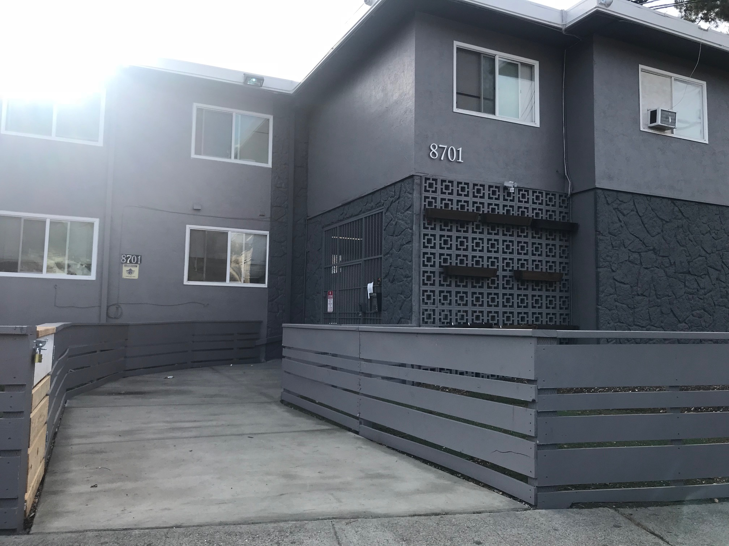
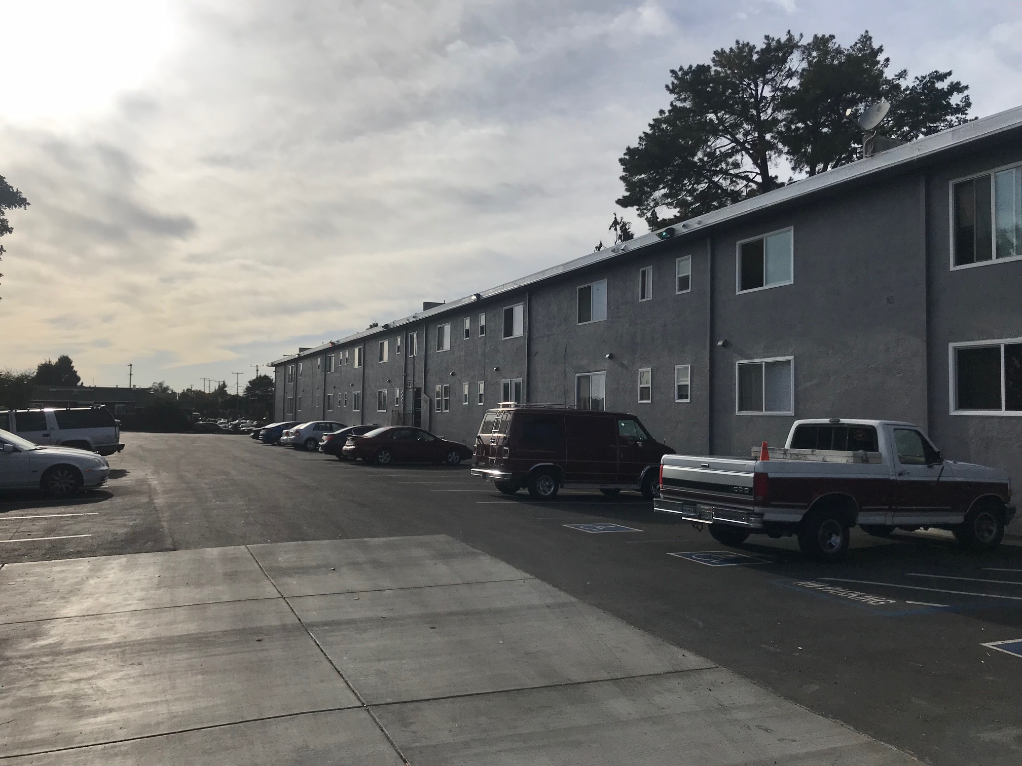
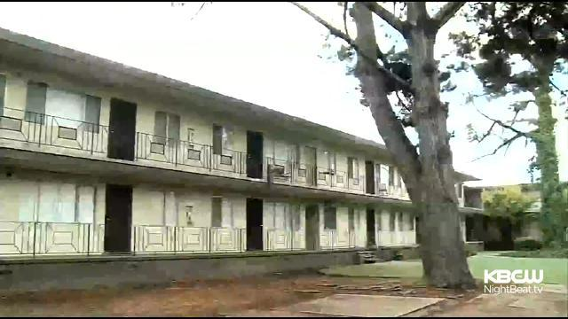
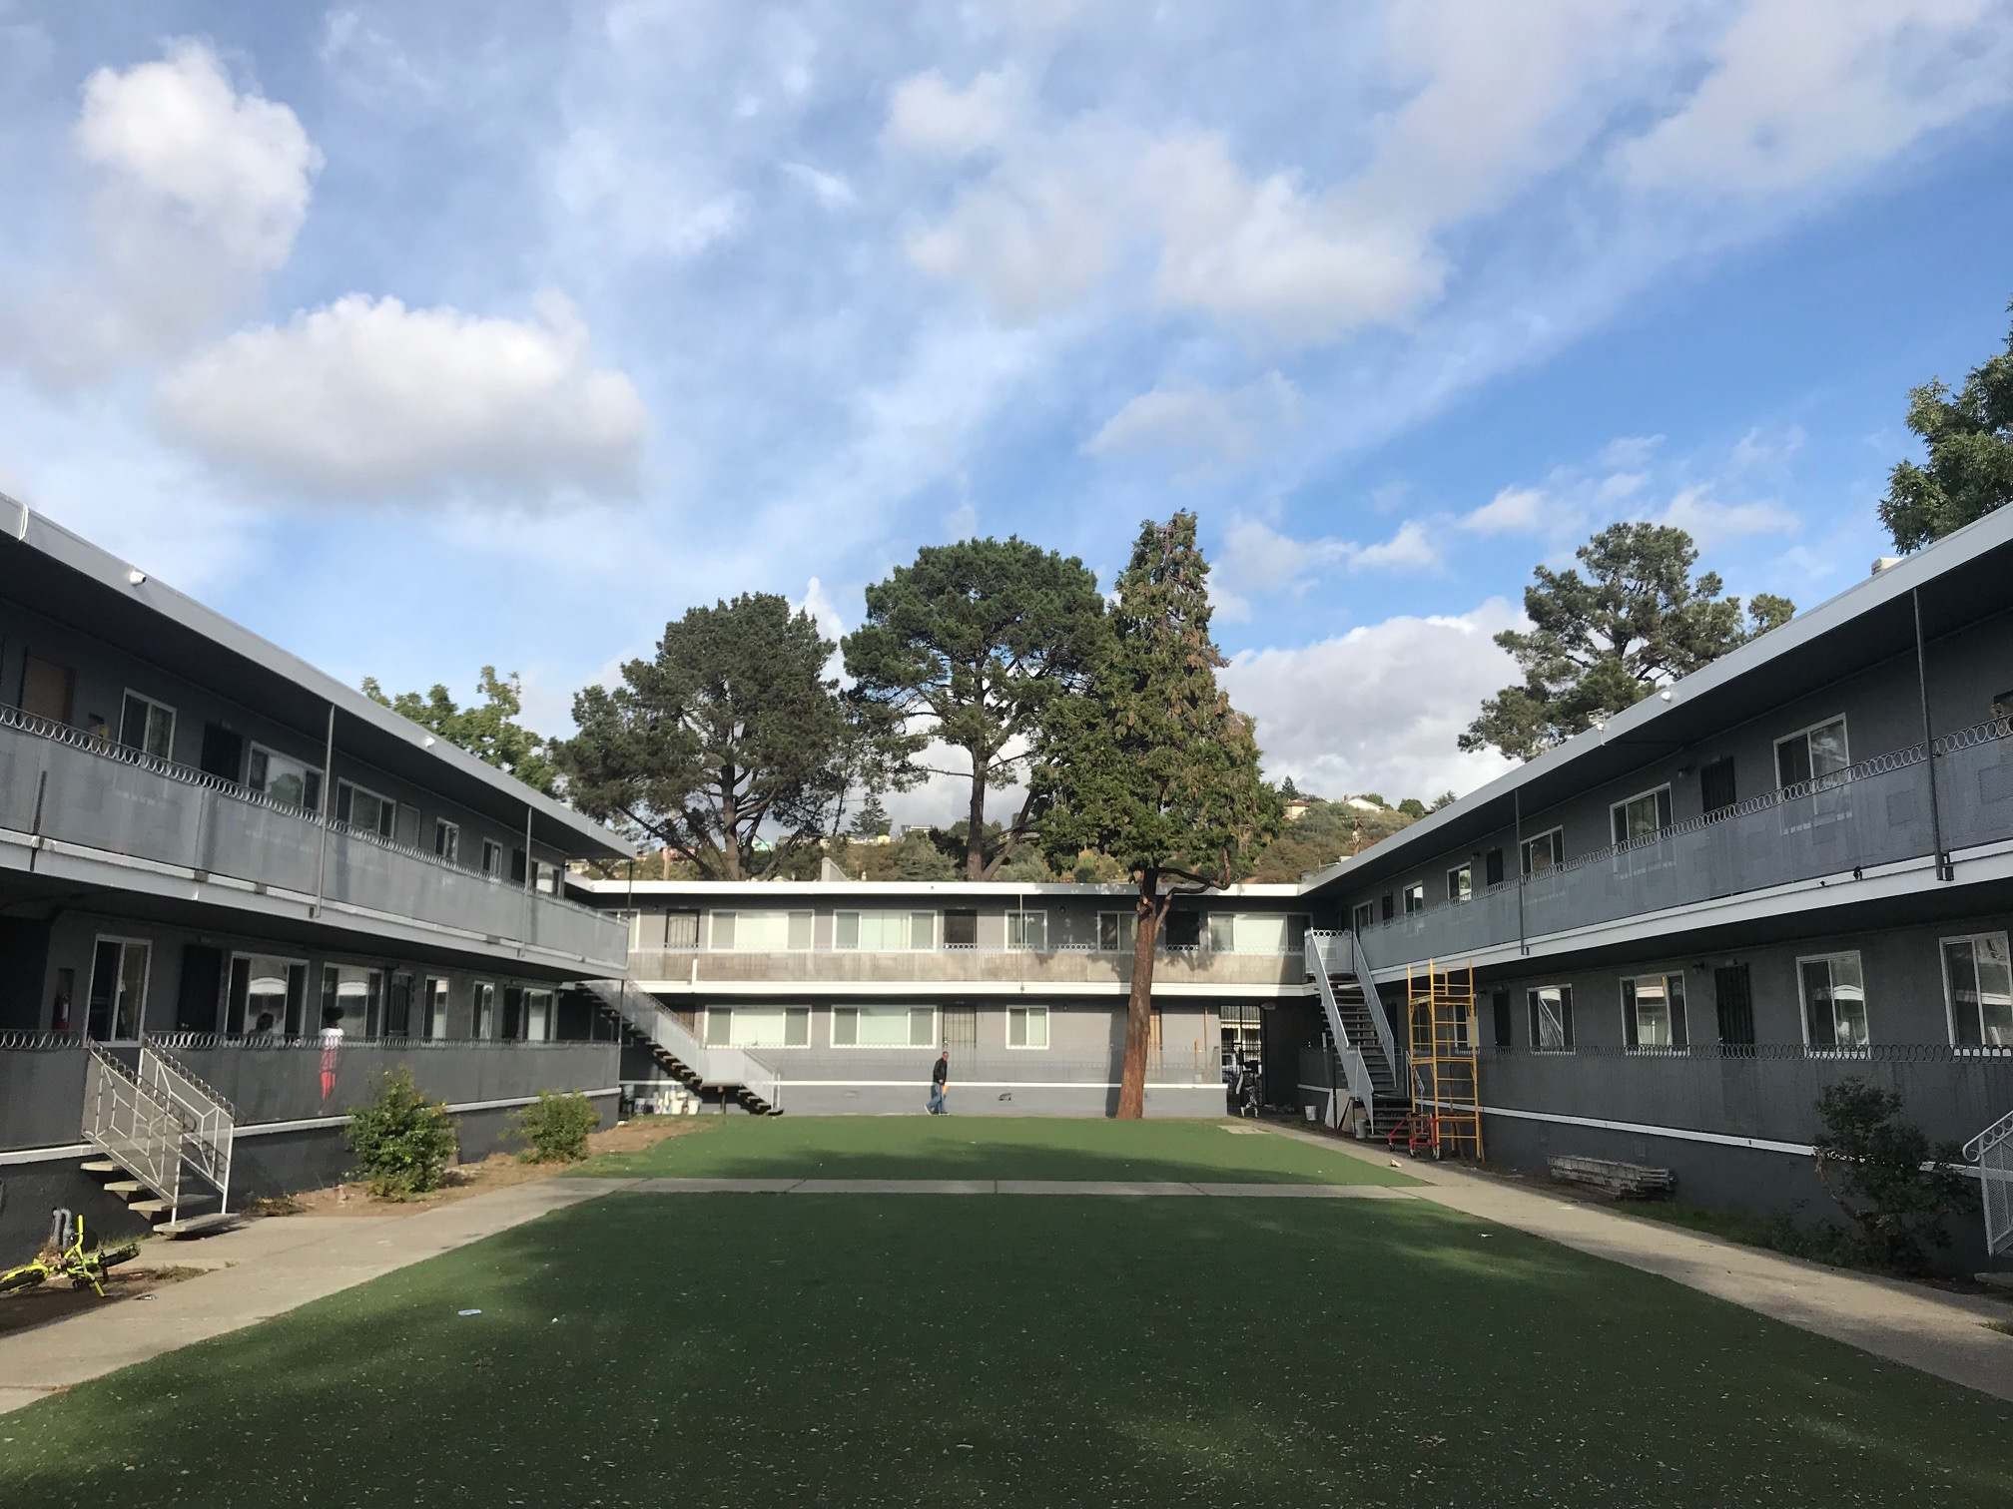
Then…
NOW…

Slide 22
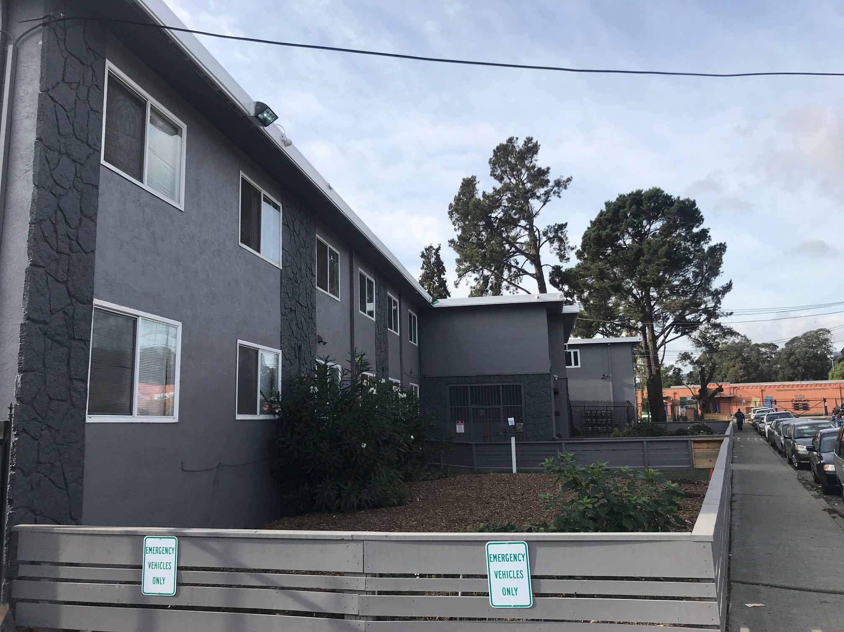
So what really did we accomplish?
Reduced crime and the fear of crime.
Safer schools.
More affordable housing dedicated to military veterans and those with a vested interest in progression.
Gave residents their dignity back.
New and improved partnerships.
Kept our promise…
The confidence to do it all over again!

