Slide 1
Howard Terminal Community Benefits Agreement
A Collaborative Process
Getting there … together

Slide 2
A Collaborative Process
Agenda:
Community Benefits Agreement
What is it?
How do we create it?
Who is involved?
Getting there … together

Slide 3

A legal tool to ensure the common promises of benefits from development projects materialize for those who need them most.
Community Benefits Agreements

Slide 4
Howard Terminal Process Equity Framework
CBA Research
Race and Equity Baseline Indicators Report
Stakeholder Outreach Meetings
Analyzed the evolution of CBAs
Analyzed existing conditions by race for indicators that CBAs can influence
Meetings with different stakeholders to hear diverse perspectives

Slide 5
Howard Terminal Community Benefits Agreement Framework
Equity-centered
Close Disparities
Guiding principles include:
Transparency
Inclusivity
Collaborative
Solution-seeking
Topics of interest could be:
Housing
Environment
Jobs / Employment
Recreation / Health
???

Slide 6
EQUITY FRAMEWORK

Slide 7
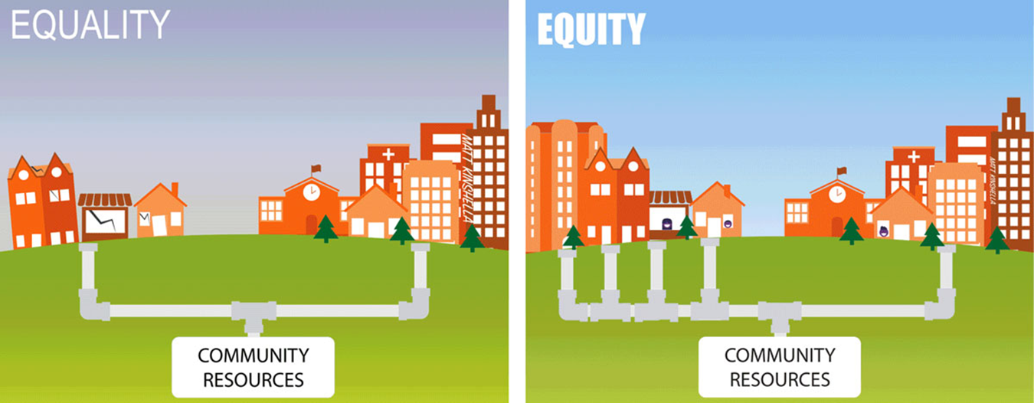
EQUITY FRAMEWORK
Identifying the disparities, root causes and addressing them through remedy

Slide 8
Collaborative Decision Making
Clear Purpose: Development of the Howard Terminal CBA
Transparent
Interest Based
Empowering
  Diversity of stakeholders
  Diversity of thought
Open Dialogue
Joint Fact Finding / Problem Solving
Policy and Technical Expertise

Slide 9
Creating the Howard Terminal CBA
Educate and Inform
Organizational Agreements
Resources and Information Gathering
Resolution
Development

Slide 10
Steps for Creating the Howard Terminal CBA
Activating a Topic Cohort Structure
Form a Steering Committee
Recommend a CBA

Slide 11
Topic Cohort Participation
Select topics
Self Select participation
Facilitated discussions and fact finding to make recommendations to Steering Committee
Attend 1 - 3 meetings per month

Slide 12
Howard Terminal CBA Steering Committee Process
City of Oakland
Community: Impacted
Areas
Steering Committee
Port of Oakland
Community:Topic Cohorts
Oakland A’s

Slide 13
Howard Terminal CBA Steering Committee Structure
Steering Committee
Topic Cohort
Topic Cohort
Topic Cohort
Topic Cohort

Slide 14
Howard Terminal CBA Steering Committee Structure Example
Steering Committee

Slide 15
Howard Terminal CBA Process Planning Group
City of Oakland
Community: Impacted Areas and Topic Cohorts
Planning Group
Port of Oakland
Oakland A’s

Slide 16
Steering Committee / Topic Cohorts
Outreach to stakeholders who may be interested and qualified
Inclusive of diverse voices
Representative of Community Groups, Organizational Partners
Considerations: geography, interests and community involvement

Slide 17
What’s next - the process
Mandatory January 11, 2020 Orientation
11:30 a.m. – 2:30 p.m, Location to be Determined
  Equity Framework Orientation
  Review of Topic Areas
  Process Overview

