Slide 1


West Oakland
Truck Management Plan
(TMP)
Regulatory Updates to Truck Parking & Network of Truck Routes and Truck Prohibited Streets in West Oakland
March 11, 2022

Slide 2
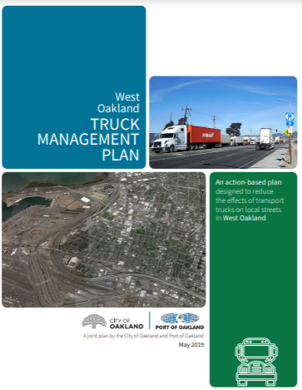
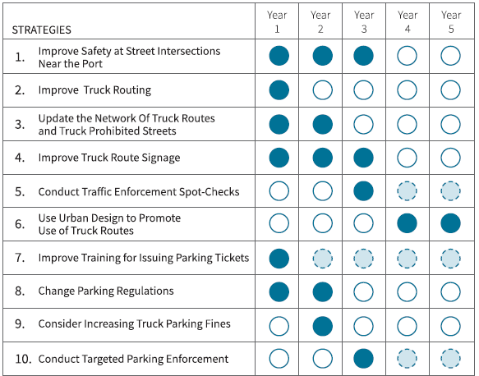
TMP: 10 Strategies to Reduce Effects of Trucks
City and Port co-manage the delivery of TMP actions
Notes:
Note extensive engagement (from following hidden slide)
WOCAP

Slide 3
May to Aug. 2020 Community Engagement
Refine TMP proposals
Communication Channels
Email blasts
Website
Survey
Flyer
Virtual Meetings
Truck–Related Business Follow up*
Industry/Trade Group Meetings
Trucker Work Group
Harbor Trucking Assoc.
Phone calls to individual businesses
Flyers emailed to:
  Biz Alert
  Western State Trucking Association e-newsletter
  Truck Driver Facebook Groups & Bill Aboudi Yahoo Group
  Flyer at Port STEP CSC
Stakeholder Group Meetings
WOEIP & WOCAP
WOCAG
Howard Terminal CBA
Neighborhood Group Meetings
Prescott Neighborhood Council
West Oakland Neighbors
Field visit to Prescott Neighborhood
*Due to low turn out at virtual meetings and the important role that truck operators and industrial community have in ensuring success of changes
Notes:
You will hear that our engagement was not good enough

Slide 4
Proposal 1
Update truck parking regulations to limit extent of truck parking in West Oakland

Slide 5
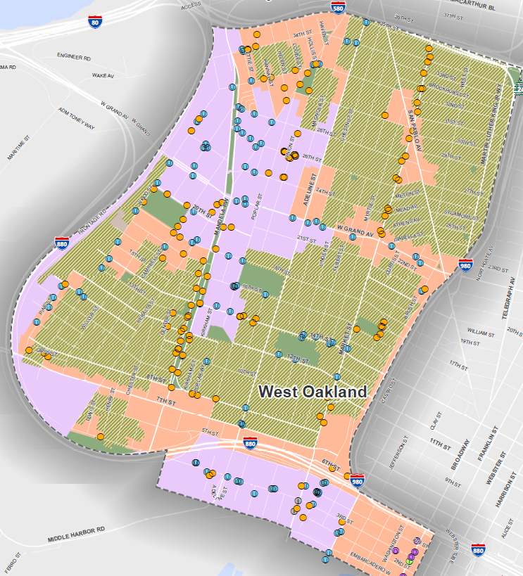
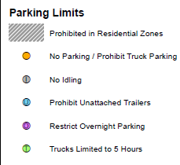
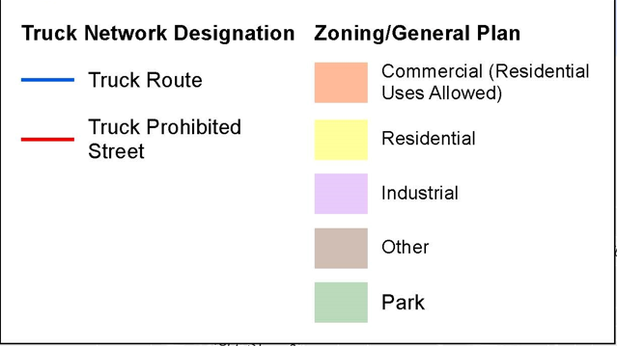
Current Truck Parking Regulations
Notes:
Touch on proposal (flips how we currently regulate) and point out where we responded to community feedback

Slide 6
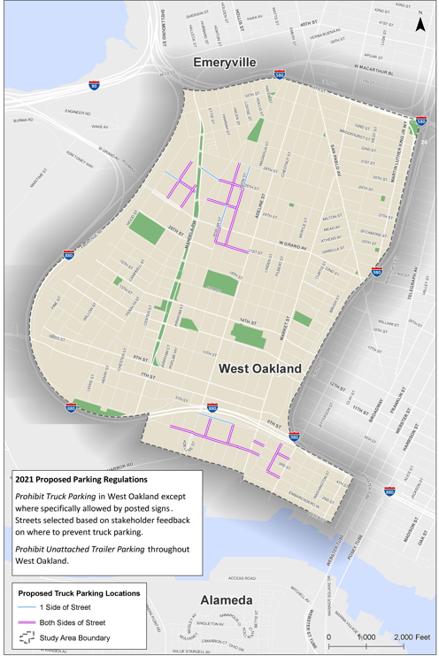
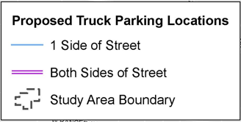
Proposed Truck Parking Regulations
Prohibit truck parking in West Oakland except where specifically allowed by posted signs.
Streets selected based on stakeholder feedback on where to prevent truck parking.
Notes:
Touch on proposal (flips how we currently regulate) and point out where we responded to community feedback

Slide 7
Proposal 2
Prohibit unattached trailer parking citywide

Slide 8
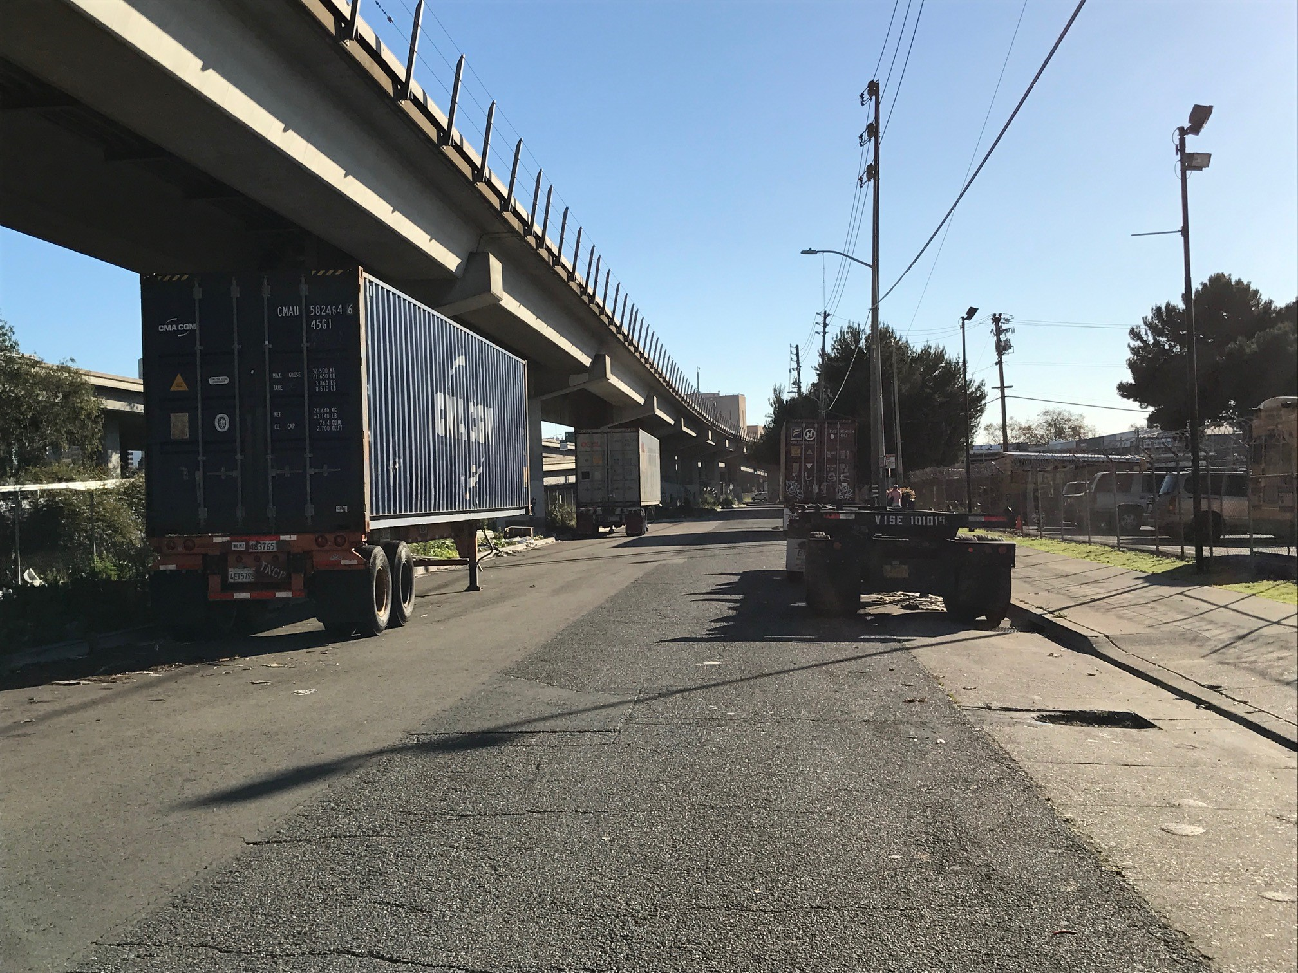
Prohibit unattached trailer parking citywide

Slide 9
Proposal 3
Update the network of truck routes and truck prohibited streets in West Oakland

Slide 10
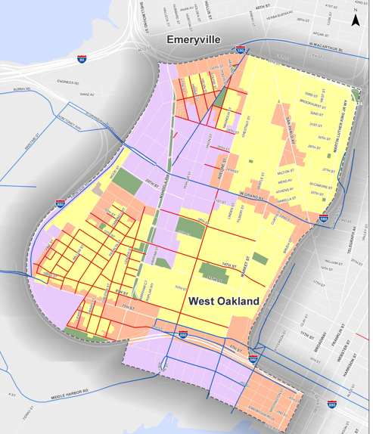
Proposed Network of Truck Routes & Truck Prohibited Streets
Notes:
Point out streets

Slide 11
Frontage Road
Community feedback & City’s and Port’s response about designating Frontage Road as a truck route

Slide 12
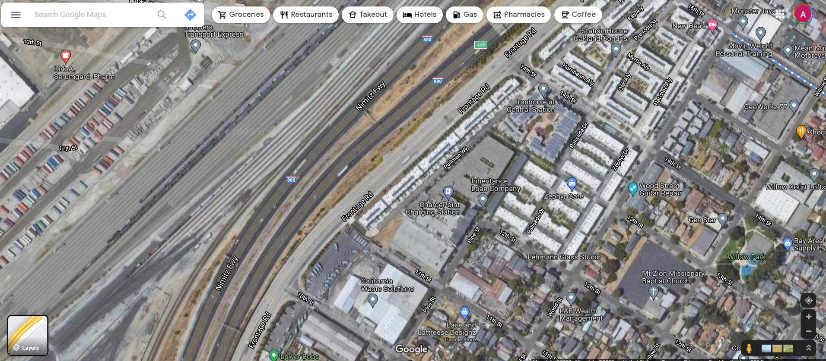
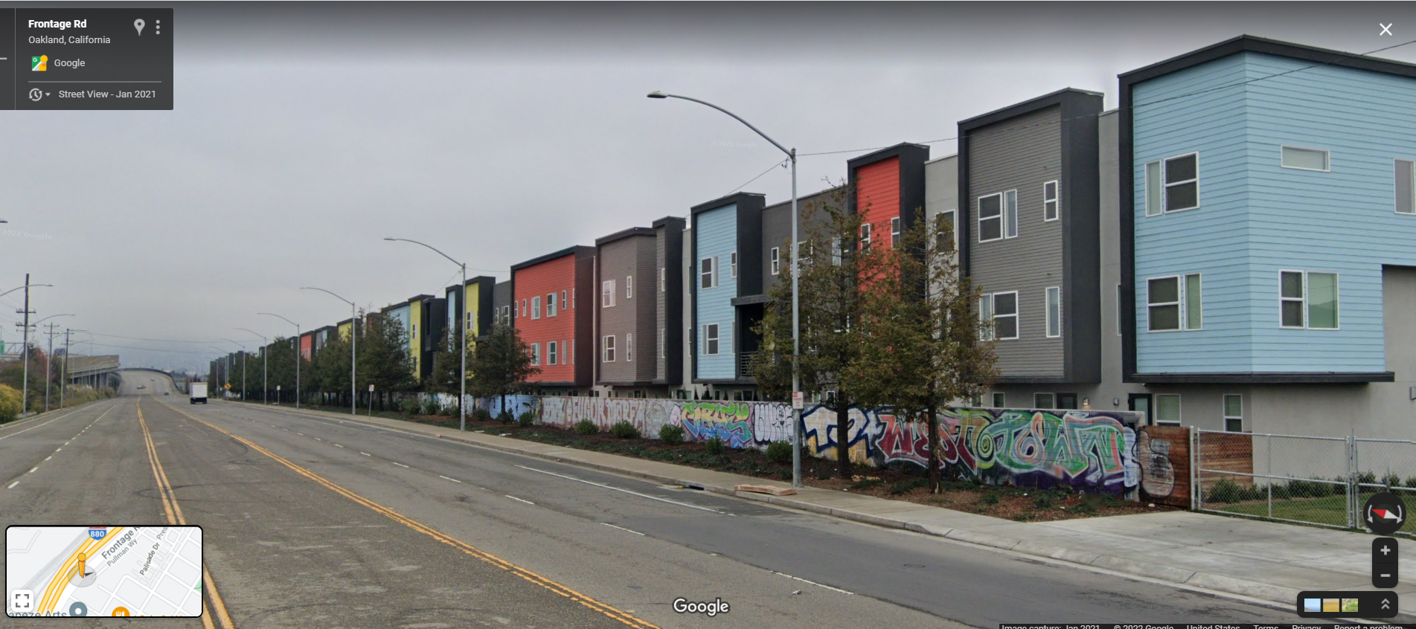
Frontage Road
Today
4 travel lanes plus a median
Trees and wall separate housing
Few driveways
Wood St. EIR is clear that project development intended to maintain truck use on Frontage Road (e.g. see MM TR-9.1)
Frontage Road at 11th St.; Google Maps
Notes:
2002 Army Base Redevelopomment

Slide 14
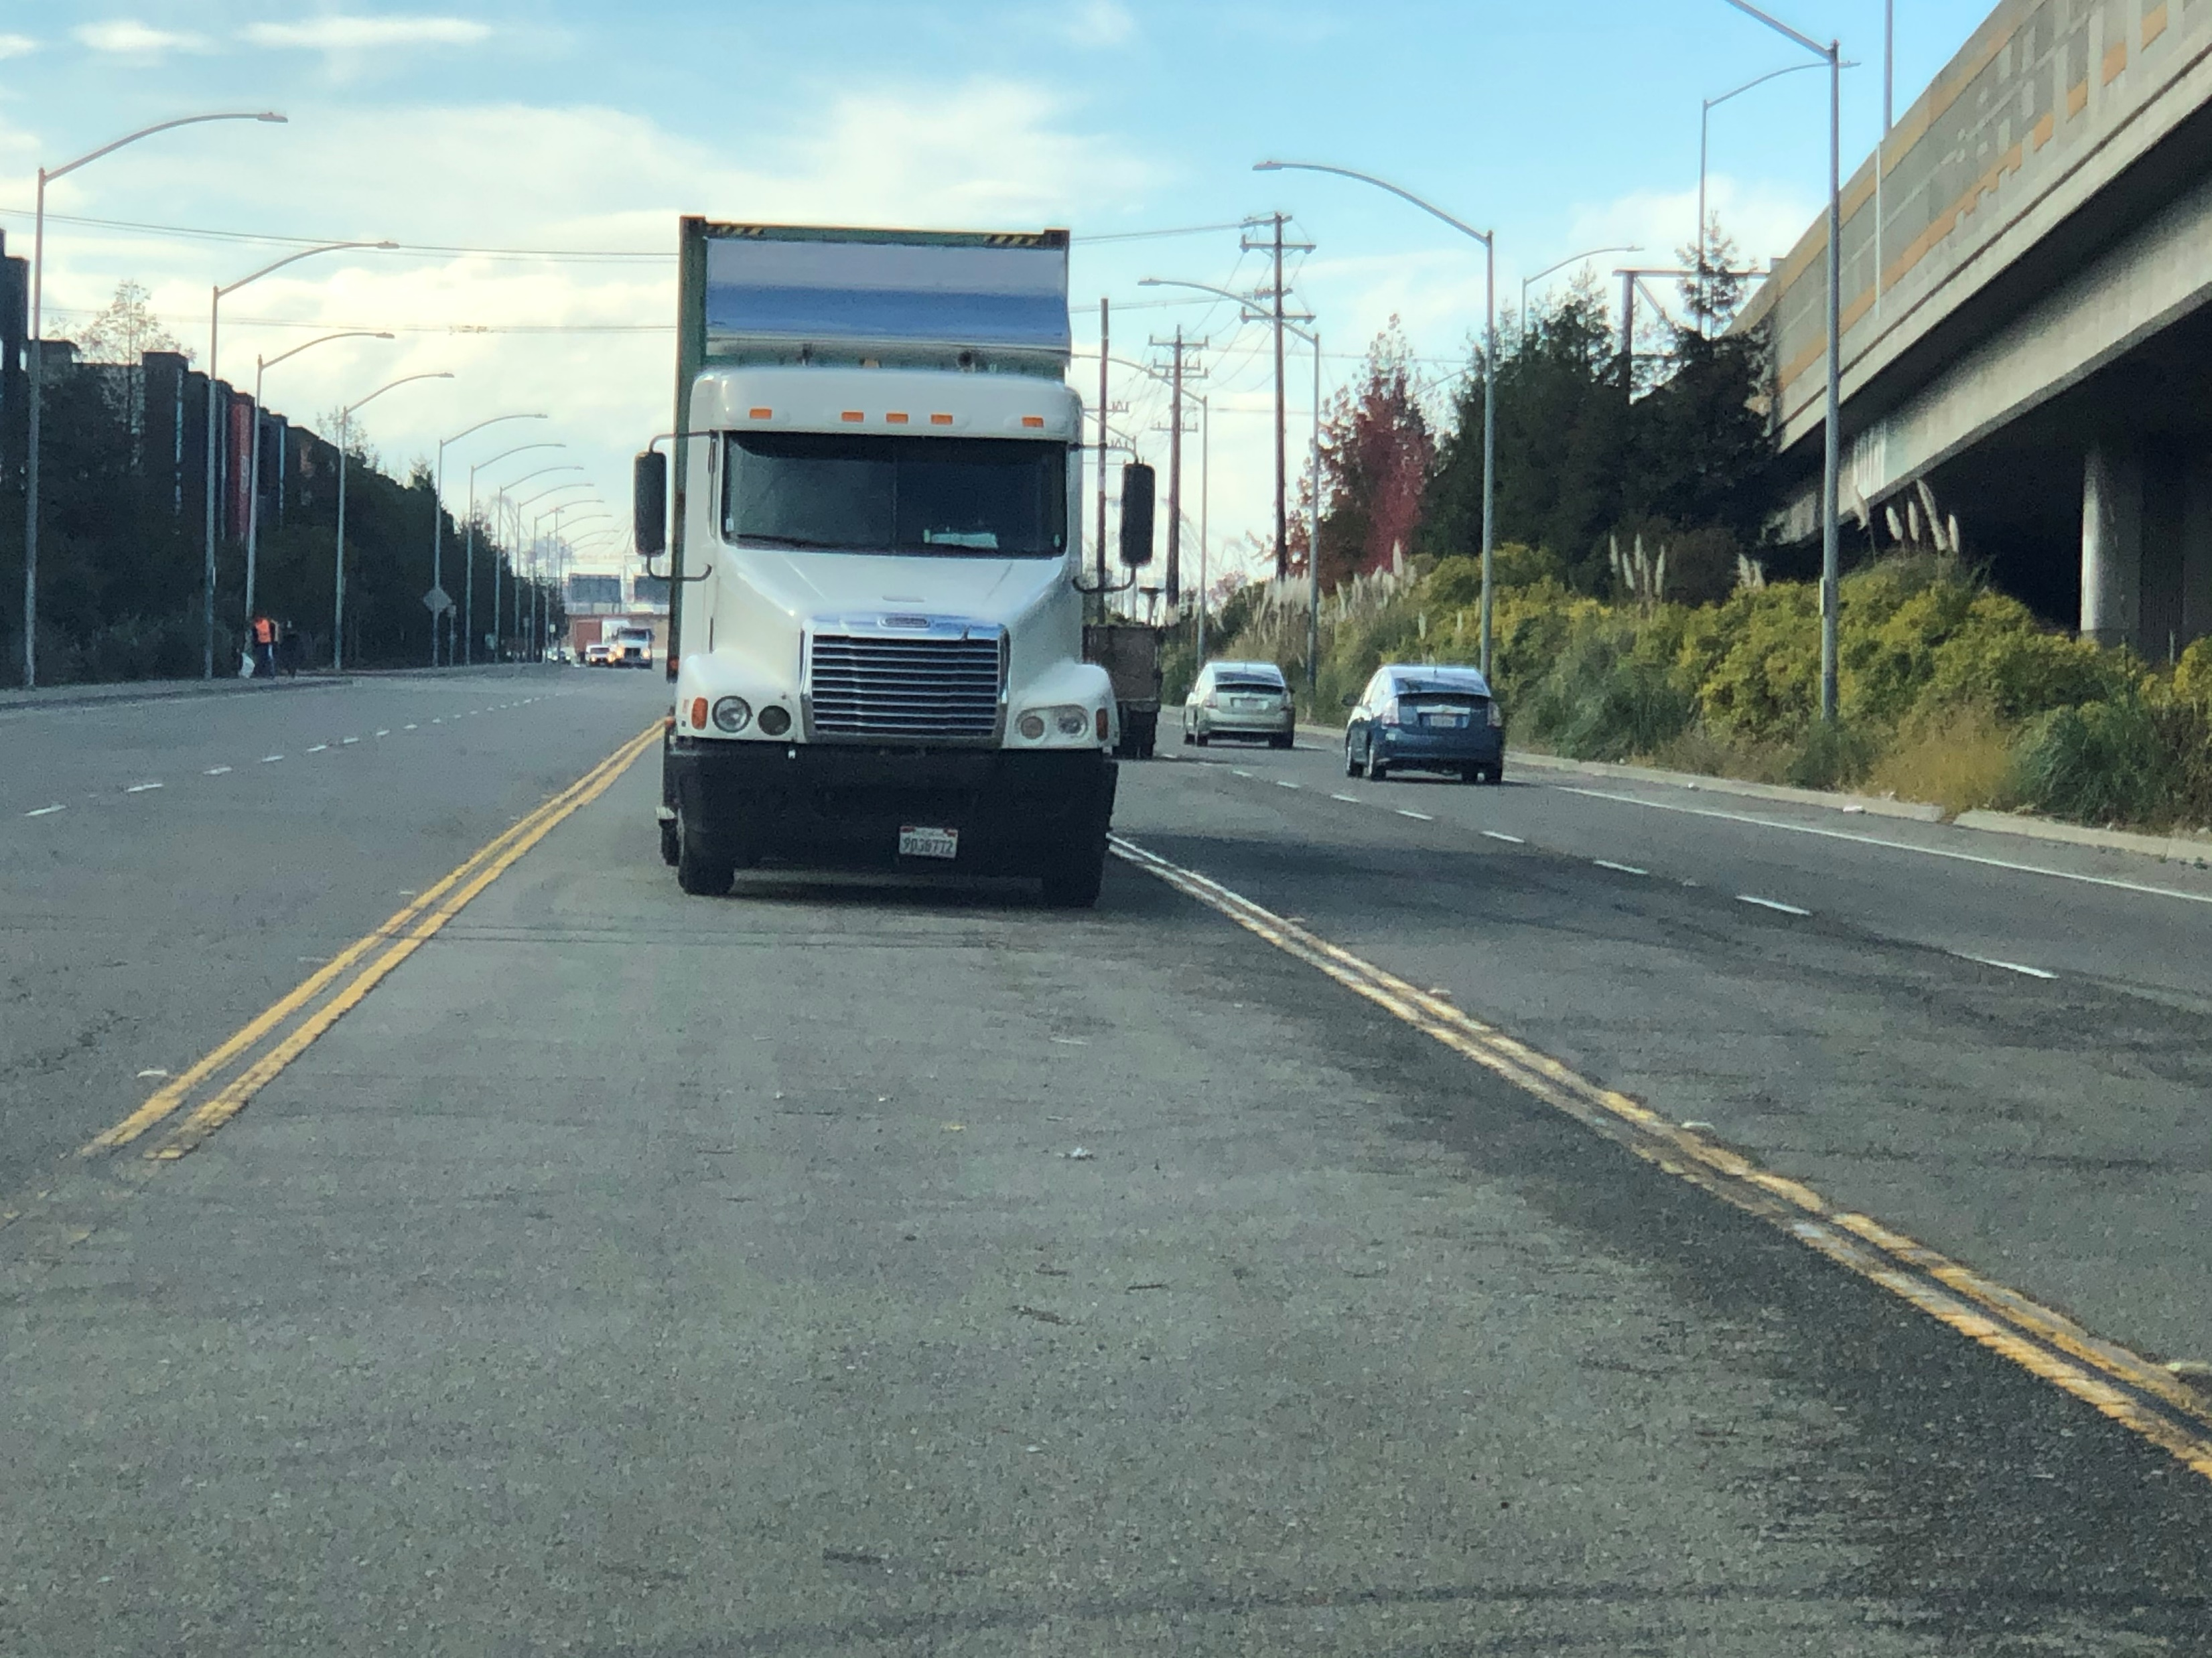
May-Aug. 2020
Outreach
Feedback on Formalizing Frontage Road as a Truck Route
  Traffic Safety
  Need to stop the truck stopping/ parking on Frontage Road (causing fatalities)
  Dangerous (traffic speed, trucks parked in the median causing collisions, sideshows)
Quality of life impacts
  Trash/litter (no one cleans up trash)
  Trucks are loud / noise issues
  Pavement deterioration
Alternatives
Design alternatives (lane narrowing, vegetated buffers & traffic calming recommendations)
Use alternative streets such as Maritime Street
Street Character
  Frontage Road is not bike/walk friendly
Neighborhood Sentiment
  Disregarding community feedback
  Historic Disinvestment
  Frontage Road should not be a truck route
  Concerned about amount of trucks, more trucks as Port grows?
Close Proximity to Residential
  High housing density near Frontage Road
  Frontage Road is residential in nature
Health and Air Quality
  Air quality/pollution /public health concerns
  Truck Idling causing diesel emissions

Slide 15
Frontage Road Study Process & Community Engagement
May-Aug. 2020
Outreach
Aug. to Sept. 2020
Sept. 2020 to Apr. 2021
Mar. 2021
Mar. to Oct. 2021
Oct. 2021
Jan. 2022
Feb. 2022
City and Port compile and review community comments (& post compiled comments online); Frontage Road opposition identified
City and Port agree to prepare Frontage Road Study and truck parking & truck route sign installation work; additional time needed for related negotiations b/w City & Port to amend “Fair Share Program” for sign design, fabrication and installation work to be done “in-house” (OakDOT)
Approach to Frontage Road Study emailed to community
Feb met w/ WOEIP to let them know consultant work kicking off and to review approach
Consultants prepare Frontage Road Study & City and Port begin negotiating approaches to address community concerns related to Frontage Road
Frontage Road Study released and City/Port meet with:
WOEIP
Pre-meet with Prescott Neighborhood Council
Prescott Neighborhood Council
City & Port sign agreement on project management roles and responsibilities related to future Frontage Road capital project to include design changes to address community concerns (beyond the scope of TMP)
City/Port meet to review approach to Frontage Road (i.e., pair truck route label with capital redesign project) with:
WOEIP
Prescott Neighborhood Group
Notes:
Point of this slide: why might community have felt excluded? In part, because it took so long between touch points for them to hear from us due to significant negotiations that took place with the Port.

Slide 16
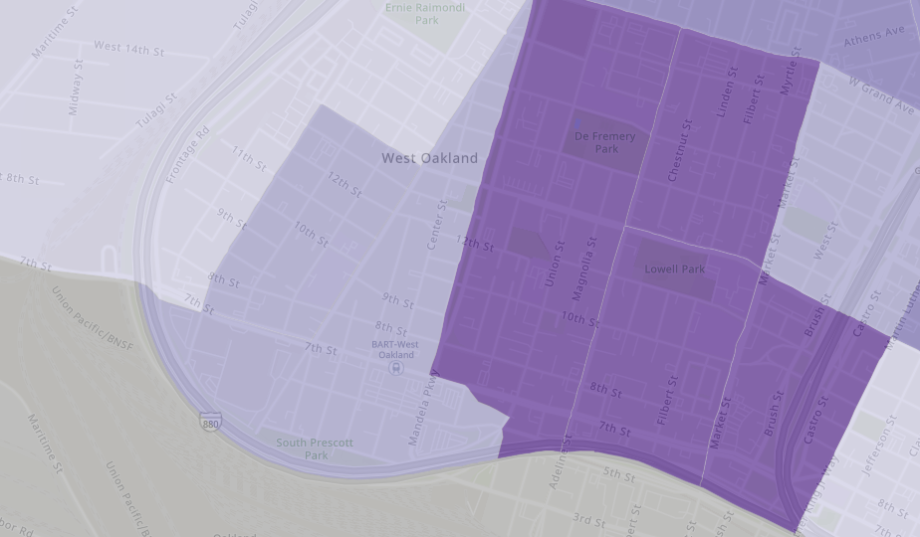
Frontage Road Study
Study Approach
Main Findings
Evaluate the impacts of different scenarios on communities of color, low income residents, and other vulnerable populations using the OakDOT Geographic Equity Tool and truck travel patterns
Scenario 1 – Frontage Road as Truck Route​
  Keeps trucks out of high priority equity neighborhoods in West Oakland​
  Relatively small percent increase in truck volumes on Frontage Road​
  Least impact to Port roadway congestion​
Scenario 2 and 3 – Frontage Road as Truck Prohibited​
  Increase in truck volumes on roads in higher-priority equity areas​
  Potential for significant congestion and operation delays for Port Trucks leading to increased idling and emissions
Notes:
Verbalize explanation re: health equity (W. Oakland pollution burden well documented); OakDOT tool prioritizes race & income, use of census data, why Literature bears out that race & income are the best predictors of life outcomes (sadly)
Maritime is not viable…
Only 10% increase in truck trips

Slide 17
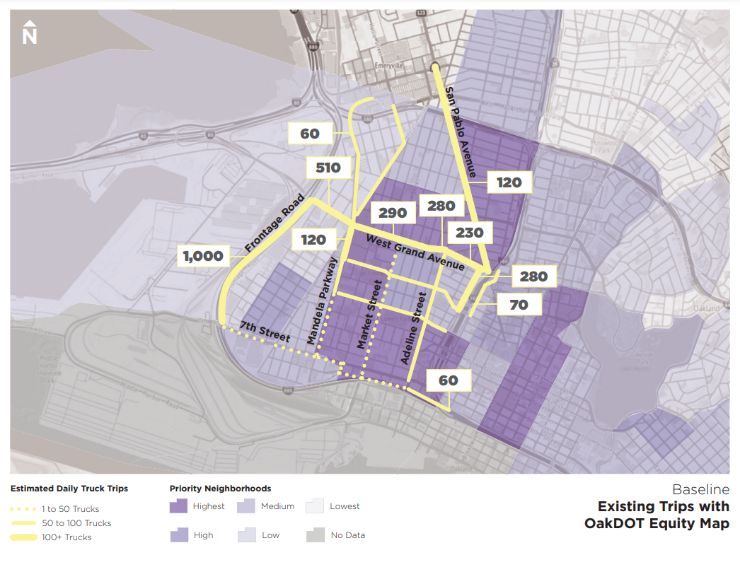
Daily Truck Trips
West Oakland Roads
Notes:
Note truck trips on Frontage Road today

Slide 18
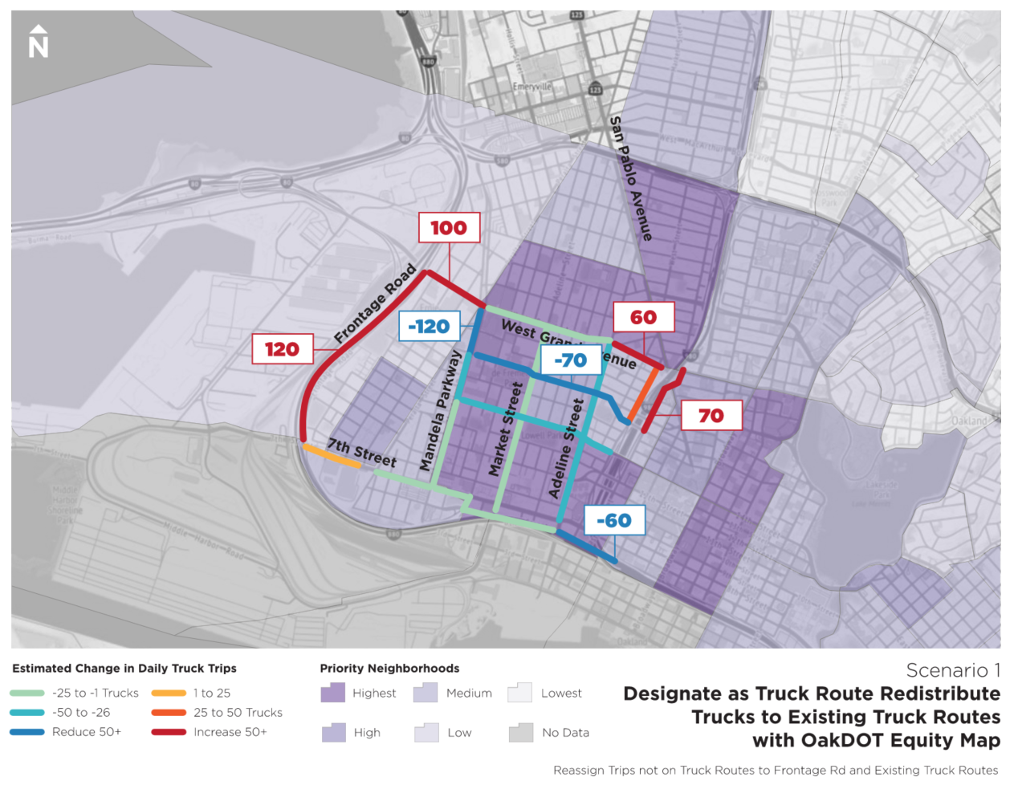
Change in Daily Truck Trips
1. Frontage Road Designated as a Truck Route
Blue/green lines: fewer truck trips
Red/orange lines: more truck trips
Primary Change: Trips to industrial areas north of West Grand Ave move from roads in interior of West Oakland to Frontage Rd.
Notes:
Small increase in truck trips on Frontage Road due to re-distribution of truck trips that otherwise would have traveled in the neighborhood
Fewer trips in the core of the neighborhood, in higher priority equity areas

Slide 19
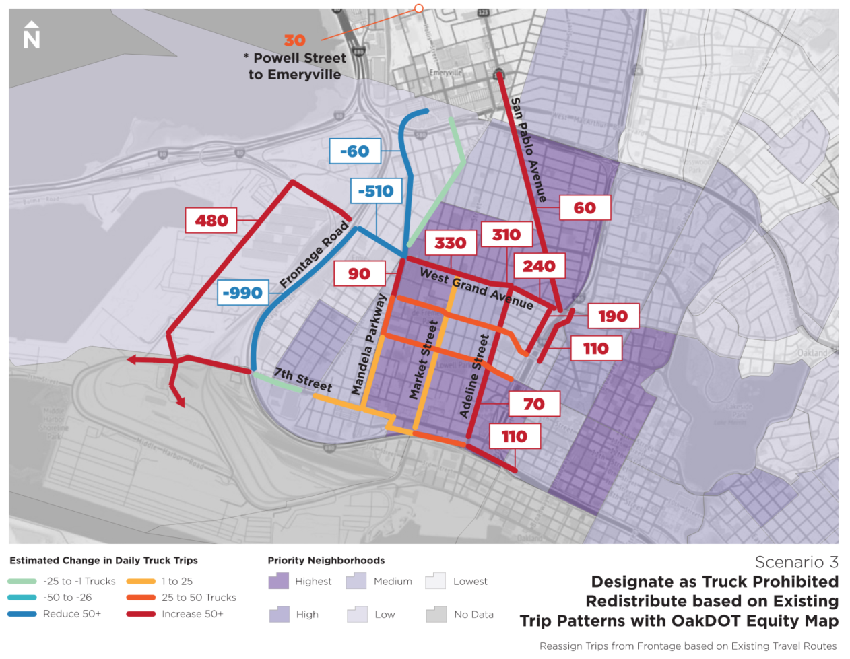
Change in Daily Truck Trips
2. Frontage Road Prohibited to Trucks
Blue/green lines: fewer truck trips
Red/orange lines: more truck trips
Primary Change: Trips to industrial areas north of West Grand Ave shift from Frontage Rd to routes through eastern part of West Oakland. Port trips shifted to Maritime St.
Notes:
designating all trucks onto Maritime St. is not feasible as it would reroute all trucks heading to the Port, West Oakland, and Emeryville onto Maritime Street. This will significantly increase trip distances, add to emissions and impact roadway capacity and Port operations (congestion)
can't send 400 trucks on w grand, not ideal

Slide 20
Staff Recommendation for Frontage Road​
Formalize Frontage Road as a truck route because it keeps trucks out of high equity priority neighborhoods
  Initiate City Council adoption process at the Feb. 22 Public Works Committee
The truck route determination is paired with future improvements to Frontage Road led by the Port including: ​
  Community workshops in partnership with OakDOT to vision streetscape ​
  Develop concepts for Frontage Road ​
  Implement Frontage Road improvements to address truck traffic impacts and other community concerns​
  Project is not subject to City CIP prioritization process; note City/Port Agreement Memo

Slide 21
Frontage Road​ Decision
City Council will decide on either:
Staff Recommendation
Designate as a truck route & Port leads a community-focused redesign process
Project becomes eligible for freight-related funding
Status Quo
trucks traveling on frontage without livability enhancements moving forward
No mechanism to deliver improvements

Slide 22
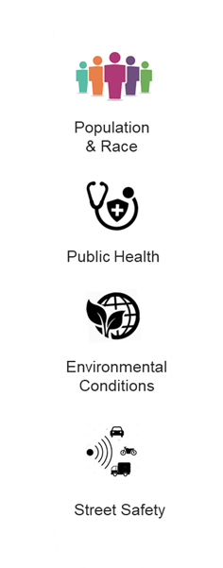




Steps to Reduce Effects of Trucks
Projects Underway Part of TMP:
  No parking and no idling signs
  Truck Driver Outreach and Education
  Other Projects Underway:
  Prescott Green Buffer (WOCAP)
Physical deterrents to prohibit trucks from parking in the median
Key indicators

Slide 23
Immediate Next Steps
Refinement of TMP truck route and truck parking strategies and community engagement
Port-led community visioning & conceptual design work for Frontage Rd.
City Council adoption of truck routes & truck parking
Jun. 2019 -
Aug. 2020
Oct. 2020 -
Feb. 2022
Feb. – Mar. 2022
Mar. – Jul. 2022
Apr. 2019
2022+
TMP Approved
Frontage Road Study & Related Community Engagement
TMP-related truck parking, truck prohibited streets and truck routes sign installation
TMP-Related Actions
New Frontage Road Project

Slide 24
Frontage Road Improvements Project
Conceptual Models (Examples)
Oakland City Council
Tuesday, March 15, 2022
(In support of Amendment to OMC 10.28.145 and 10.28.160)

Slide 25
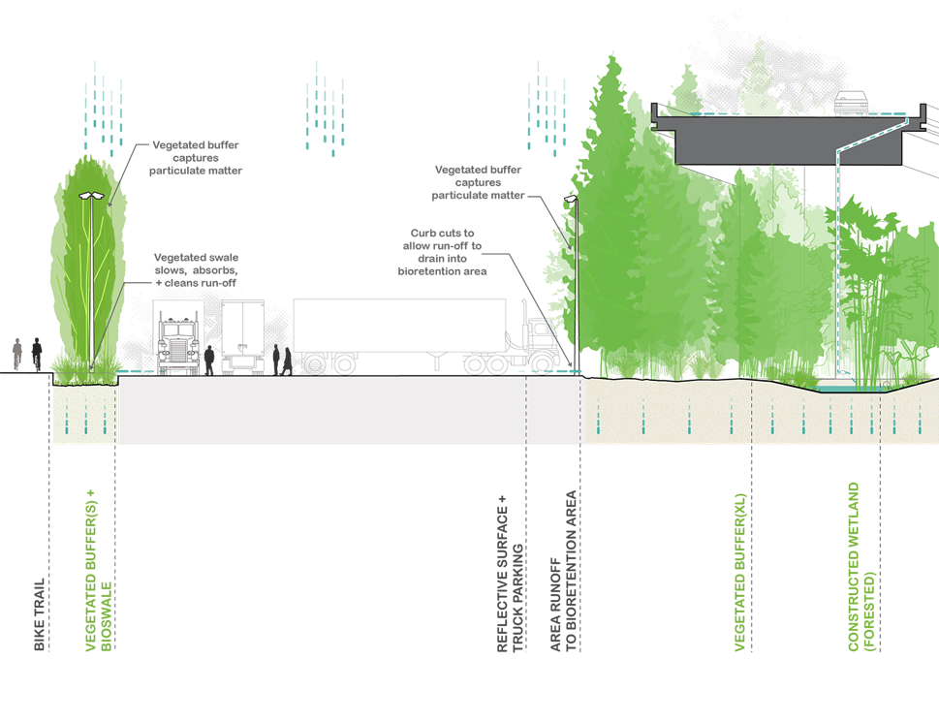
Multi-Modal Road with Vegetative Buffer
Source:
Adapt Oakland (2014)

Slide 26
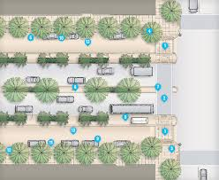
Multi-Way Boulevards
Source:
San Francisco Better Streets

Slide 27
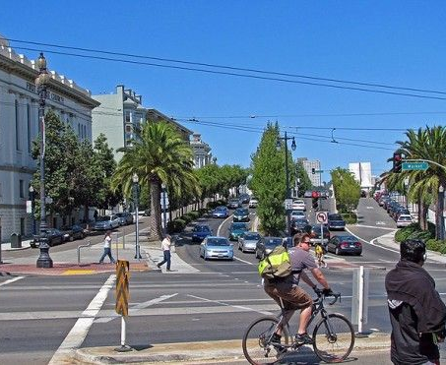
Octavia Boulevard
San Francisco MTA

