Slide 1
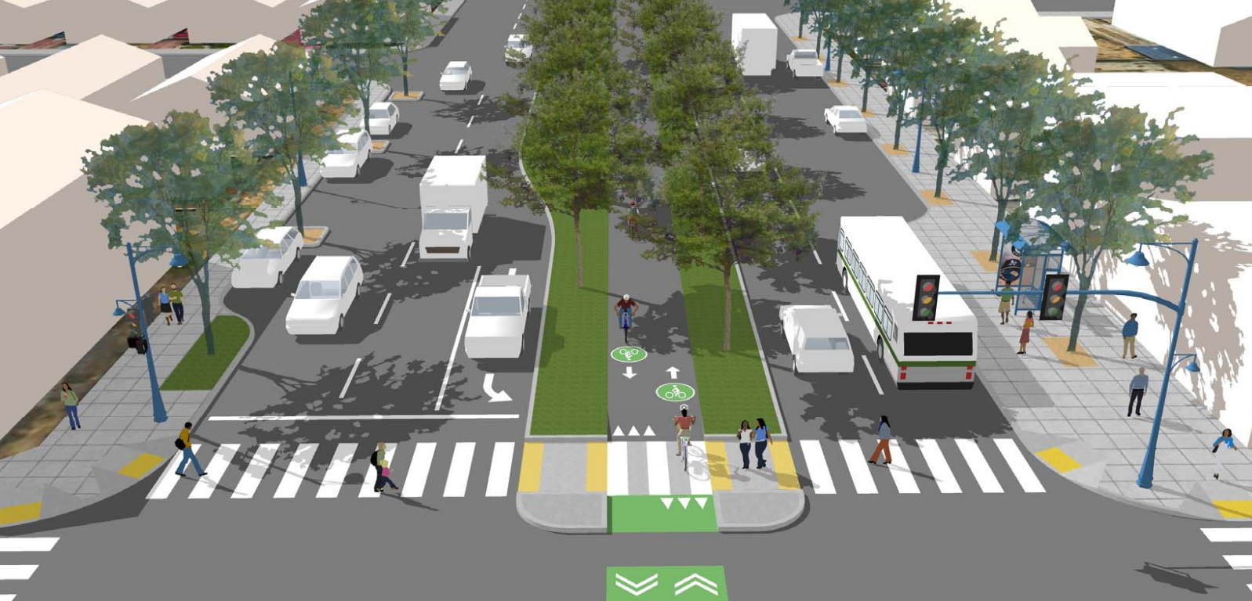

73rd Ave Design Selection
April 18, 2024 | BPAC| Manuel Corona
Notes:
Discuss design alternative developed
Engagement with community
Survey input
Staff recommendation

Slide 2
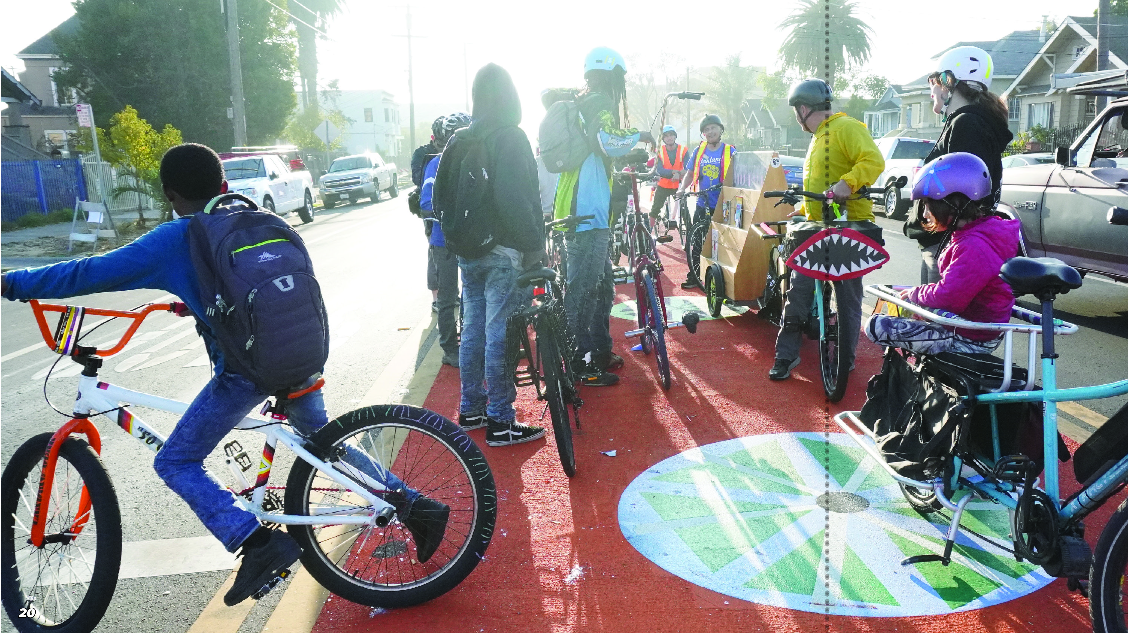
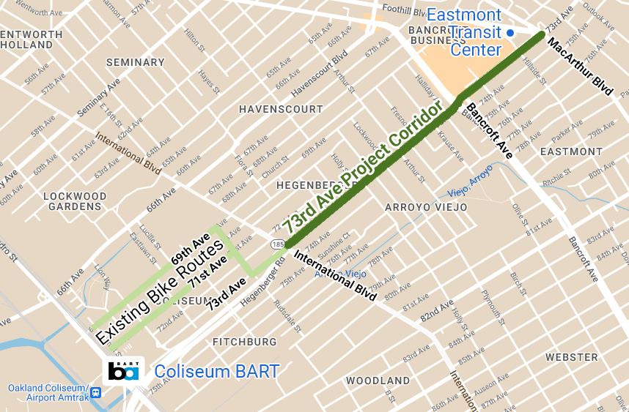
73rd Ave Active Routes to Transit
Introduction
OakDOT is currently working on design plans to seek implementation funding for enhanced multimodal transportation infrastructure along 73rd Avenue, connecting the Eastmont Transit Center, Coliseum BART Station, and the newly constructed International Blvd Bus Rapid Transit (Tempo) system.
This project seeks to prioritize safety enhancement for the comfort of transit users, pedestrians, and cyclists.
PROJECT AREA
https://www.oaklandca.gov/projects/73rd-avenue-active-routes-to-transit
Notes:
Bancroft median path

Slide 3
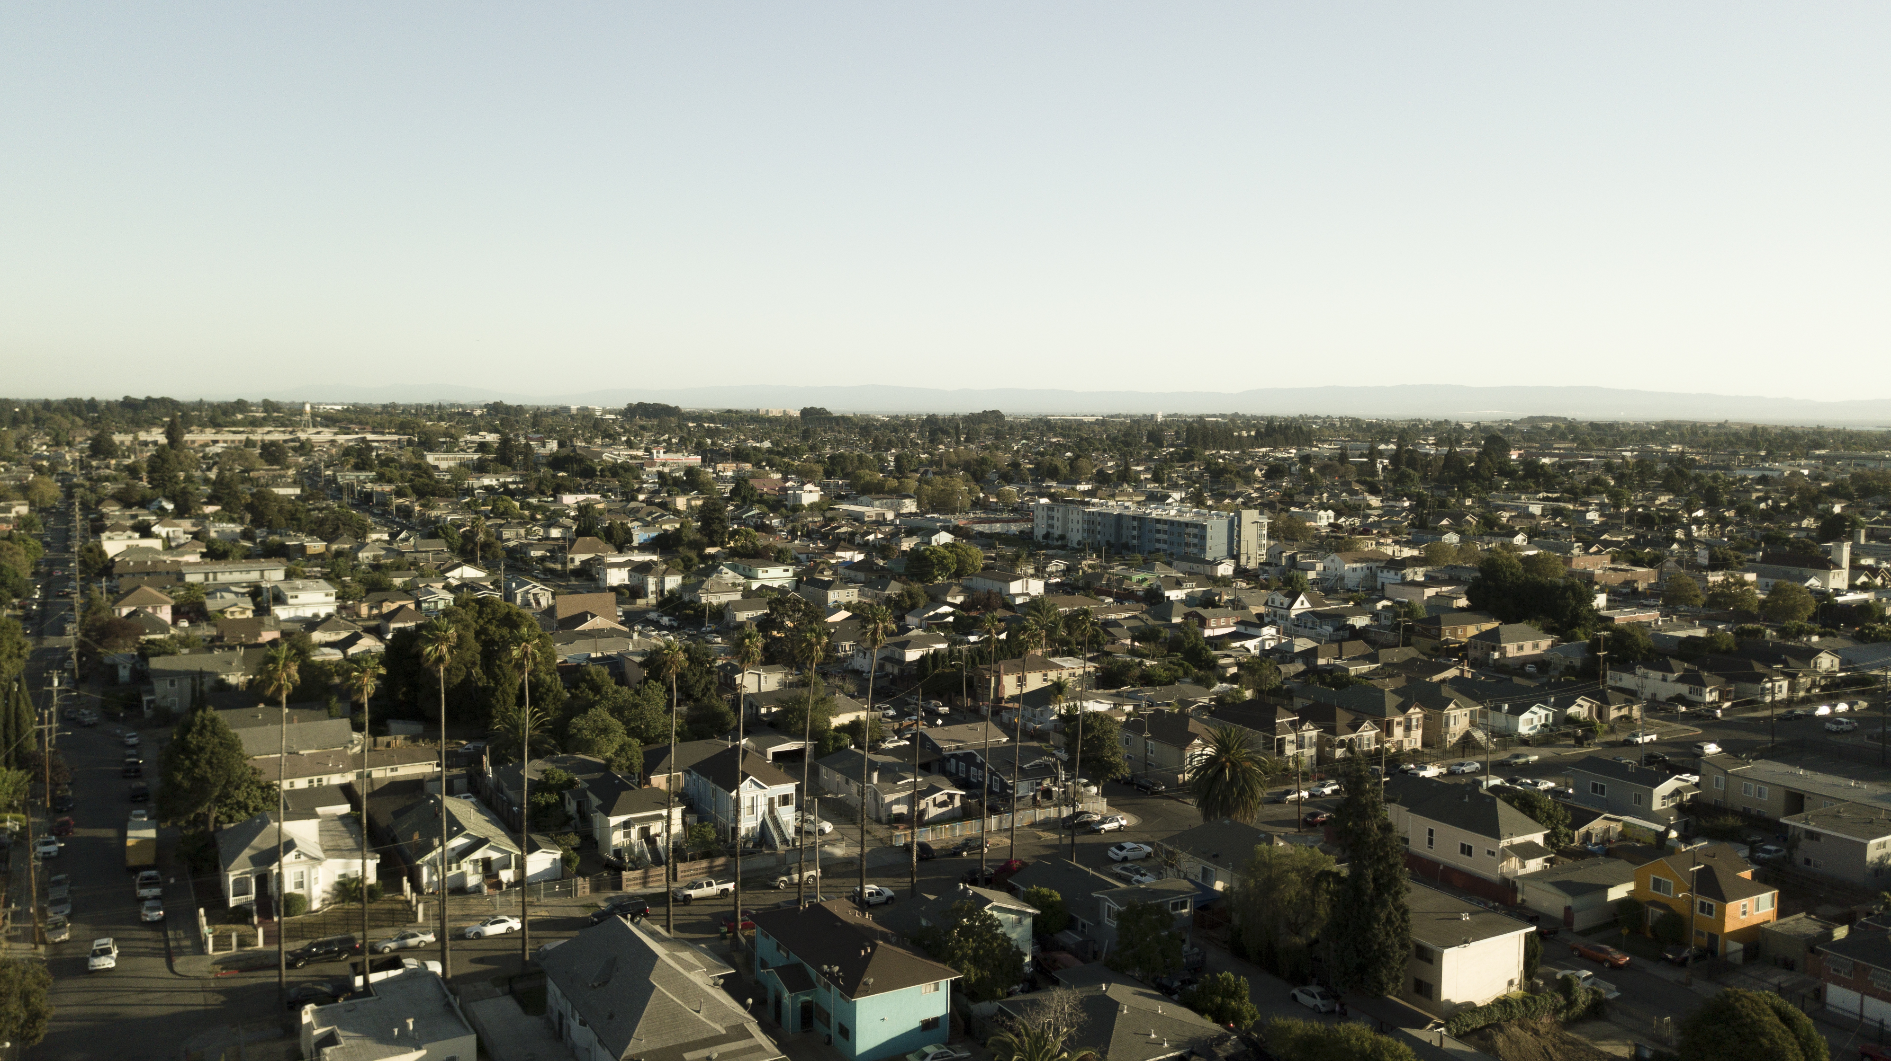
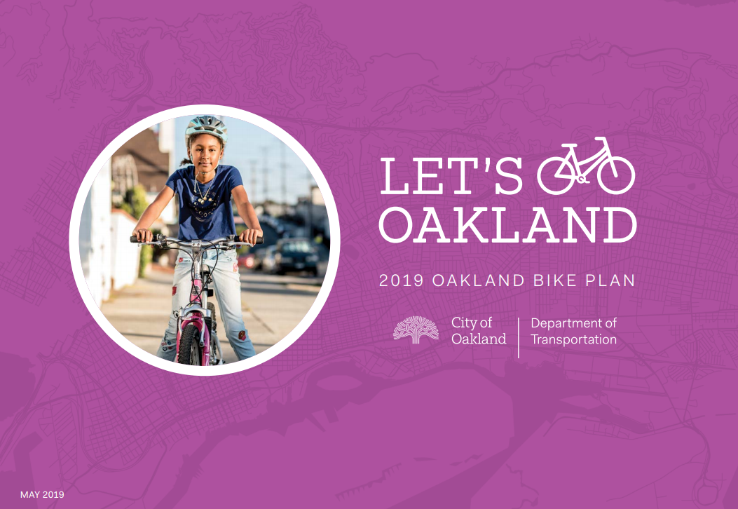
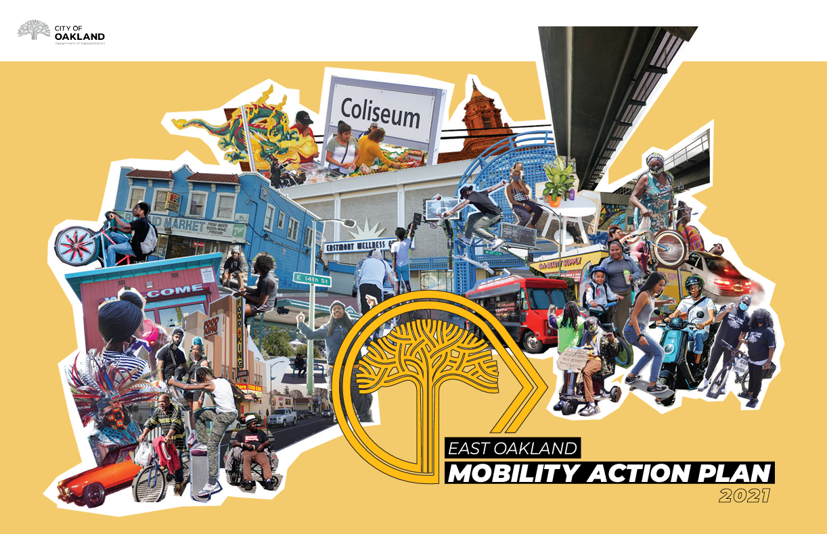
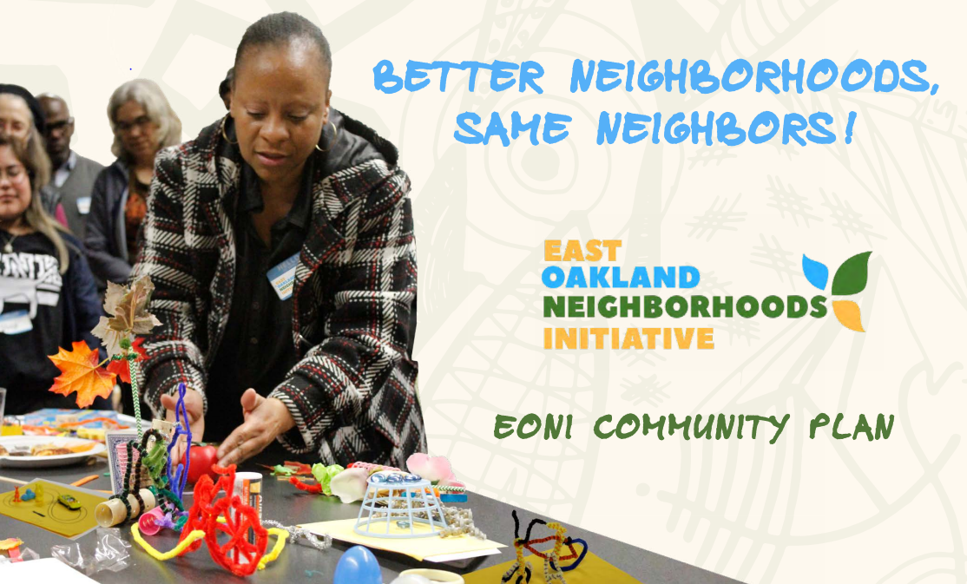
Background
Past Planning Efforts
Let’s Bike Oakland, Oakland Bike Plan Update (2019)
East Oakland Mobility Action Plan(2021)
East Oakland Neighborhood Initiative (2019)
Notes:
Project was identified as a priority project in the 2019 bicycle plan update “Let’s Bike Oakland” and the 2021 East Oakland Mobility Action Plan (EOMAP).
We heard:
Safety concerns regarding speeding and bad driving behavior at intersections,
Security concerns biking and walking next to vehicle traffic due to potential exposure to drive-by assault.
Community members shared that they did not feel safe using the current bike facilities or crossing 73rd Ave to access the Eastmont Transit Center.
E 73rd has been on the priority list since the 2007 Community streets plan

Slide 4
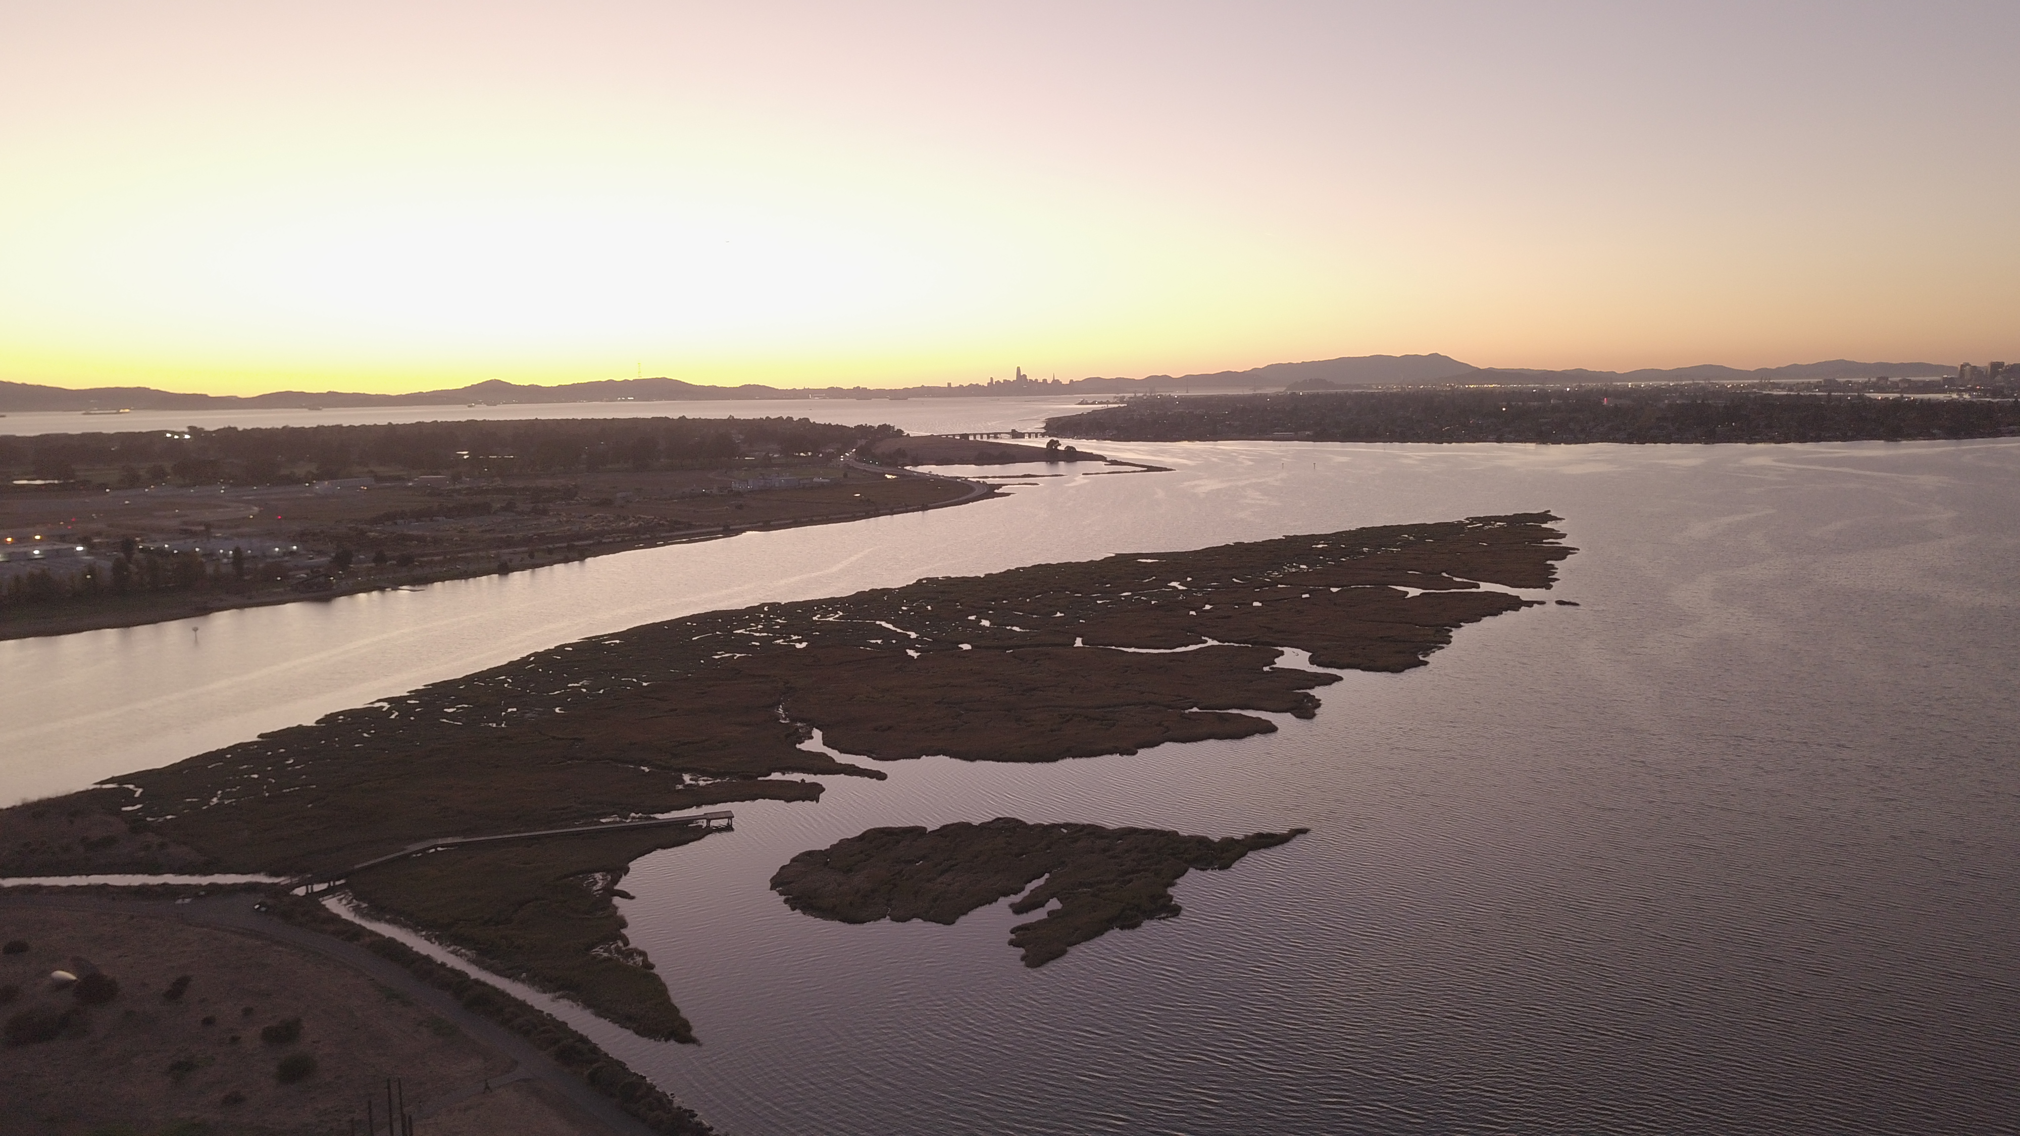
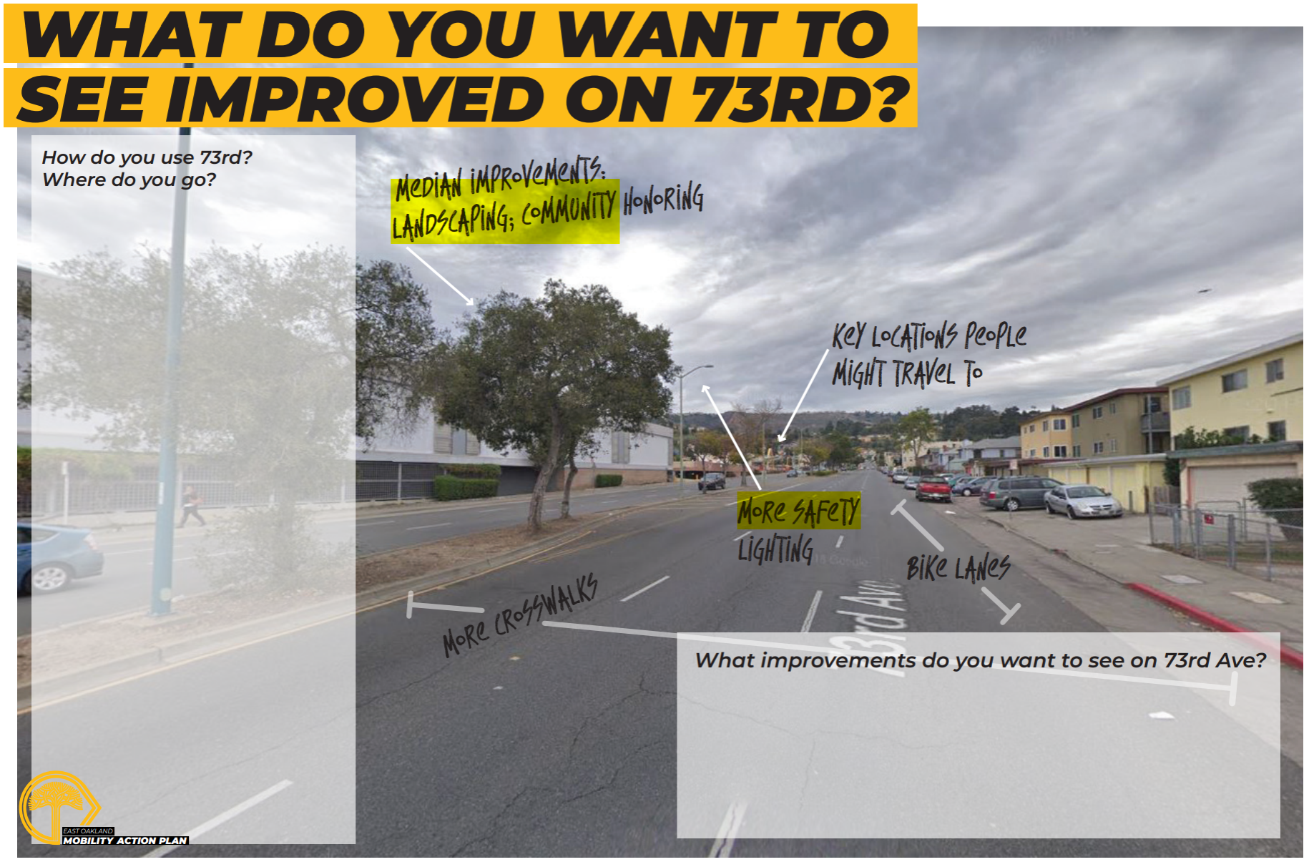
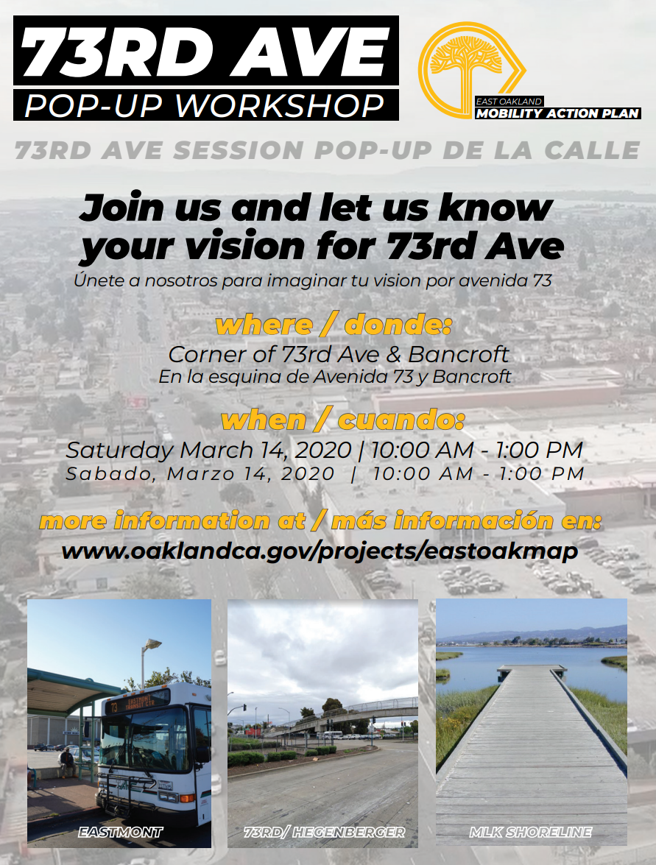
Previous Grant Application
Outreach And Engagement
Previously in 2022:
Focused groups
“Pop up” mobile workshops
Tabling at existing events
Online survey
What we heard:
To close gaps in the bike lanes
Better connections to BART
Improved pedestrian crossings
Bus stop improvements
Better access to Eastmont Transit Center
Notes:
Happened during COVID
Major emphasis on how to make 73rd better for people walking and biking

Slide 5
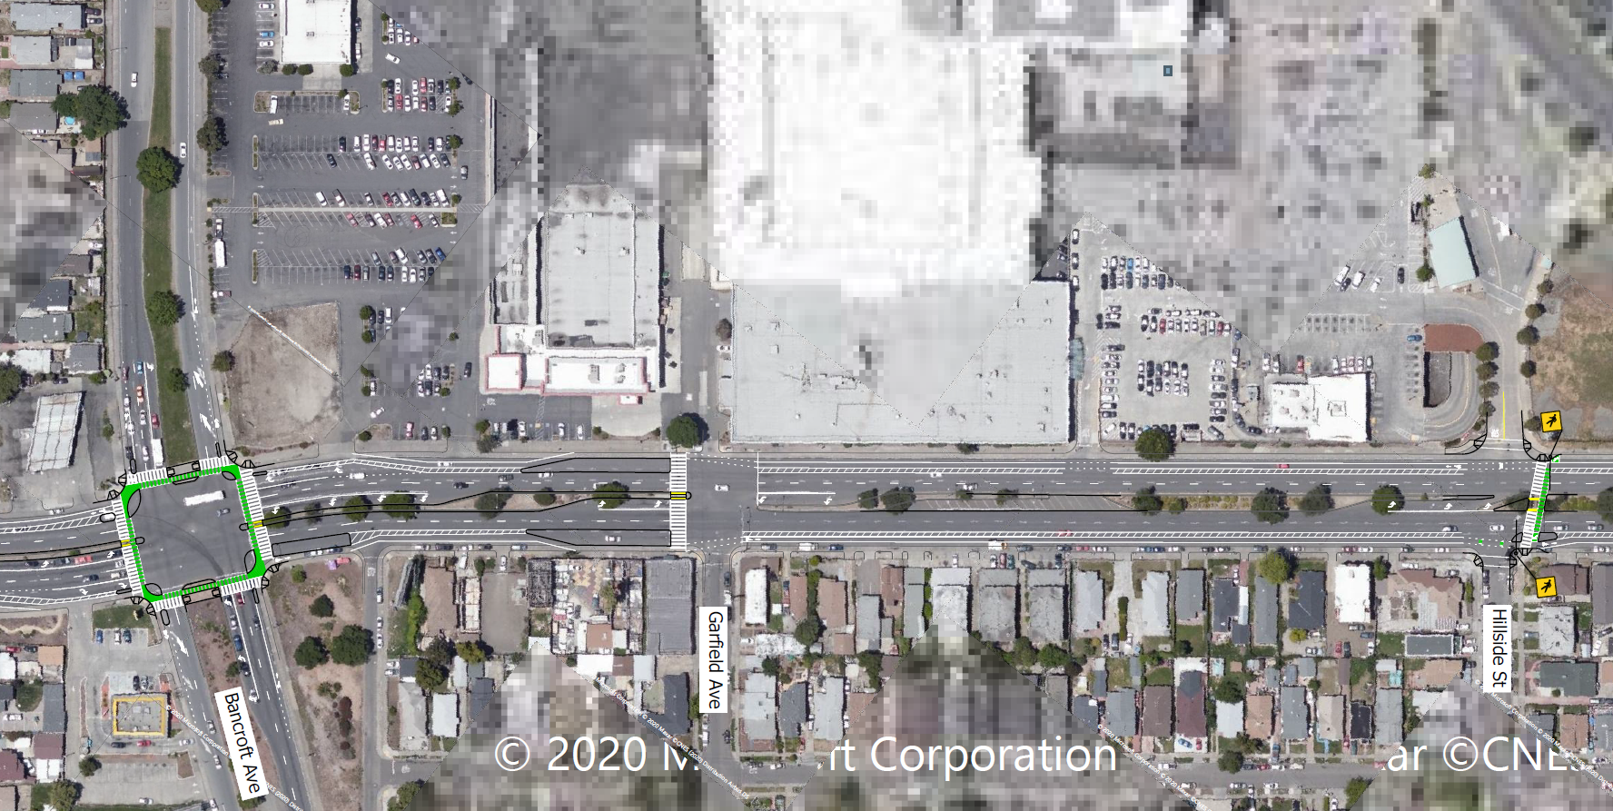
Previous Grant Application
Active Transportation Program (ATP)
The purpose of the ATP is to encourage an increased use of active modes of transportation, such as walking and biking.
Design included:
Buffered bike lanes
Protected intersections
Bus boarding islands
New Pedestrian crossings
Extended medians
OakDOT applied to ATP Cycle 6 in 2022 and was not awarded
Notes:
Increase the proportion of trips accomplished by biking and walking.
Increase the safety and mobility of non-motorized users.
Advance the active transportation efforts of regional agencies to achieve greenhouse gas reduction.
Enhance public health
Ensure that disadvantaged communities fully share in the benefits of the program.
Provide a broad spectrum of projects to benefit many types of active transportation users.

Slide 6
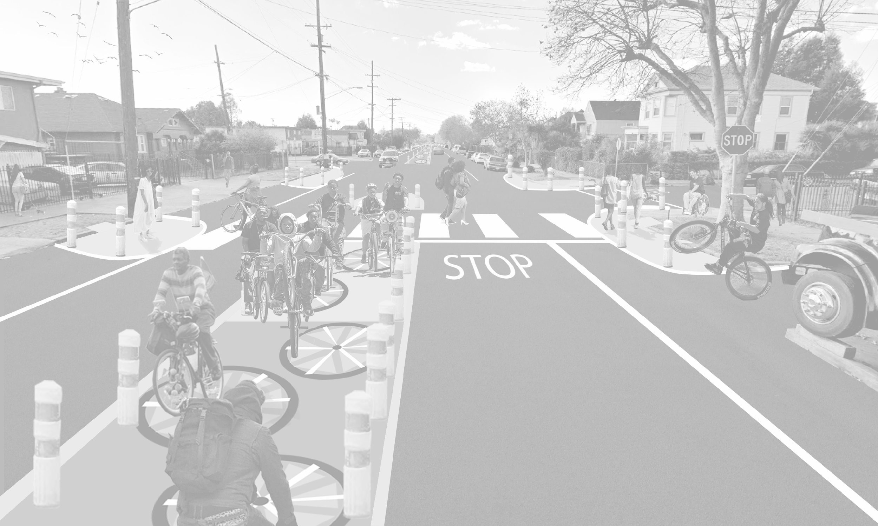
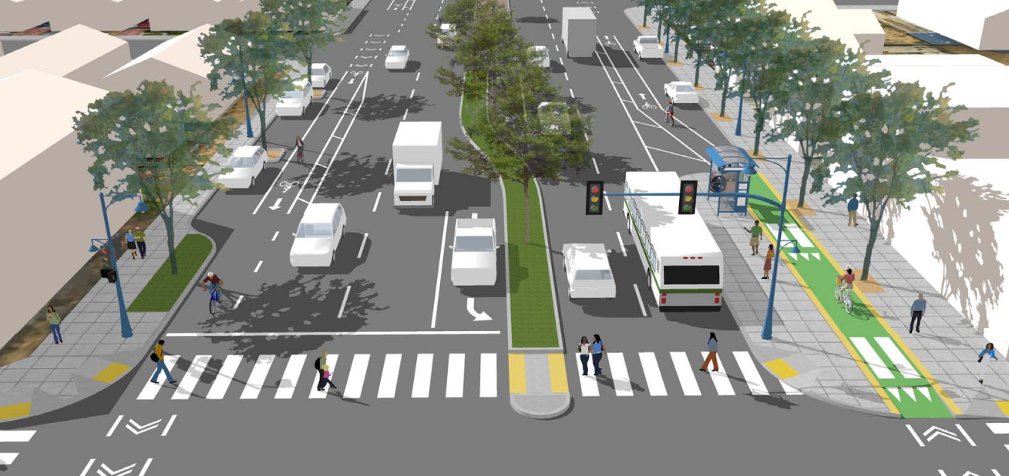
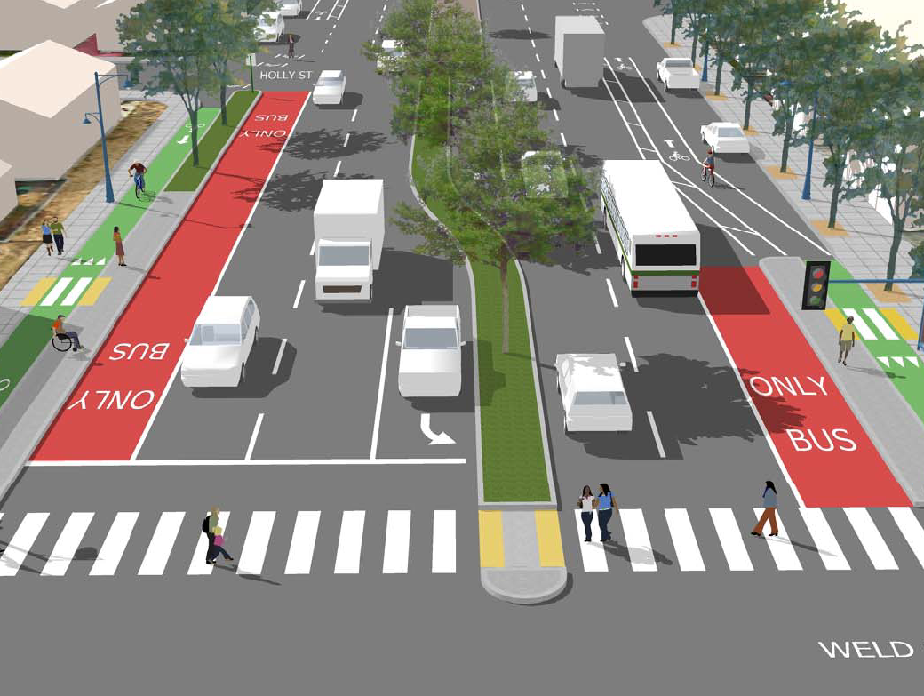
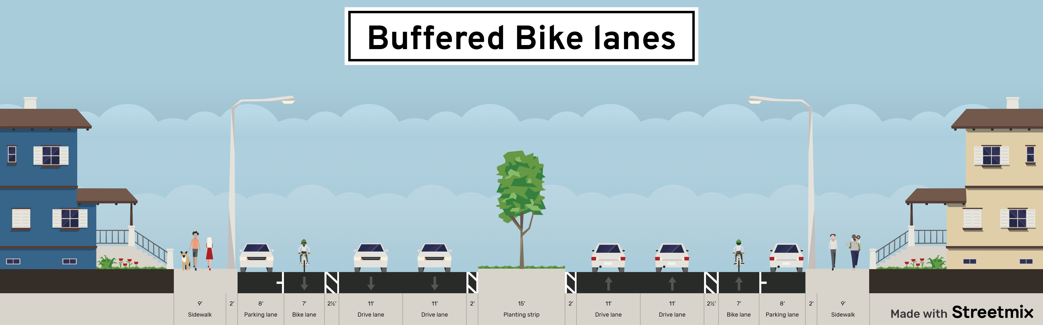
Design Alternative 1
Buffered Bike Lanes
Cost: $21 million
Features:
Painted buffer between drivers and bicyclists to create separation.
Clearly marked lanes for better visibility and traffic awareness.
Notes:
This design would not be a big difference from current conditions.
Brings more improvement for transit

Slide 7
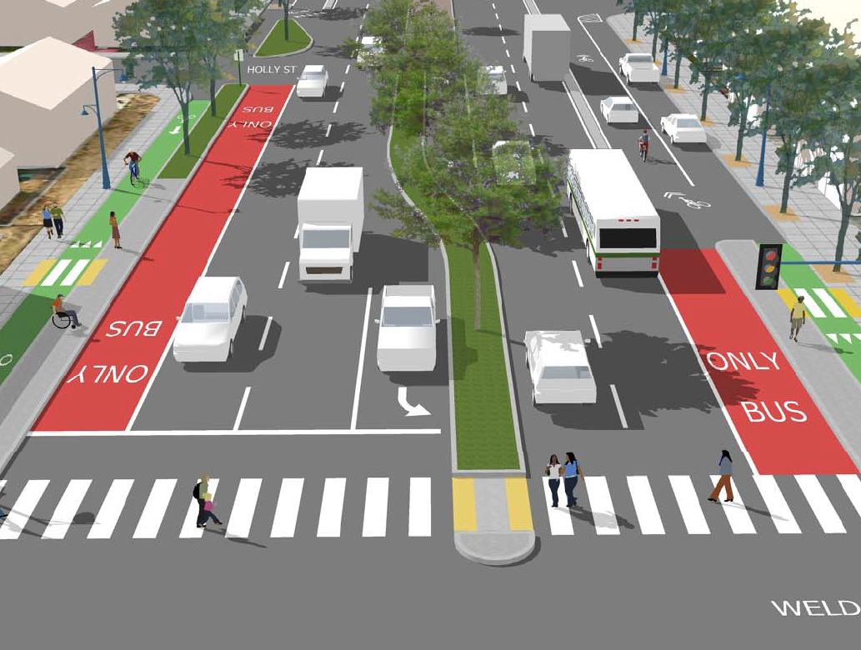
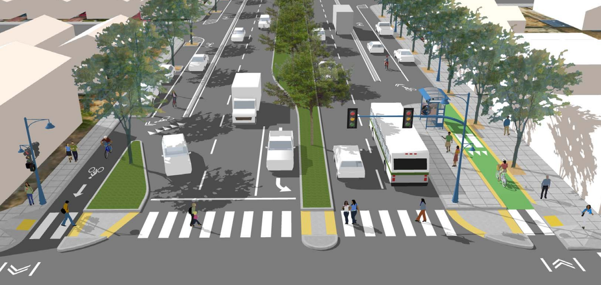
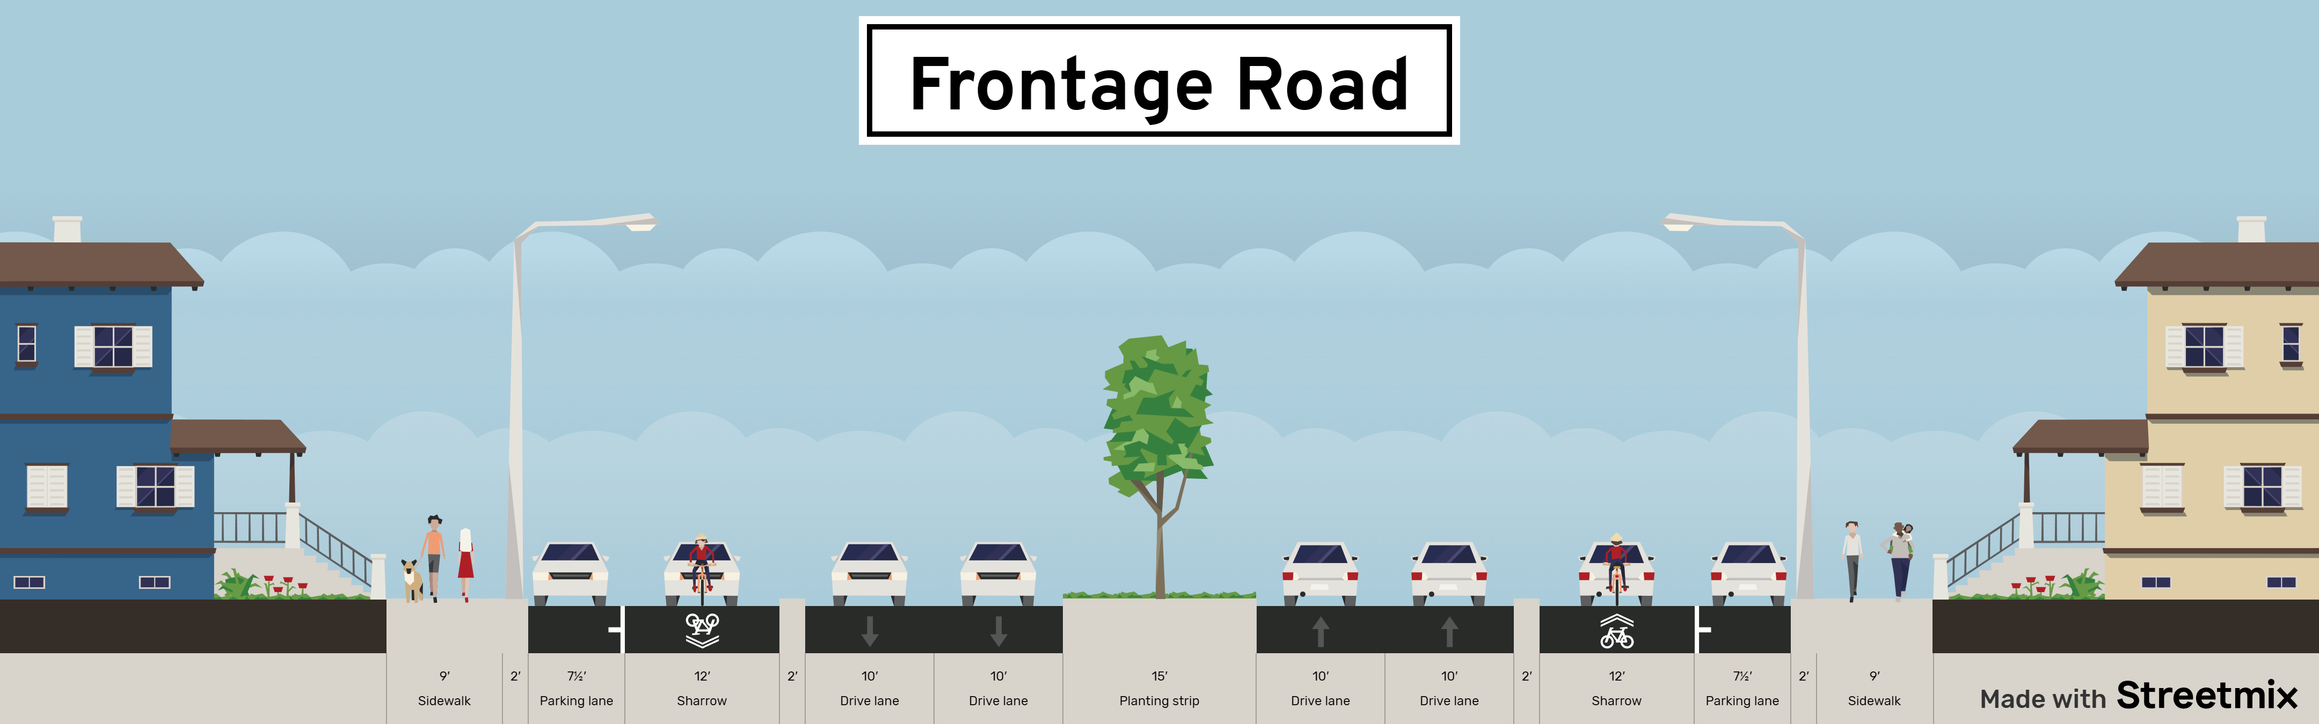
Design Alternative 2
Local Access Lane
Cost: 24 million
Features:
Adds a concrete curb separating the right-most lane from other lanes.
Creates a lane that is calmer and less busy for residents, visitors, and others.
Local Access Lane
Notes:
Add a lane of travel closer to the curb
Provides some transit improvement
Separates fast moving traffic from the sidewalk

Slide 8
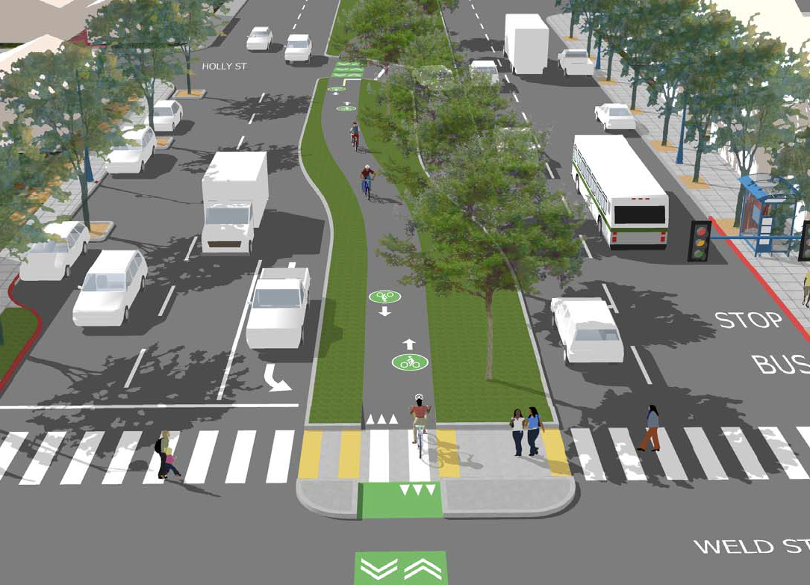
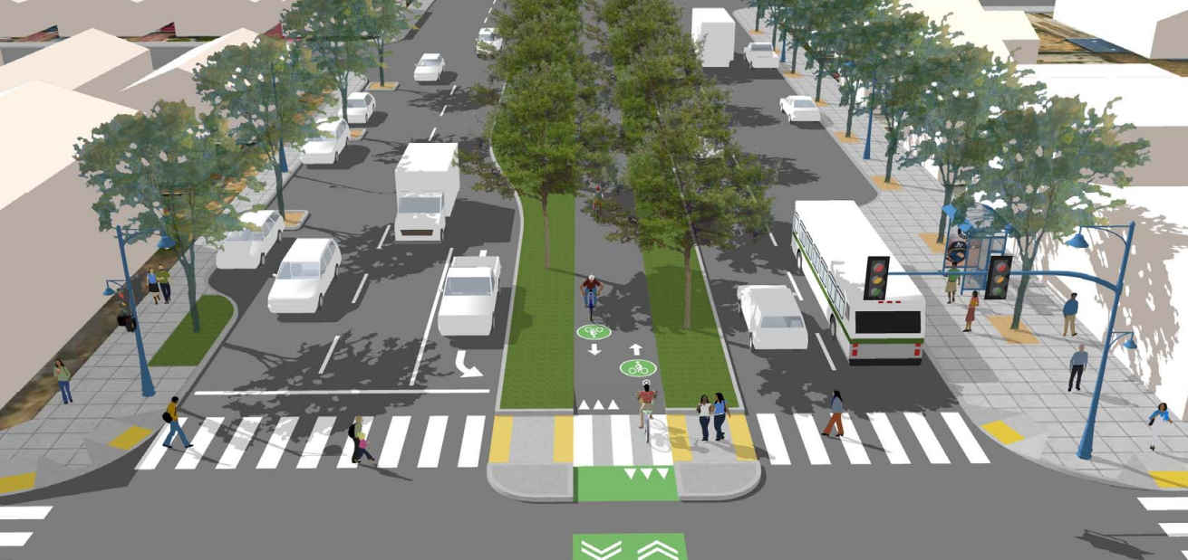

Design Alternative 3
Median Bike Path
Cost: 32 million
Features:
Dedicated path in the median that physically separates bicyclists from vehicular traffic to reduce the risk of collisions.
Includes landscaping along the median, creating an aesthetically pleasing environment.
Notes:
Minimal transit improvements
Does provide full separation for bicyclist

Slide 9
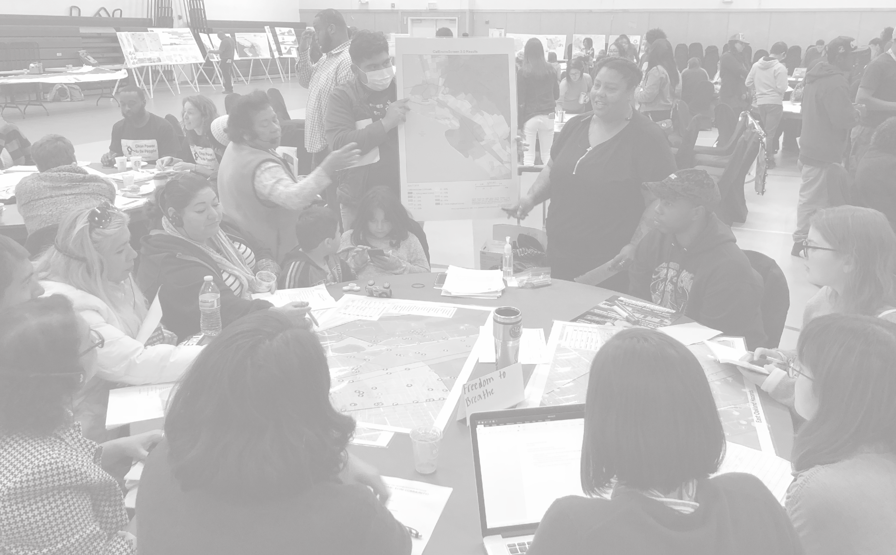
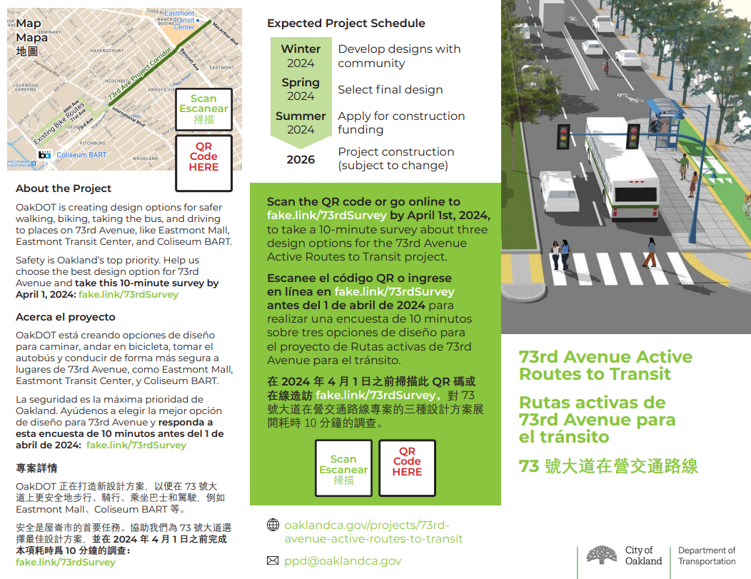
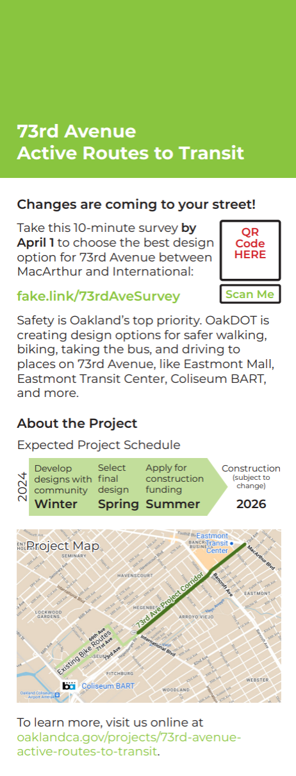
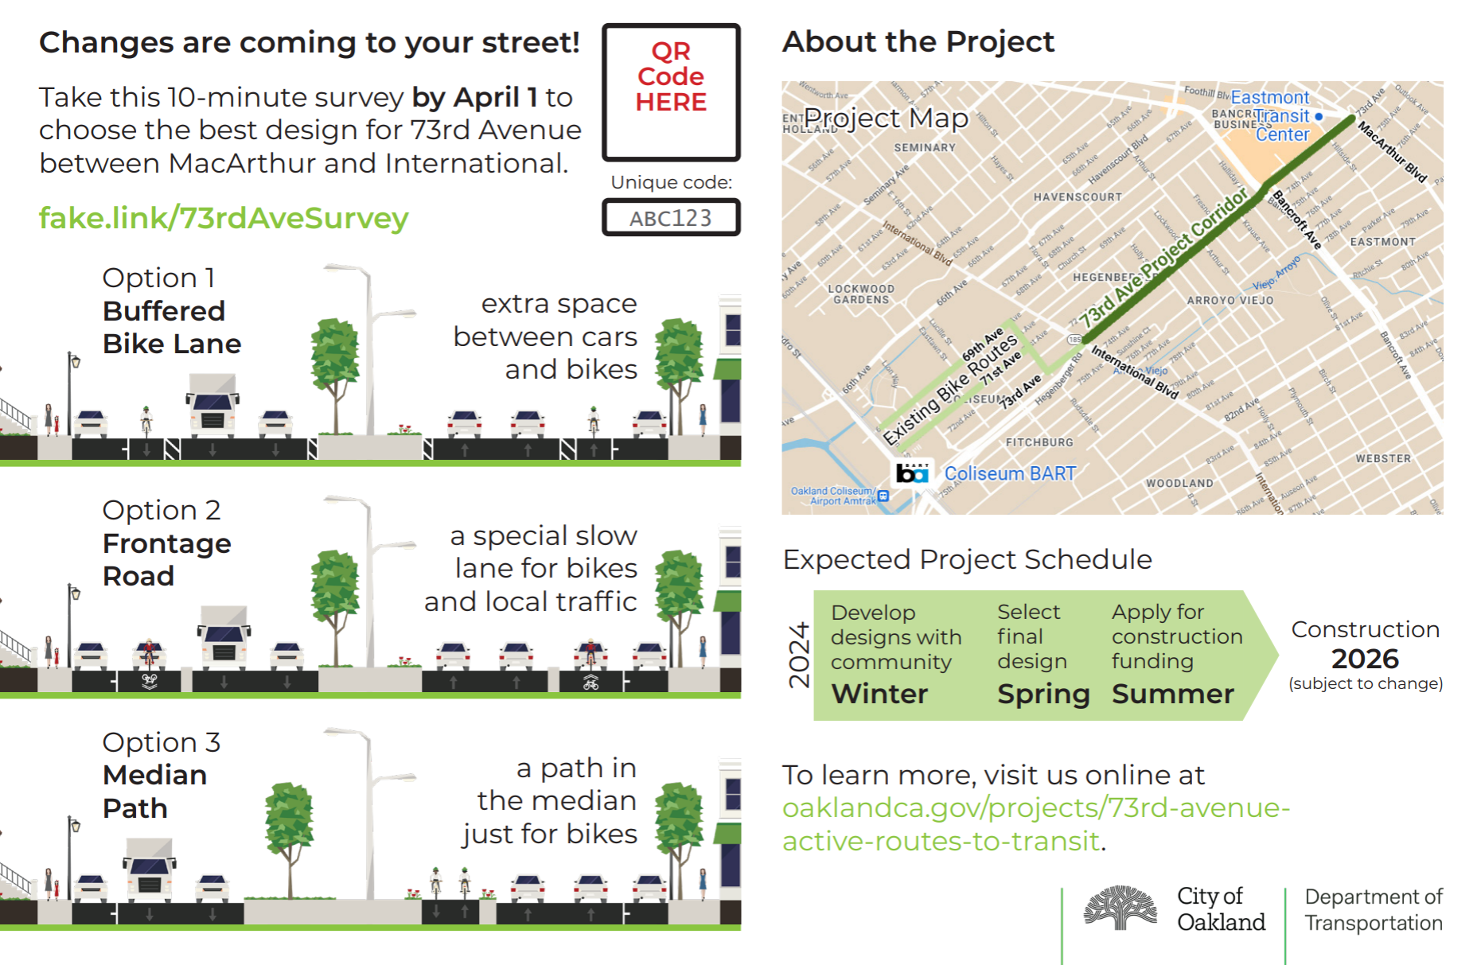
Current Grant Application
Outreach and Engagement
Postcards within .25 miles radius
Door hangers
Presented at 30X and 30Y
Met with Markham Elementary
Met with parents of Markham
Pop up flyer distribution at Coliseum BART Eastmont Center
Talked with small business
Online Survey
Met with Fire
Met with AC transit
Notes:
- Distributed 2000 mailers to residents within a .25 mile of project with unique code
- left door hangers at every address along project extent to ensure residents were aware.
- talked to small businesses to hear concerns
- parking is a big issue
- multiple conversations with AC transit
- learned they want pull out stops in stead of in lane because of traffic speed
- happy to consolidate buses
- talked through preference for bus location

Slide 10
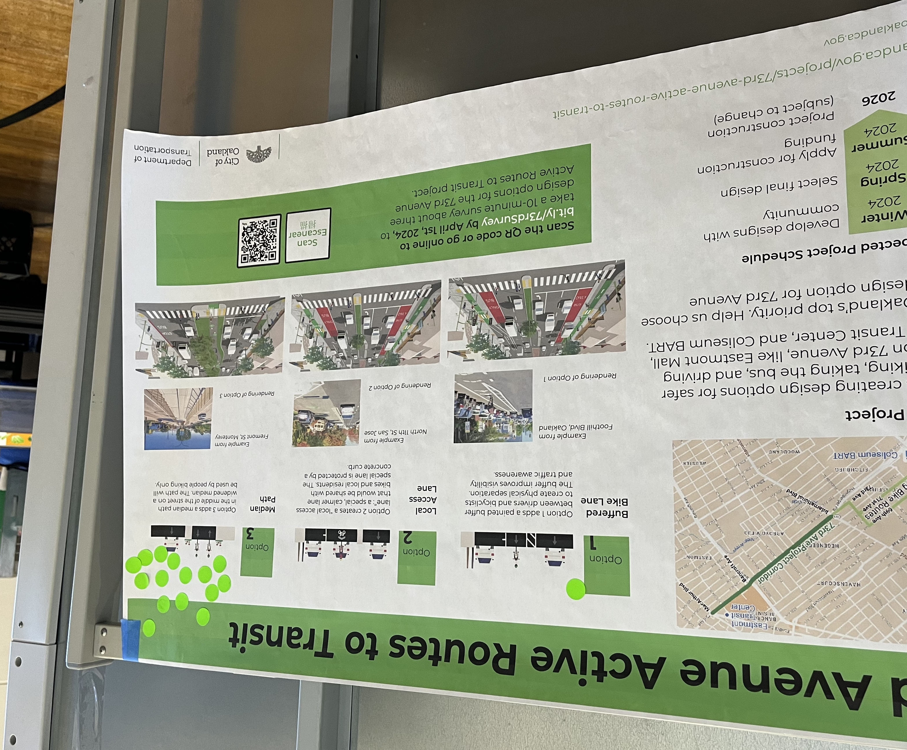
Current Grant Application
Key Themes of Engagement
Prioritize safety of people walking and biking
Make it easier to cross 73rd Ave
School drop off pick up zone creates disruption on 73rd Ave
More traffic enforcement
Uncomfortable to walk/ need more trees
Don’t remove any lanes of travel
Notes:
Aside from this people talking about blights, potholes and bueatification

Slide 11
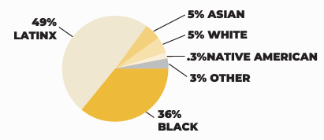
Survey Results
Demographics: Who responded?
680 total respondents
279 within 0.25 mi
* Out of 635 respondents who provided demographic info. Some respondents may have checked multiple races or genders.
DEMOGRAPHICS IN EAST OAKLAND
(Source: EOMAP, ACS 2017-2021)
Notes:
# RESPONDENTS: 680
RACE/AGE/INCOME: Majority of respondents where largely white, male ages between 36-49 with and income higher than 100K. Compare to 49% Latine/x in East Oakland
RESIDENCY: 279 of 680 respondents lived within 0.25 mi of the project corridor
MODE SPLIT: 7% of respondents bike compared to 5% of Central East Oakland residents

Slide 12
Survey Results
Top Choice
The Median Path was the preferred option across all demographic groups and modes of travel.
Note: Residents within the project area (0.25 mi) preferred the Buffered Bike Lane over the Local Access Lane as their second choice.
Notes:
Strong preference for Median Path option
Consistent across all demographic groups and typical modes of travel
Majority of respondents drive on 73rd, both overall and within the project area
680 total responses
378 not in project area
260 within project area
EMC survey in the 2019 Bike Plan Update “Let's Bike Oakland”

Slide 13
Survey Results
Mode use and Top Choice

Slide 14
Current Grant Application
Key Themes of Survey
Compared to the street today, do you think each design is better for biking, walking, taking the bus, or driving?
Buffered Bike Lane | Pct | In general | Walking | Biking | Taking the bus | Driving | Sum of all | Pct
Much better | 11% | 75 | 69 | 86 | 71 | 42 | 343 | 10%
A little better | 42% | 284 | 146 | 283 | 200 | 95 | 1008 | 30%
No difference | 25% | 167 | 343 | 146 | 235 | 321 | 1212 | 36%
Worse | 19% | 130 | 85 | 130 | 91 | 158 | 594 | 17%
I don't know | 1% | 7 | 12 | 10 | 58 | 35 | 122 | 4%
(blank) | 3% | 17 | 25 | 25 | 25 | 29 | 121 | 4%
Local Access Lane | Pct | In general | Walking | Biking | Taking the bus | Driving | Sum of all | Pct
Much better | 24% | 160 | 148 | 160 | 104 | 67 | 639 | 19%
A little better | 34% | 231 | 193 | 229 | 208 | 162 | 1023 | 30%
No difference | 10% | 66 | 188 | 72 | 167 | 169 | 662 | 19%
Worse | 26% | 180 | 93 | 169 | 107 | 214 | 763 | 22%
I don't know | 1% | 10 | 19 | 18 | 55 | 31 | 133 | 4%
(blank) | 5% | 33 | 39 | 32 | 39 | 37 | 180 | 5%
Median Path | Pct | In general | Walking | Biking | Taking the bus | Driving | Sum of all | Pct
Much better | 45% | 306 | 251 | 411 | 155 | 140 | 1263 | 37%
A little better | 28% | 193 | 169 | 117 | 181 | 135 | 795 | 23%
No difference | 4% | 26 | 136 | 21 | 175 | 187 | 545 | 16%
Worse | 18% | 122 | 87 | 98 | 89 | 161 | 557 | 16%
I don't know | 1% | 9 | 16 | 14 | 54 | 32 | 125 | 4%
(blank) | 4% | 24 | 21 | 19 | 26 | 25 | 115 | 3%
Comments from community members:
Prioritization of traffic safety, especially curbing aggressive driving
Improve safety for walking and crossing the street
Maintaining vehicle capacity and overall speeds
Some requests for speed humps
Changes outside of OakDOT’s jurisdictions, such as traffic enforcement and blight removal
Notes:
Buffered Bike Lane
- Most respondents thought the Buffered Bike Lane would not make a difference or would be slightly better.
Local Access Lane
- About half of respondents said the Local Access Lane would be better across all modes, except for driving.
- More respondents thought this design would be worse.
~30% felt the Local Access Lane was worse for driving, despite the extra travel lane in each direction.
- Slightly more people left their thoughts blank.
Median Path
- Almost three quarters think the Median Path would be better in general.
- 60% think the Median Path would be better for walking.
- More than three quarters think the median path would be better for biking, with ~60% saying it would be "much better".

Slide 15
Staff Recommendation
Median Bike Path
Things to consider:
Crossings at major intersections.
Will this be a bike only path or multi-use trail
Mid block access to/from
Vehicle traffic closer to sidewalk
Increase in queue length at major intersections
Limited improvements to transit

Slide 16
Next Steps
Timeline
Concept Development
Concept Engagement
ATP Application
December 2023
February
June 2024
May 2024
100% Design
January 2024
~
September 2025
~
Final Concept
~
March 2024
  April 2024

Slide 17
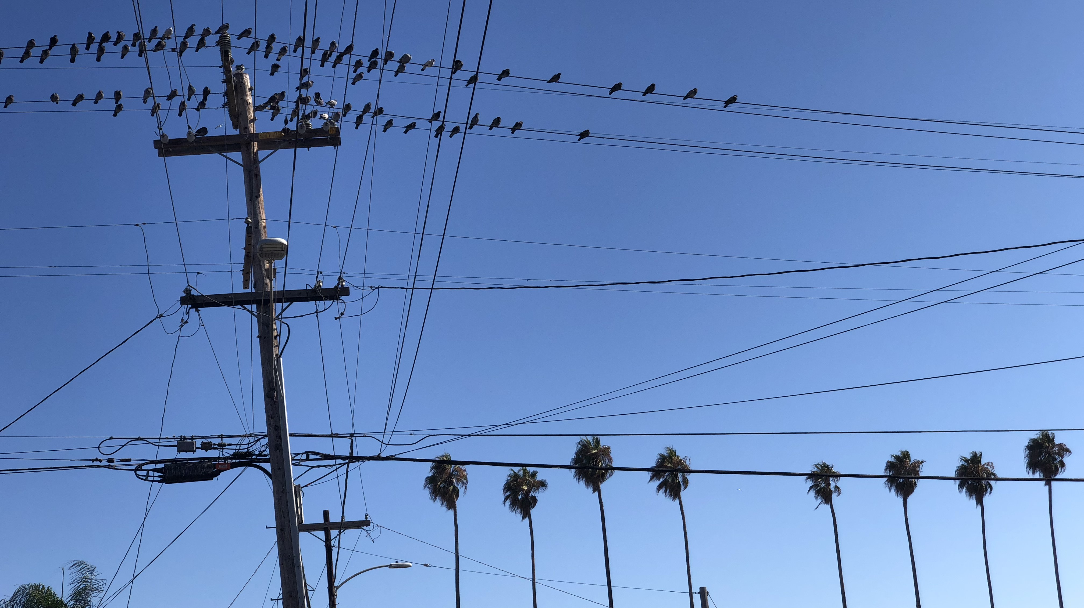
Questions/comments?

