Slide 1
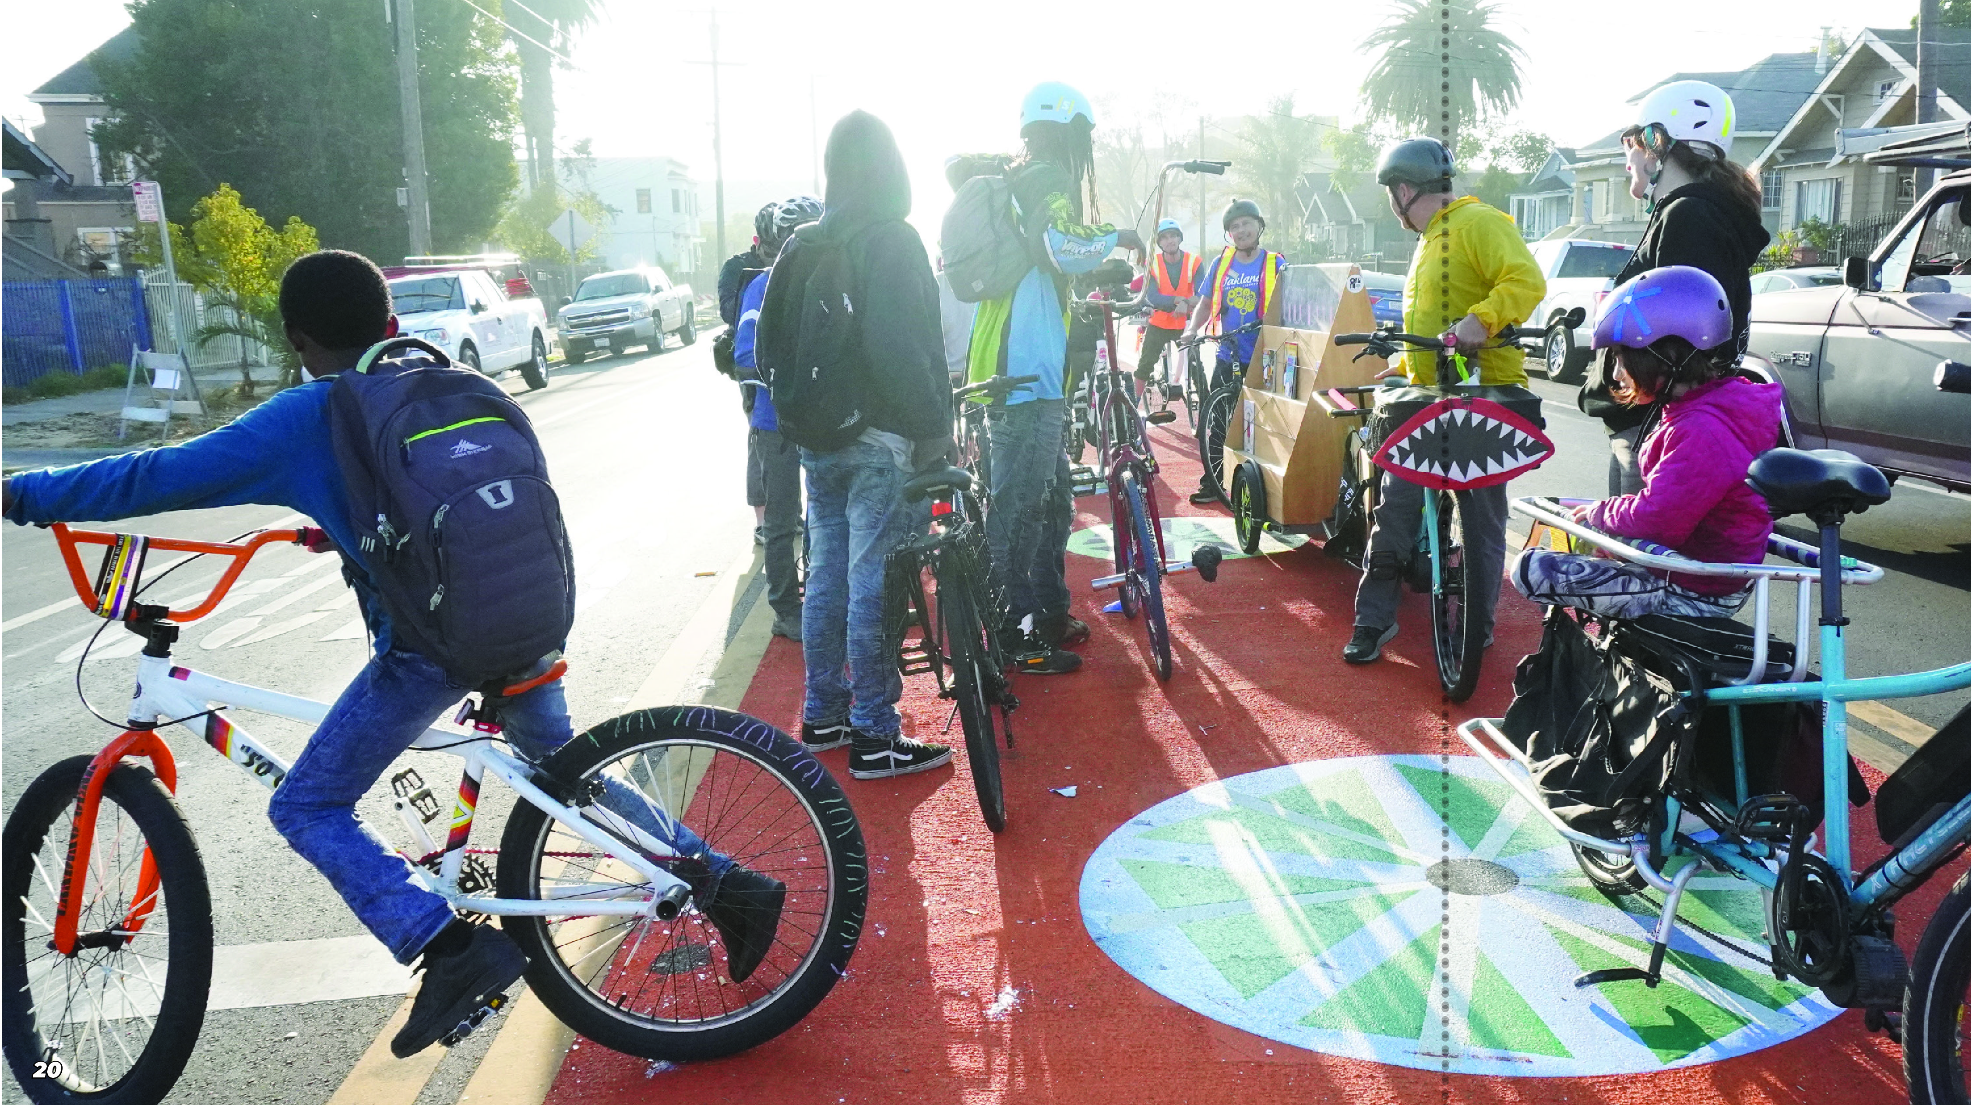
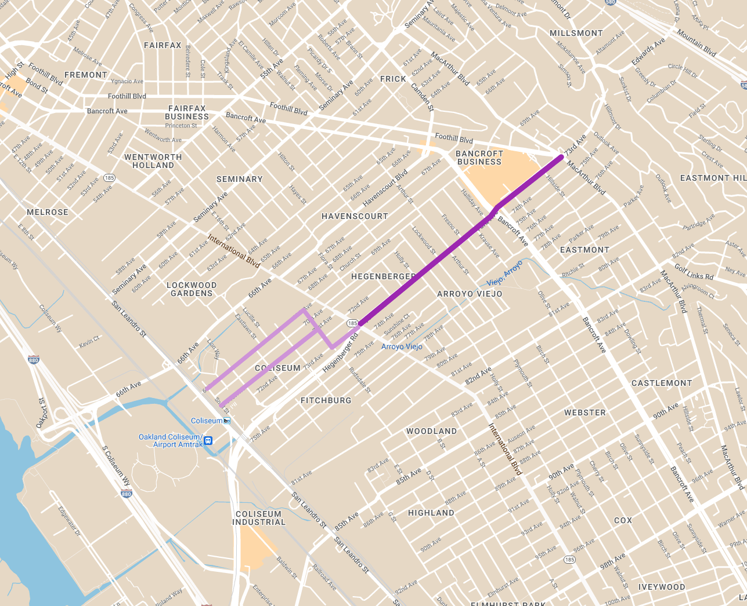

Introduction
73rd Ave Active Routes to Transit
Introduction
OakDOT is currently working on design plans to seek implementation funding for enhanced multimodal transportation infrastructure along 73rd Avenue, connecting the Eastmont Transit Center, Coliseum BART Station, and the newly constructed International Blvd Bus Rapid Transit (Tempo) system. This project seeks to prioritize safety enhancement for the comfort of transit users, pedestrians, and cyclists.
PROJECT AREA
https://www.oaklandca.gov/projects/73rd-avenue-active-routes-to-transit

Slide 2
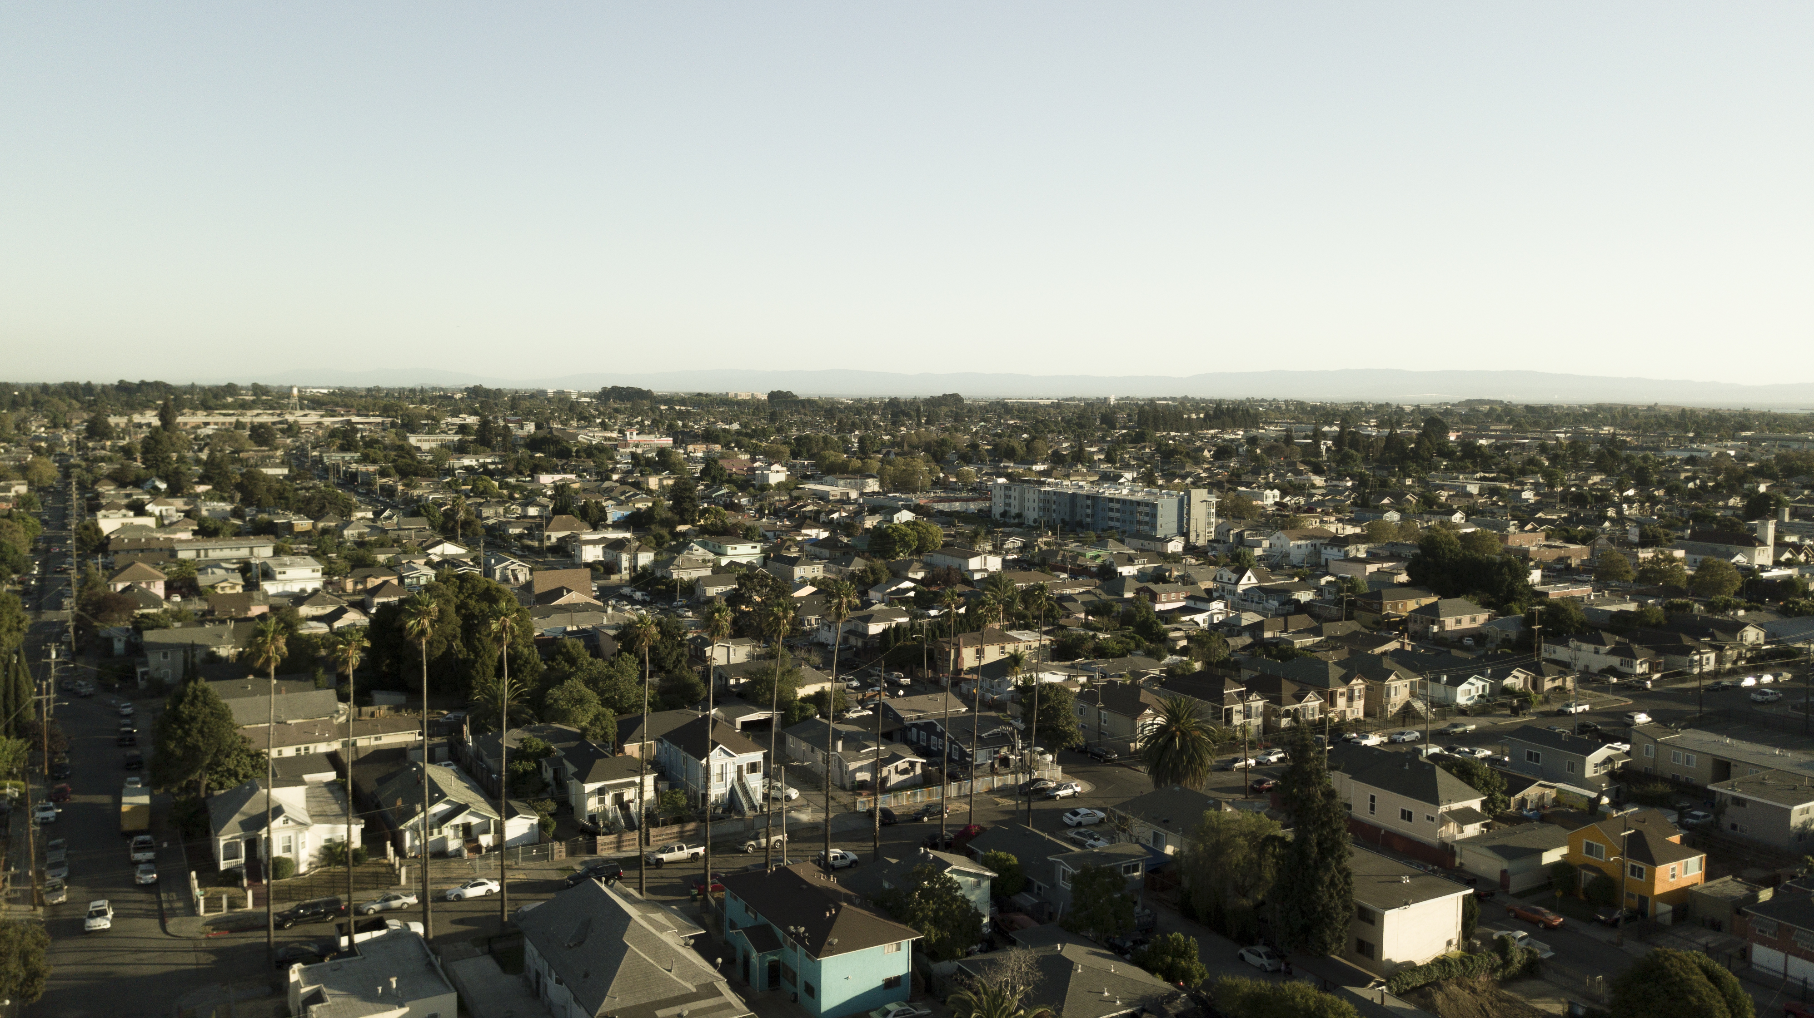
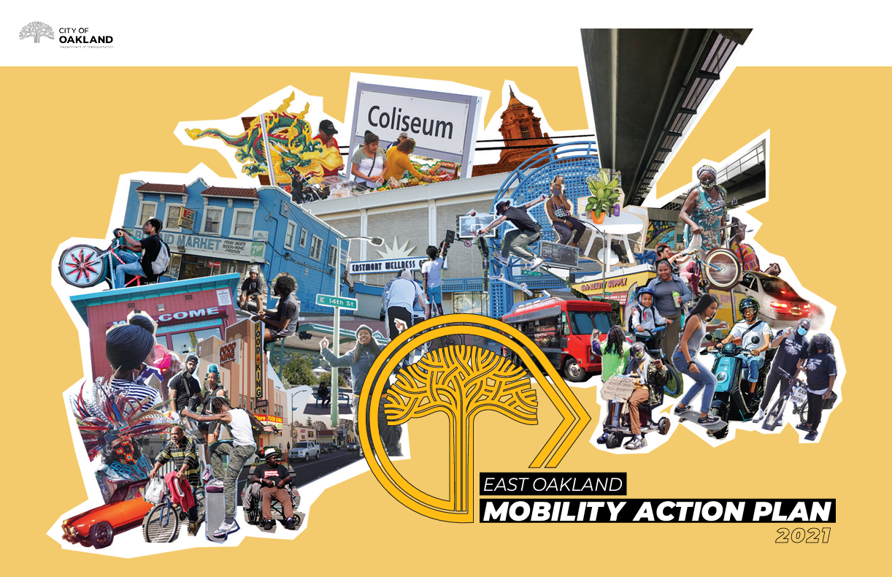
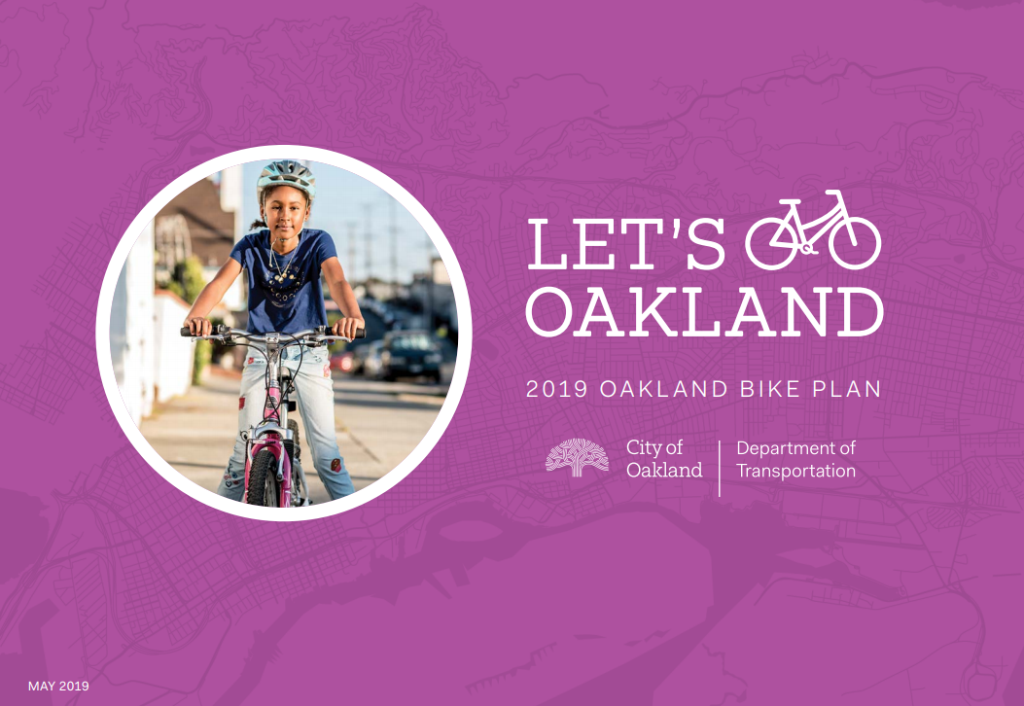
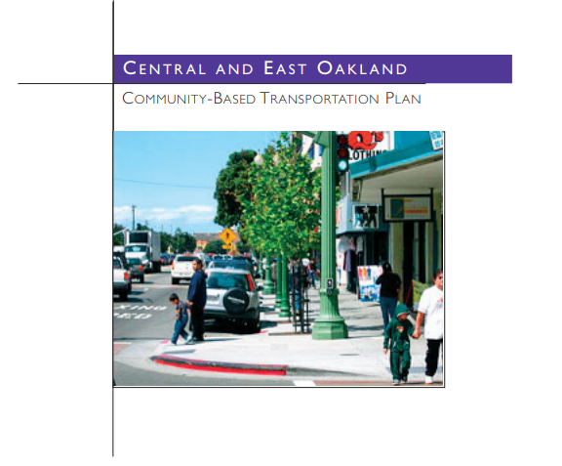
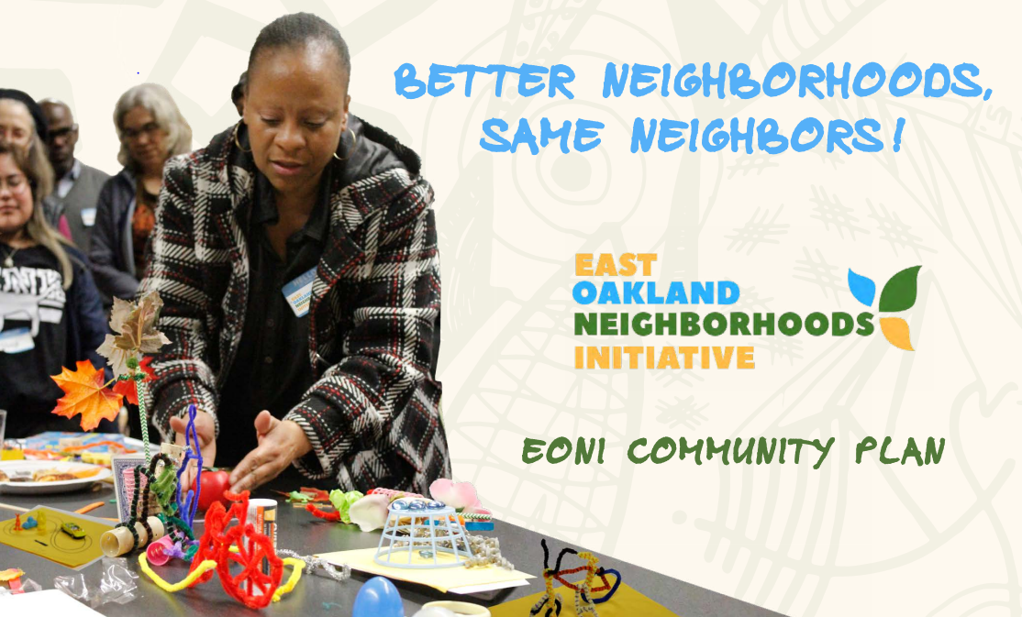
Background
Past Planning Efforts
Let’s Bike Oakland, Oakland Bike Plan Update (2019)
East Oakland Mobility Action Plan(2021)
East Oakland Neighborhood Initiative (EONI) Community Plan (2019)
East Oakland Community Based Transportation Plan (2007)
Notes:
The project was identified as a priority project in the 2019 bicycle plan update “Let’s Bike Oakland” and the 2021 East Oakland Mobility Action Plan (EOMAP).
We heard:
Safety concerns regarding speeding and bad driving behavior at intersections,
Security concerns biking and walking next to vehicle traffic due to potential exposure to drive-by assault.
Community members shared that they did not feel safe using the current bike facilities or crossing 73rd Ave to access the Eastmont Transit Center.

Slide 3
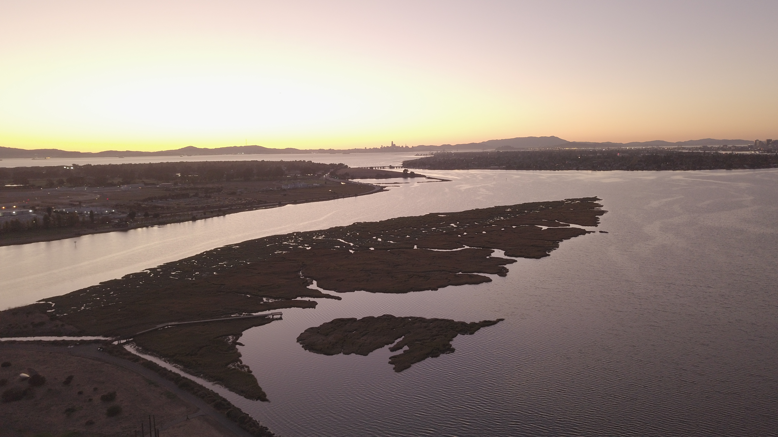
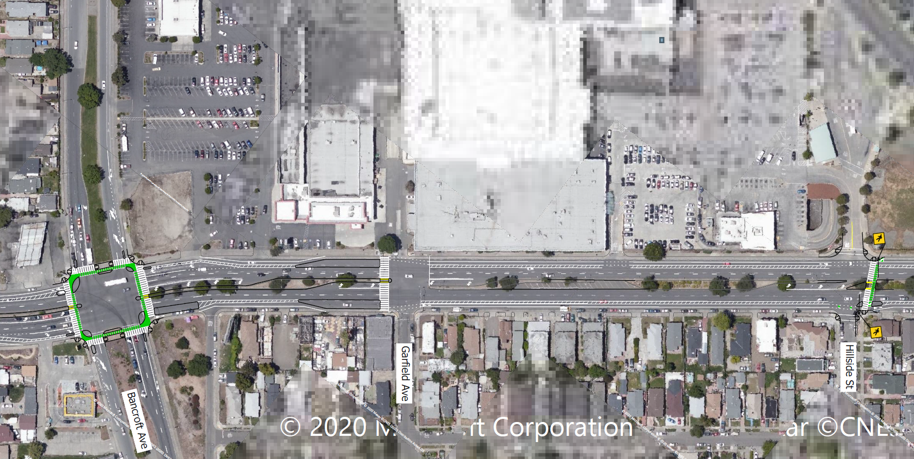
Introduction
Previous Grant Application
Active Transportation Program (ATP)
The purpose of the ATP is to encourage an increased use of active modes of transportation, such as walking and biking.
Design included:
Buffered bike lanes
Protected intersections
Bus boarding islands
New Pedestrian crossings
Extended medians
OakDOT applied in 2022
Notes:
Increase the proportion of trips accomplished by biking and walking.
Increase the safety and mobility of non-motorized users.
Advance the active transportation efforts of regional agencies to achieve greenhouse gas reduction.
Enhance public health
Ensure that disadvantaged communities fully share in the benefits of the program.
Provide a broad spectrum of projects to benefit many types of active transportation users.

Slide 4
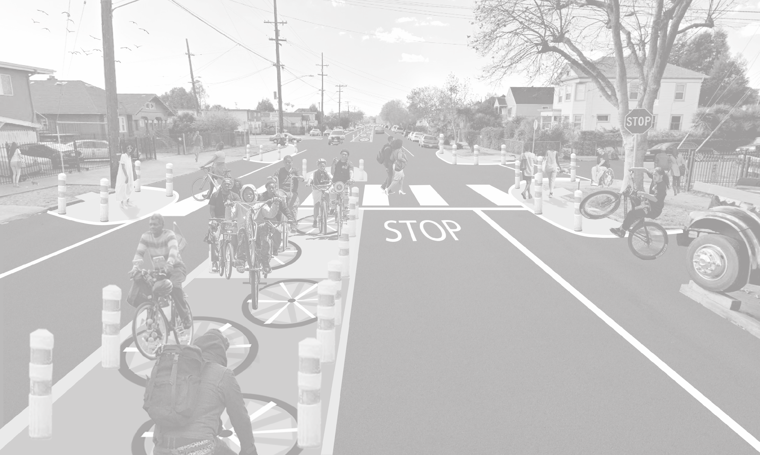
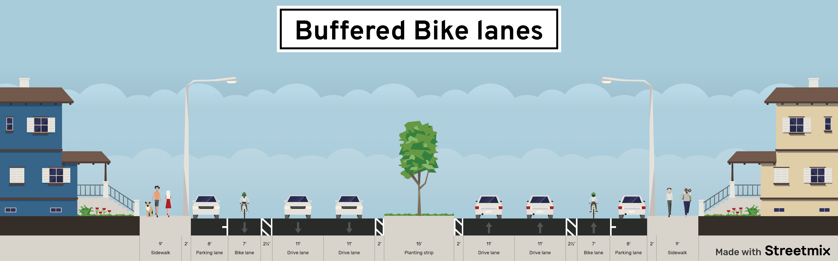
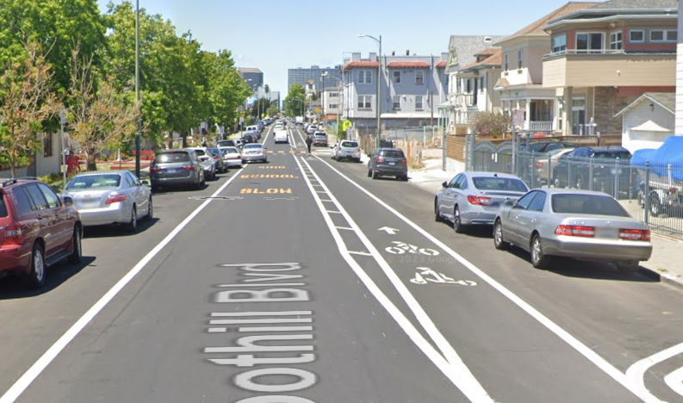
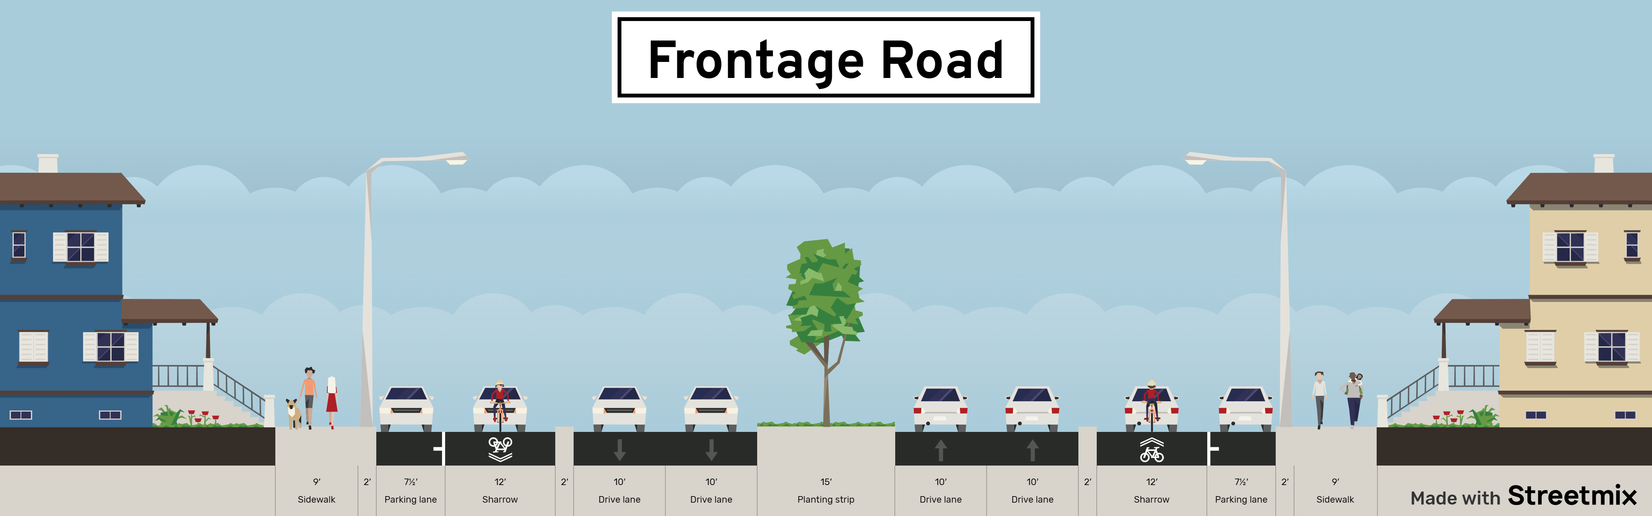
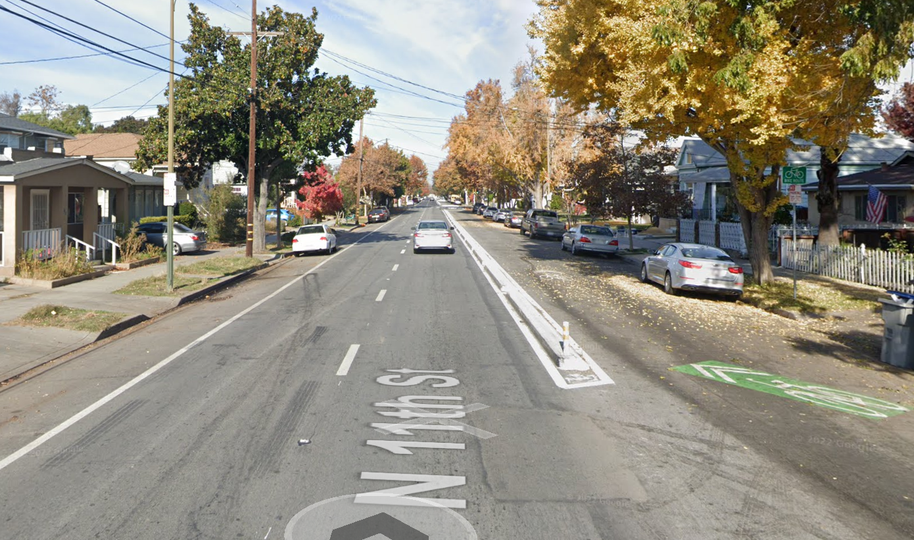

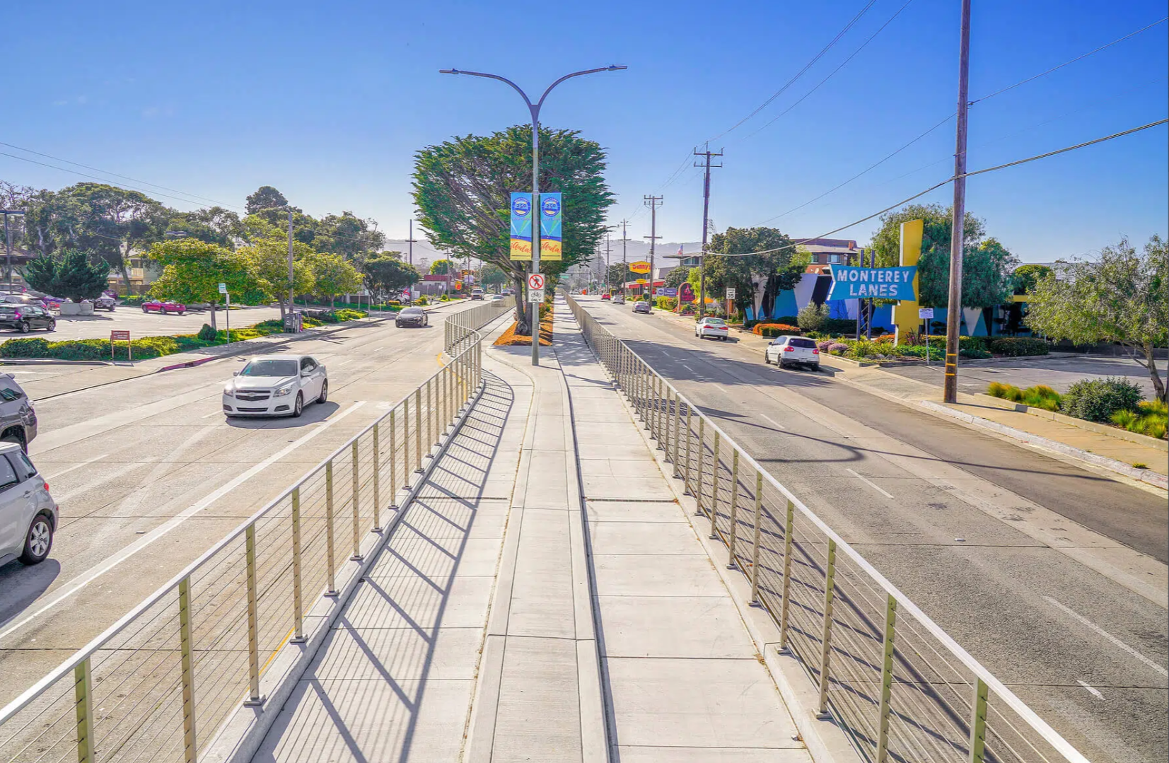
Next Steps
Example Projects
Design Alternatives
Foothill Blvd – Oakland, CA
11th St – San Jose, CA
N Fremont St – Monterrey, CA

Slide 5
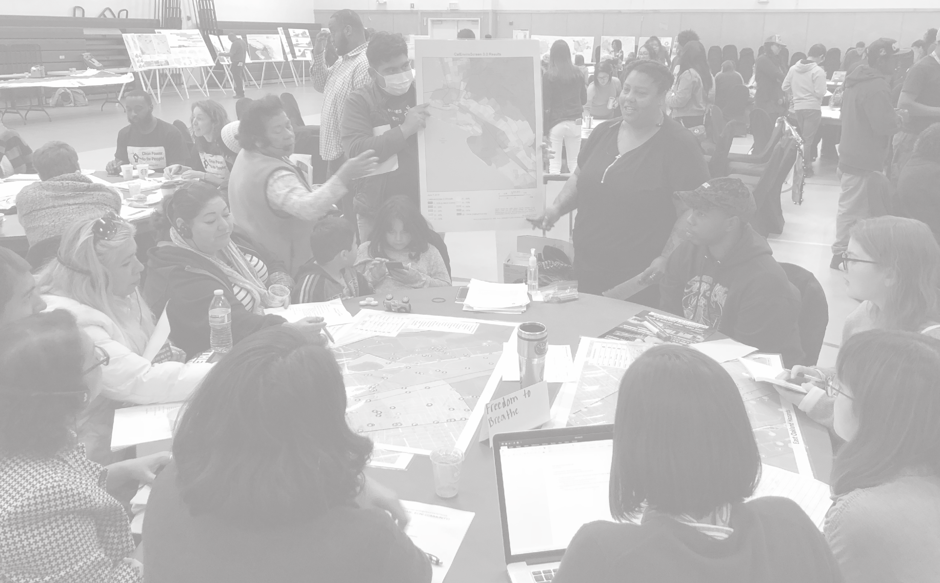
Next Steps
Outreach and Grant Development
Initial Outreach
November – December 2023
Concept Engagement
January – May 2024
3 Concepts Developed
December 2023
1 Finalized Concept
March 2024
ATP Application
June 2024

Slide 6
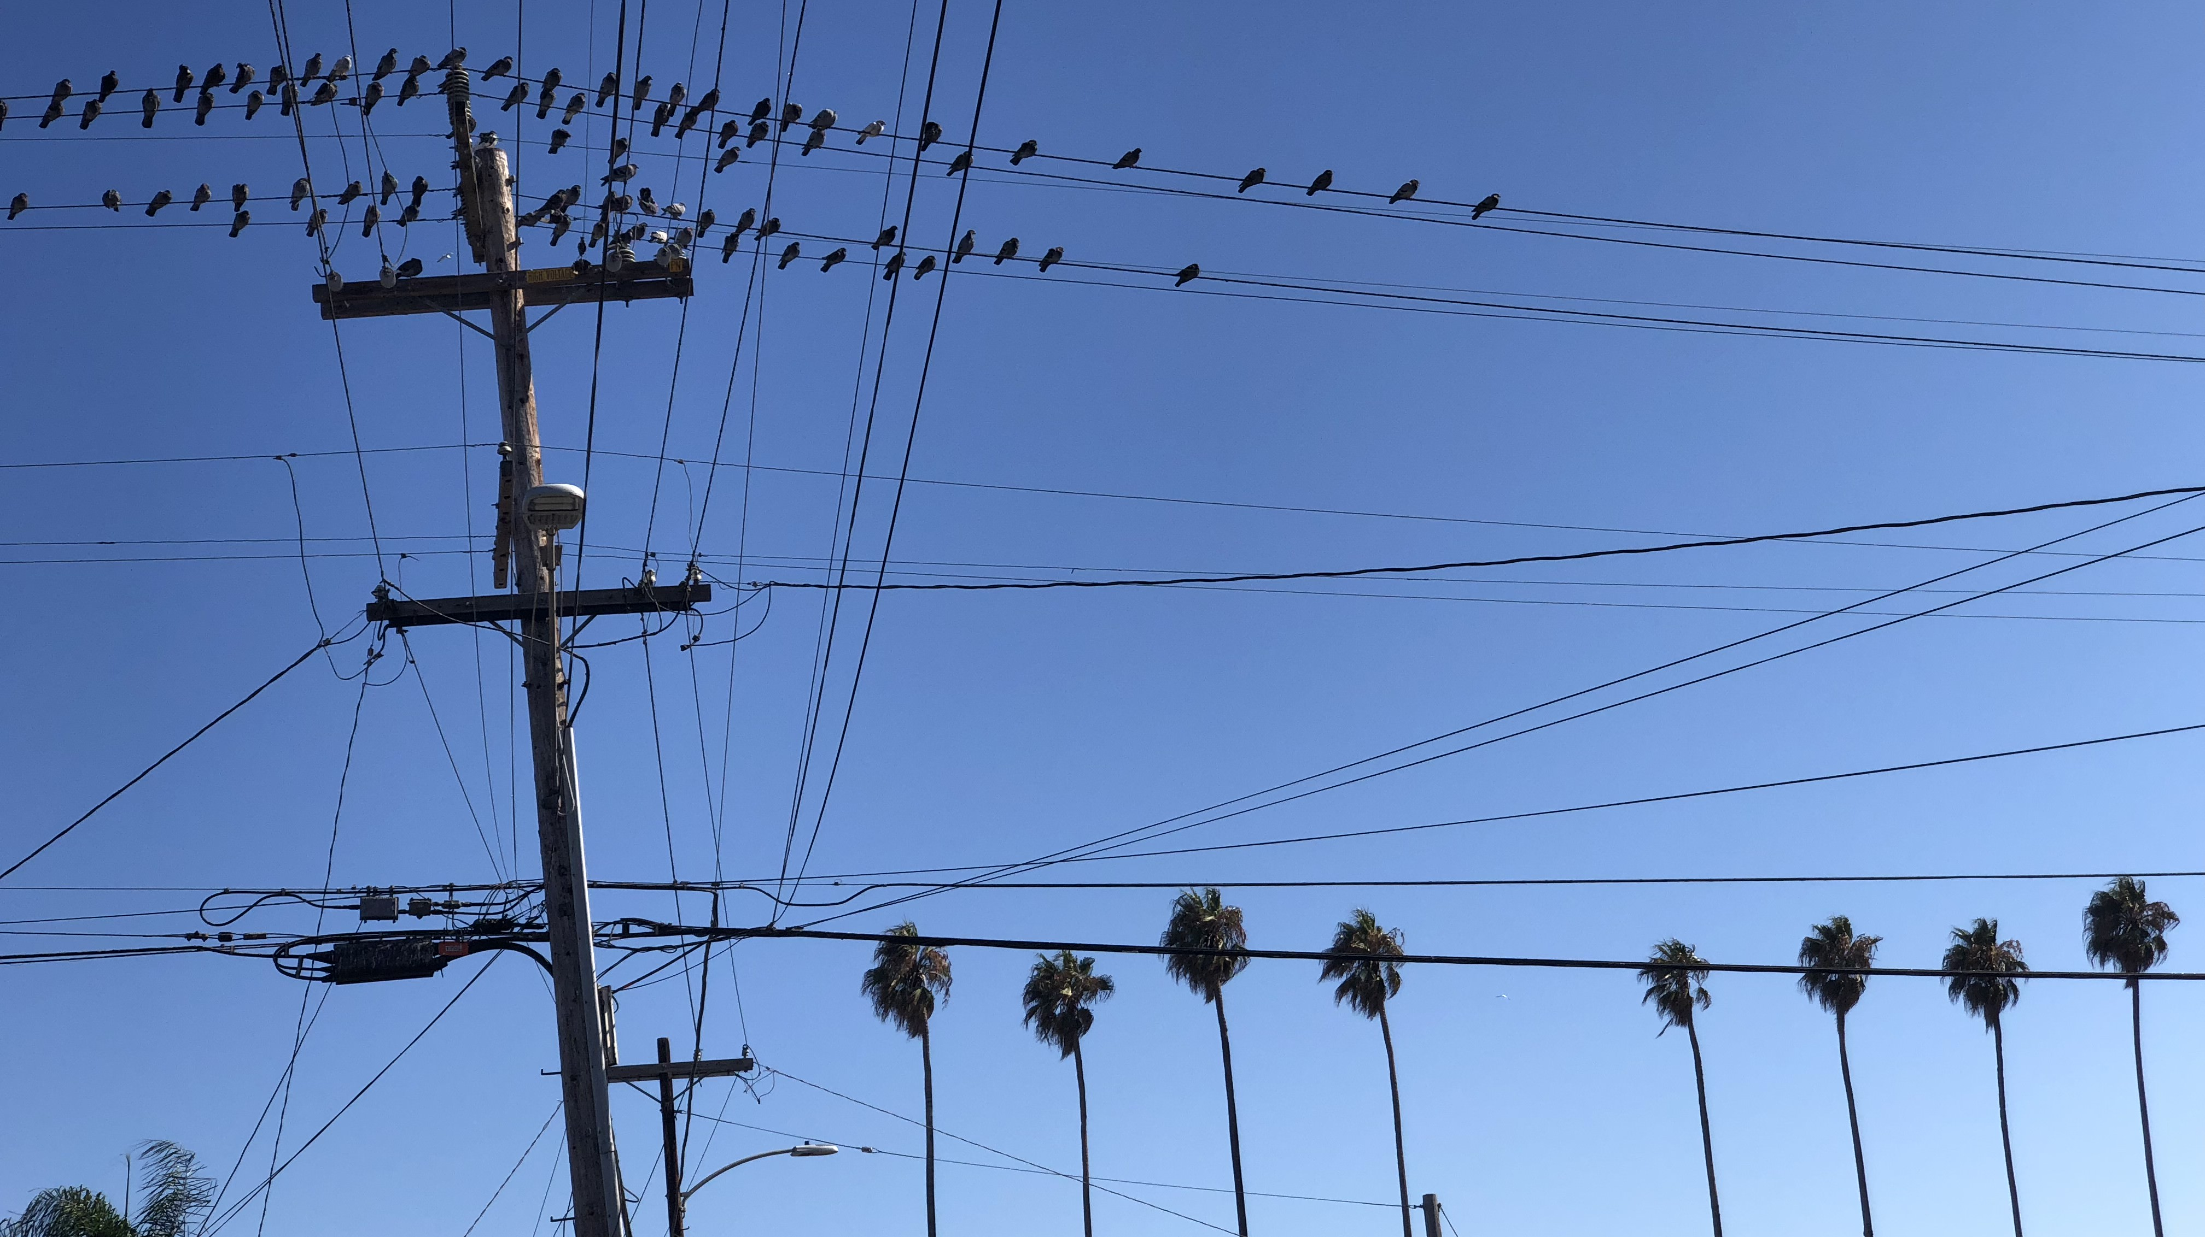
Thank you!
Any questions or comments please email me at: mcorona@oaklandca.gov

