Slide 1
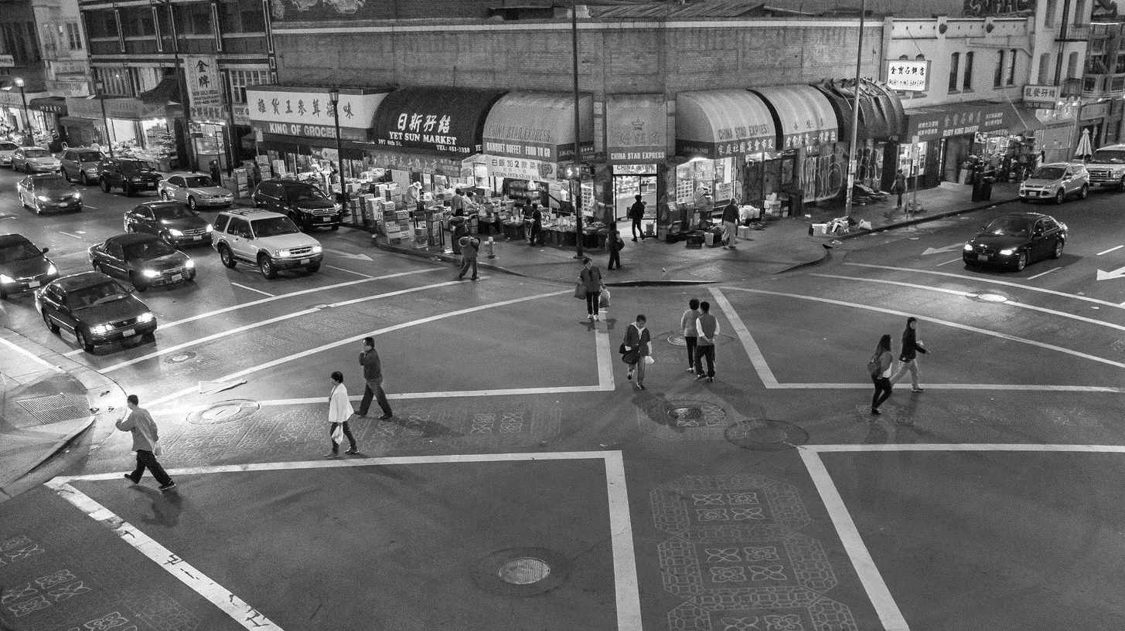
Chinatown Complete Streets Plan
June 15, 2023 | BPAC | Manuel Corona

Slide 2
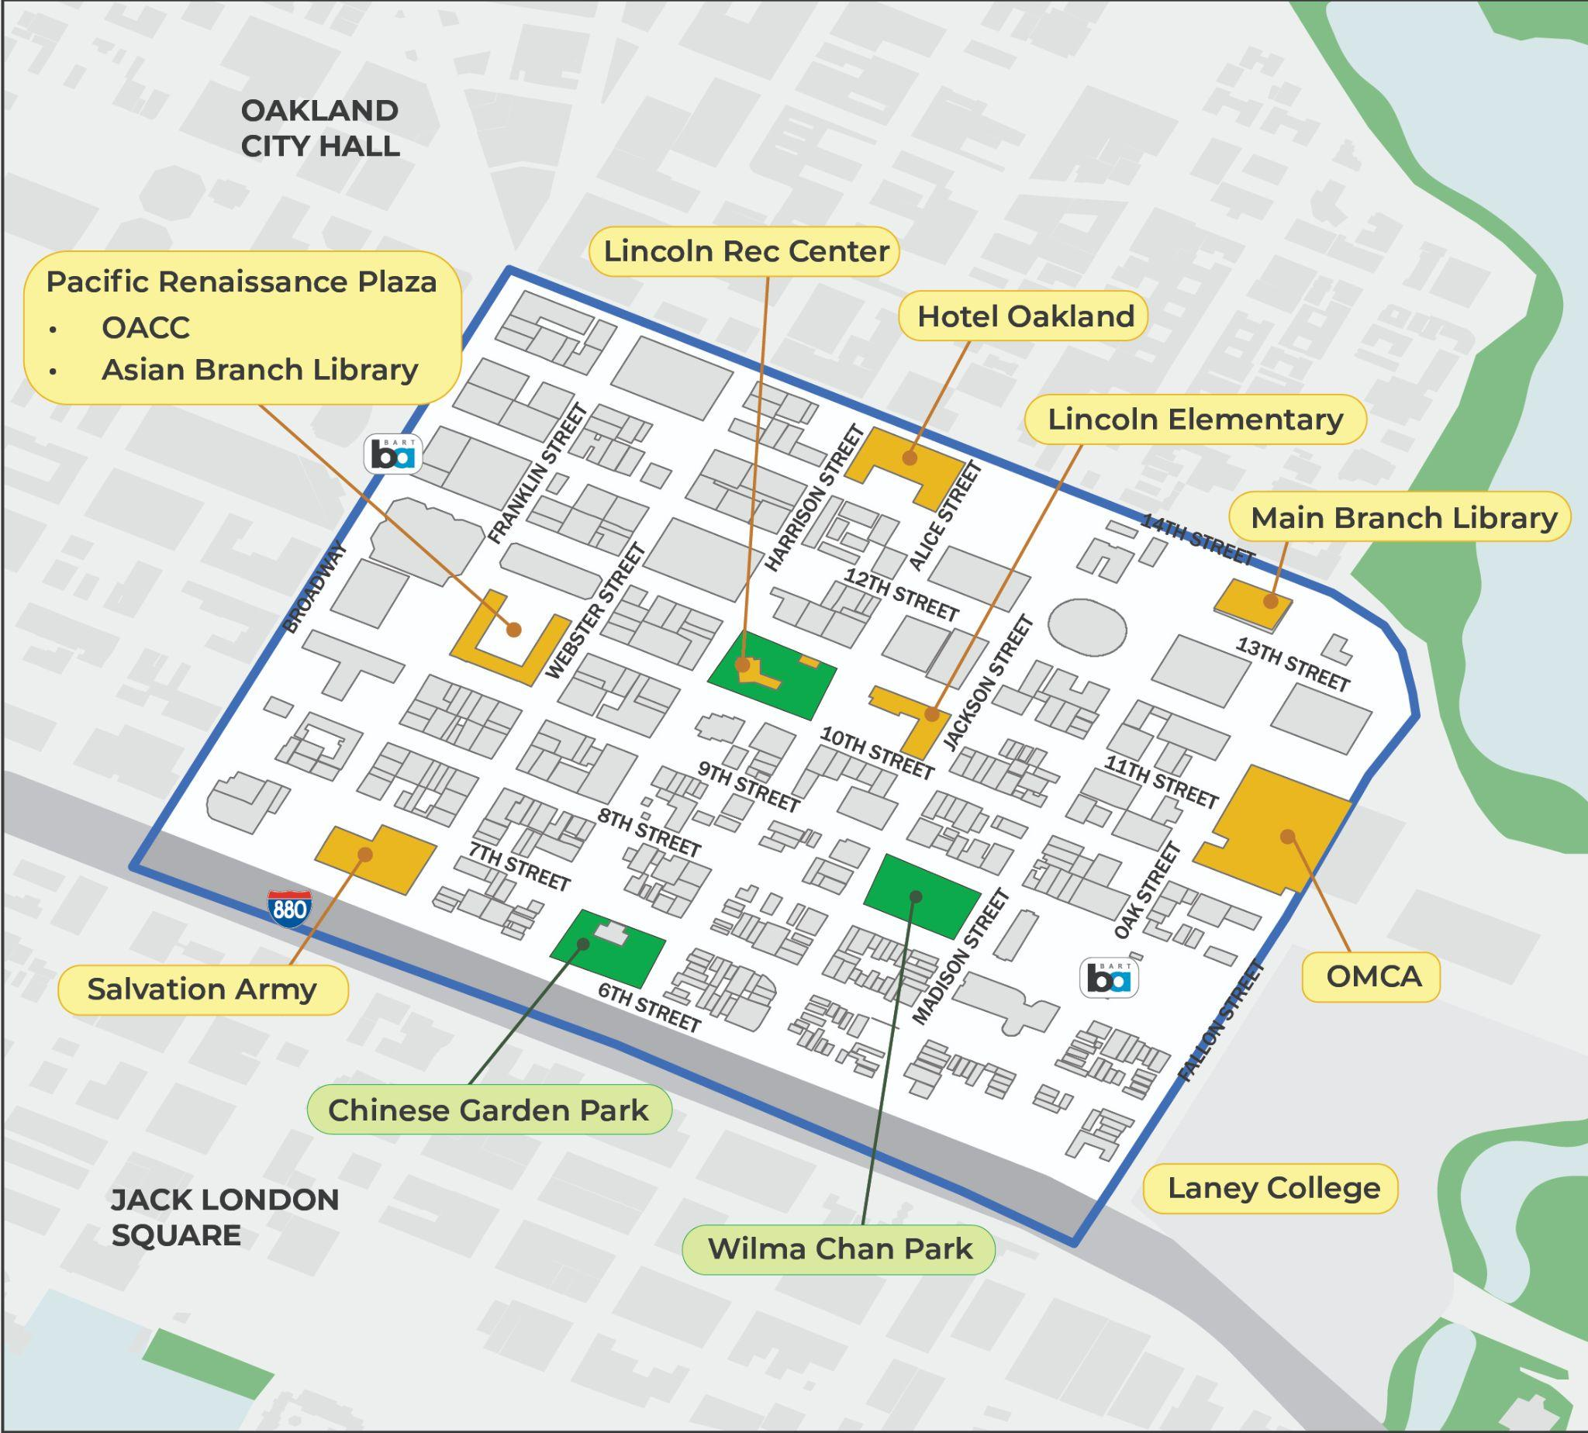
OUTLINE
Plan Overview
Goals
Timeline
Engagement
Plan Development
Previous Studies
Corridor Selection
Next Steps

Slide 3
Plan Overview

Slide 4
Plan Overview
Goals
Create a path for implementation of community-developed and approved projects.
Work with community members and local non-profits to identify a set of key corridors with multimodal upgrades.
Complete the conceptual designs necessary to advance the project for future construction grant funding opportunities.
Coordinated with future developments or regional projects.
Project Website:
www.oaklandca.gov/projects/chinatown-complete-streets-plan
Notes:
The goals of the plan are to prioritize corridors to go after funding. The City of Oakland has partnered with EBALDC to engage with community members, local business owners and Chinatown leaders to identify a set of key corridors with a suite of upgrades for all types of roads users to create safer streets. Once we nail down the 4 corridors and elements we want, in conjunction with the planning process this plan will develop conceptual designs iteratively. with for future construction grant funding opportunities and/or coordinate with future developments that will position Chinatown to safely accommodate new residents and visitors.
This plan will shift the course for Oakland's Chinatown by creating a path for implementation of community-developed and approved projects
noting that timeline of previous plans 20 + years in the making and still some time out before building
New information 7th st will be tried to the new CIP scoring process and can potentially get improvements done on a quicker timeline
Sustainable Transportation Plan Caltrans
Working with EABLDC for engagement

Slide 5
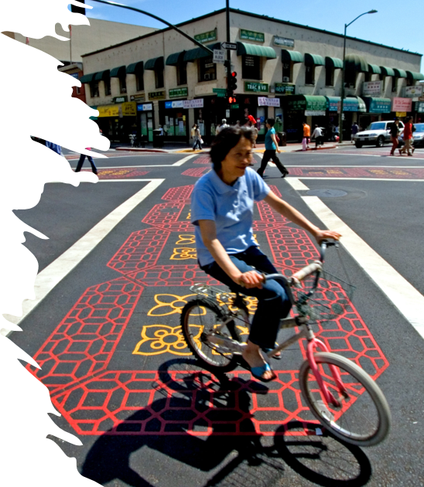
Plan Overview
Timeline
Phase 1
Examine past planning recommendations and identify a set of key corridors for development (up to 4 budgeted).
Phase 2
Agree on final project description for multimodal upgrades on key corridors and connection points
Phase 3
Perform conceptual designs for capital improvements on key corridors
Expected Outcome
Designs ready for grant development
Notes:
This timeline details the phases of how to get to the outcome of designs ready for implementation. Phase 1 is to identify four key corridors for improvement in Chinatown. Phase 2 is to agree on final project descriptions for multimodal upgrades. Phase 3 is to have the conceptual designs for capital improvements ready for implementation

Slide 6
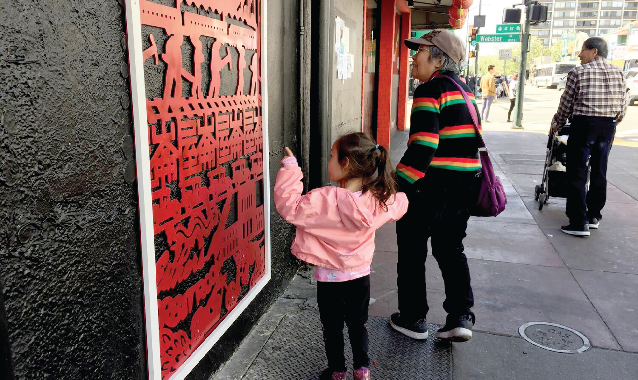
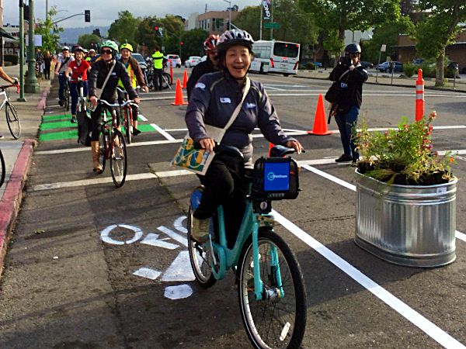
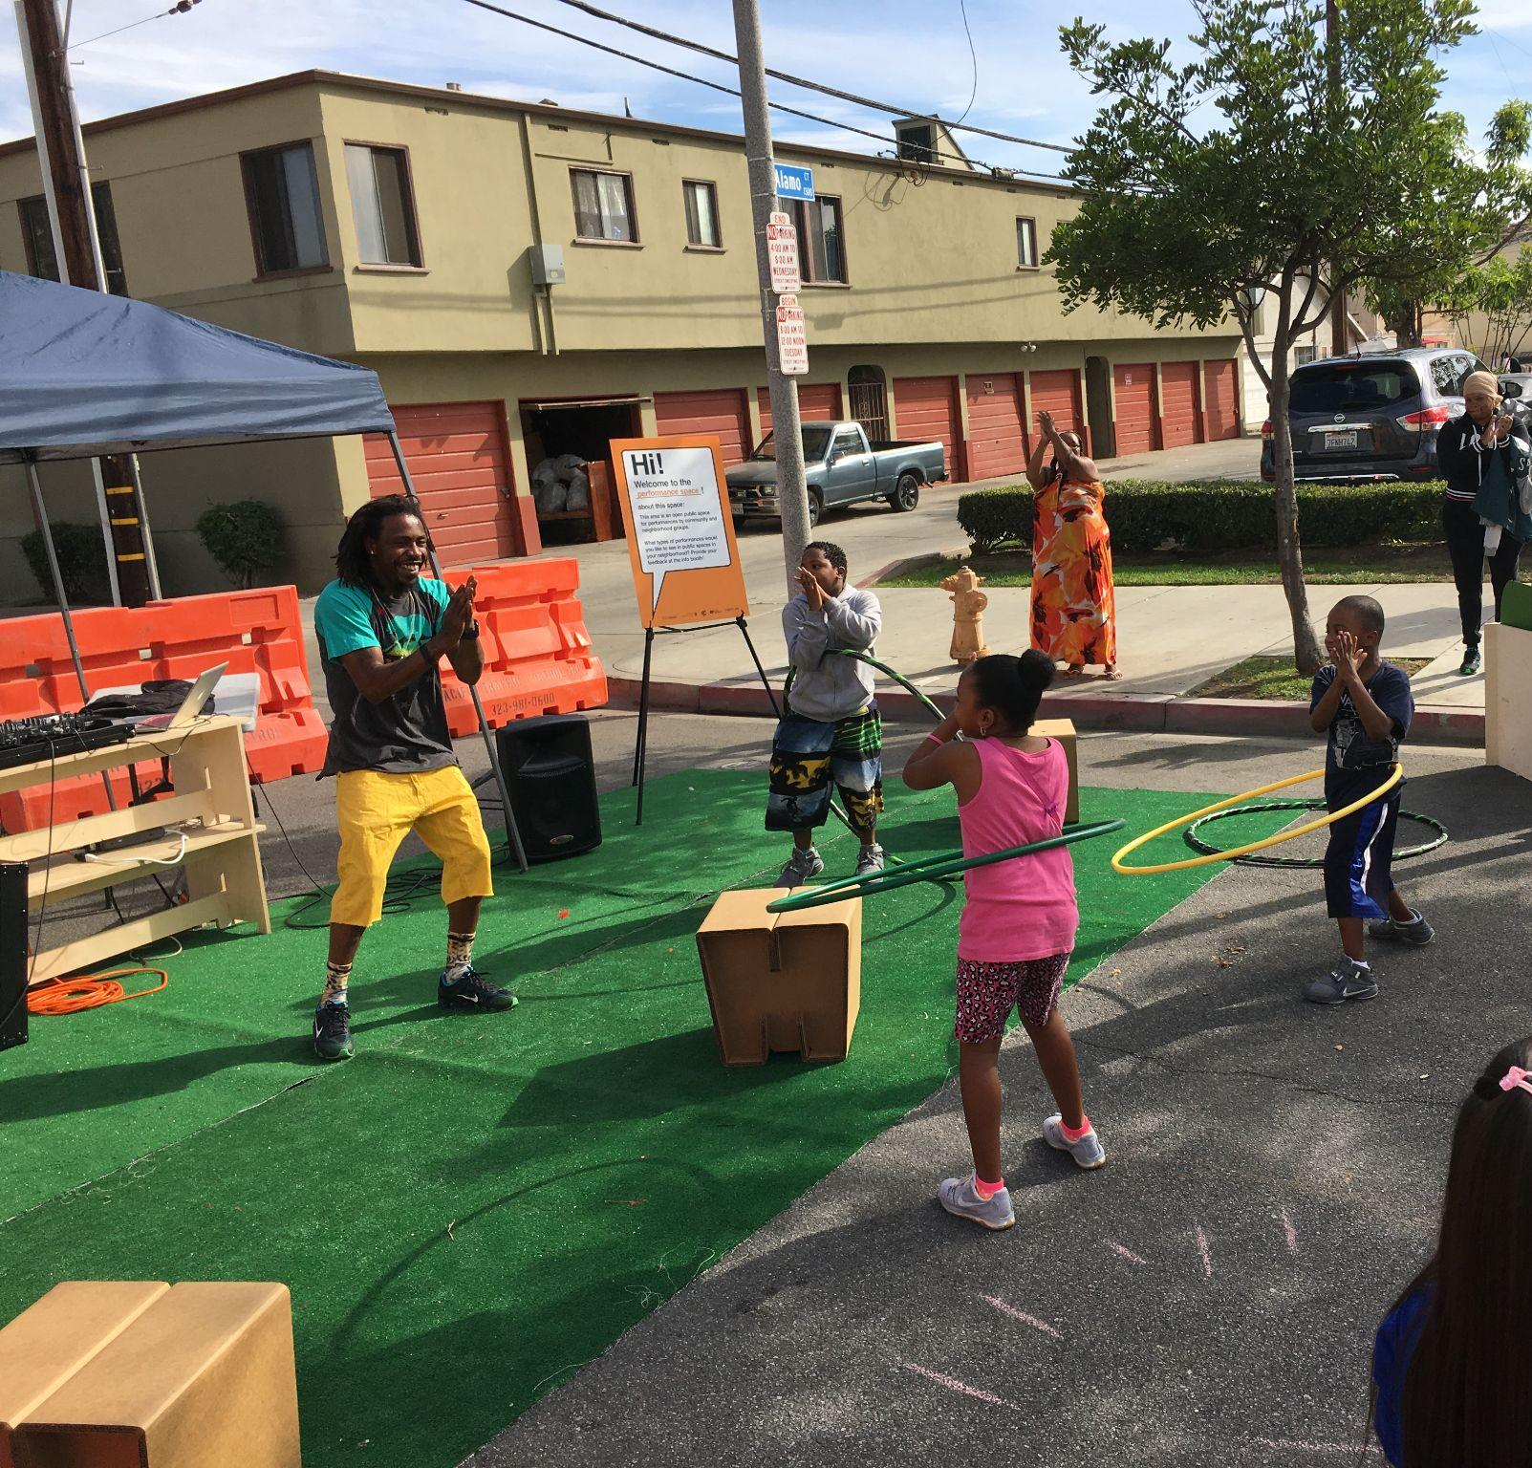
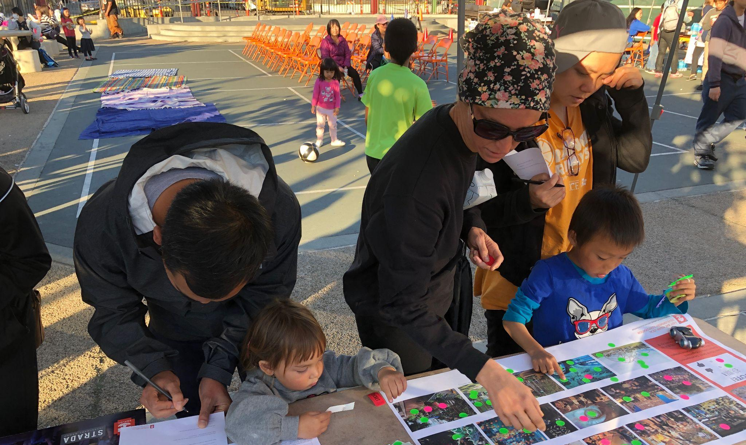
Plan Overview
Engagement
Technical Advisory Committee (TAC)
Neighbor Group Discussions
Survey/ Social Media
Sitewalk Workshop
“Pre-Enactment” Event: A Temporary Complete Streets Installation

Slide 7
Plan Development

Slide 8
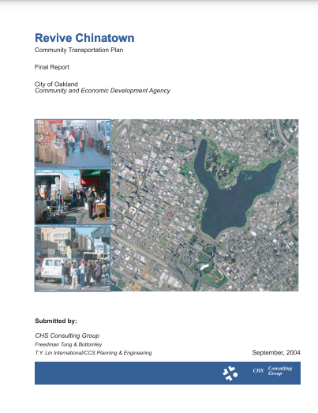
Plan Development
Previous Plans
Lake Merritt Station Area Plan (2017)
Oakland Walks! Pedestrian Plan (2017)
Let’s Bike Oakland (2019)
Revive Chinatown
Community Transportation Plan (2004)
Lake Merritt BART
Station Access Plan
(2004)
Notes:
-Some of these are very old. Implementation is slow, citizens get frustrated, accountability to progress
-Some plans focus on Lake Merritt BART area and connectivity as opposed to within Chinatown
-Some of the recommended projects may already have been implemented
-Worked on organizing data/recommended projects but some recommendations are easier to define geographically than others
-Some intersections and streets come up the most across these plans

Slide 9
Plan Development
Previous Plans Street Improvements
Parking | Bike Infrastructure | Traffic Signals | Crosswalks | Intersections | Curb Extensions | Sidewalks | Traffic Lanes
8th Street Franklin Street 10th Street 11th Street Harrison Street | 8th Street Franklin Street Madison Street 9th Street 11th Street Oak Street | 9th Street Franklin Street 7th Street Harrison Street Madison Street Oak Street | 7th Street 8th Street Harrison Street Fallon Street 9th Street | 8th Street Harrison Street 7th Street Franklin Street | 7th Street 8th Street Harrison Street Jackson Street Madison Street Oak Street | 7th Street Jackson Street Madison Street 9th Street 11th Street | 11th Street 10th Street
Notes:
The recommendations from these plans show up in the pros/cons list of each of the 6 corridors later in the presentation, so we don’t have to go into these in detail.

Slide 10
Plan Development
Previous Plans Intersection Improvements
Intersection | Bike Infrastructure | Traffic Signals | Crosswalks | Intersections | Curb Extensions | Sidewalks | Traffic Lanes
8th Street-Fallon Street |  |  | 5 |  | 2
8th Street-Franklin Street |  | 1 | 3 | 2
8th Street-Harrison Street |  |  | 3 | 1 | 2
7th Street-Fallon Street |  |  | 2 | 1 |  | 1 | 1
7th Street-Harrison Street |  |  | 2 | 1 | 1 | 1 | 1
10th Street-Oak Street | 1 | 1 |  |  |  |  | 1
7th Street-Oak Street | 1 | 1 |  |  | 1 | 1
9th Street-Harrison Street | 2 | 1 | 1

Slide 11
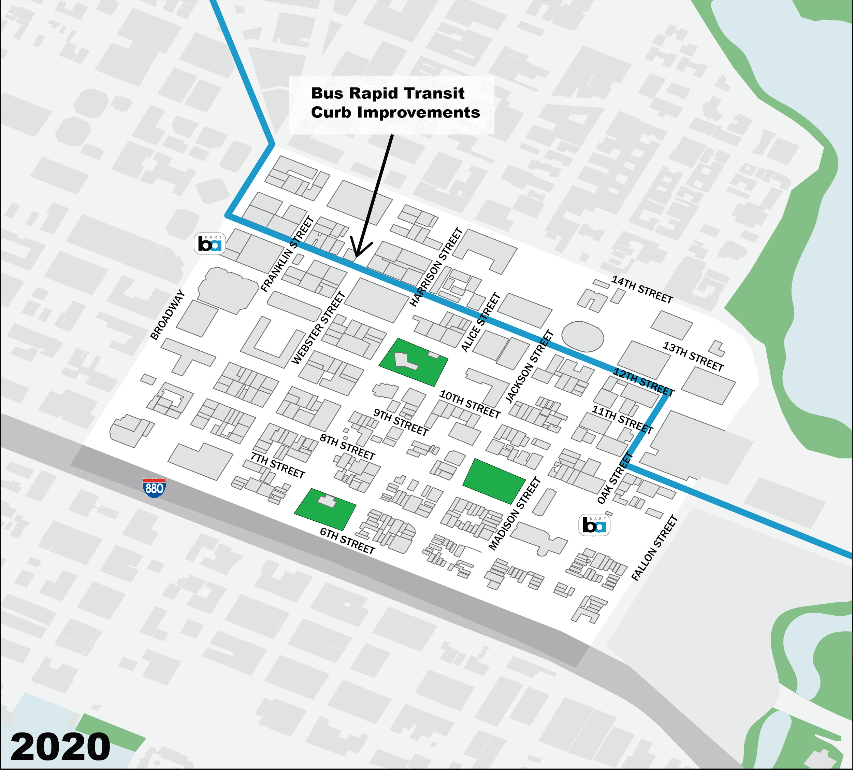
Plan Development
Corridor Selection
Major Transportation Projects
14th Street Safety & 13th Street Paving Project
Bus Rapid Transit Curb Improvements
10th Street Safe Routes to School & Pedestrian Improvements
Bikeway Improvement Project
Lake Merritt BART TOD
8th Street Streetscape Improvements to BART
Alameda Access Project
Traffic Signal Improvements
Broadway Streetscape Improvement Project
https://linktr.ee/majortransitprojects
Notes:
Aside from the - 14th Street Safety Project and theOakland Alameda Access Project, most of these improvements are at spot locations
This is plan is a chance to get something big done, through the heart of Chinatown, planned for and by the community. Think Big!
14th Street Safety & 13th Street Paving Project - OakDOT
Bus Rapid Transit Curb I
10th Street Safe Routes to School & Pedestrian Improvements - OakDOT improvements - AC Transit
Bikeway Improvement Project - OakDOT
Lake Merritt BART TOD - EBALDC & Strada
8th Street Streetscape Improvements to BART - OakDOT
Alameda Access Project - ACTC
Traffic Signal Improvements - OakDOT
Broadway Streetscape Improvement Project - OakDOT

Slide 12
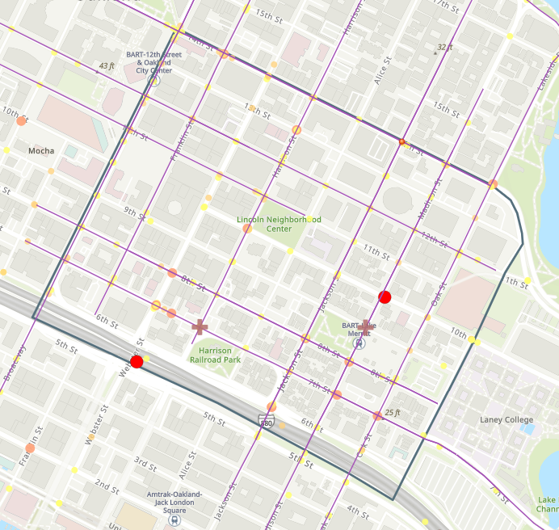
Plan Development
Corridor Selection
GIS Data
Existing projects
Equity data
Proposed major projects
Crash data
Previous plans data
Streetlights
Chinatown CCS Draft (arcgis.com)
Notes:
GIS map in this section: Chinatown CCS Draft (arcgis.com)

Slide 13
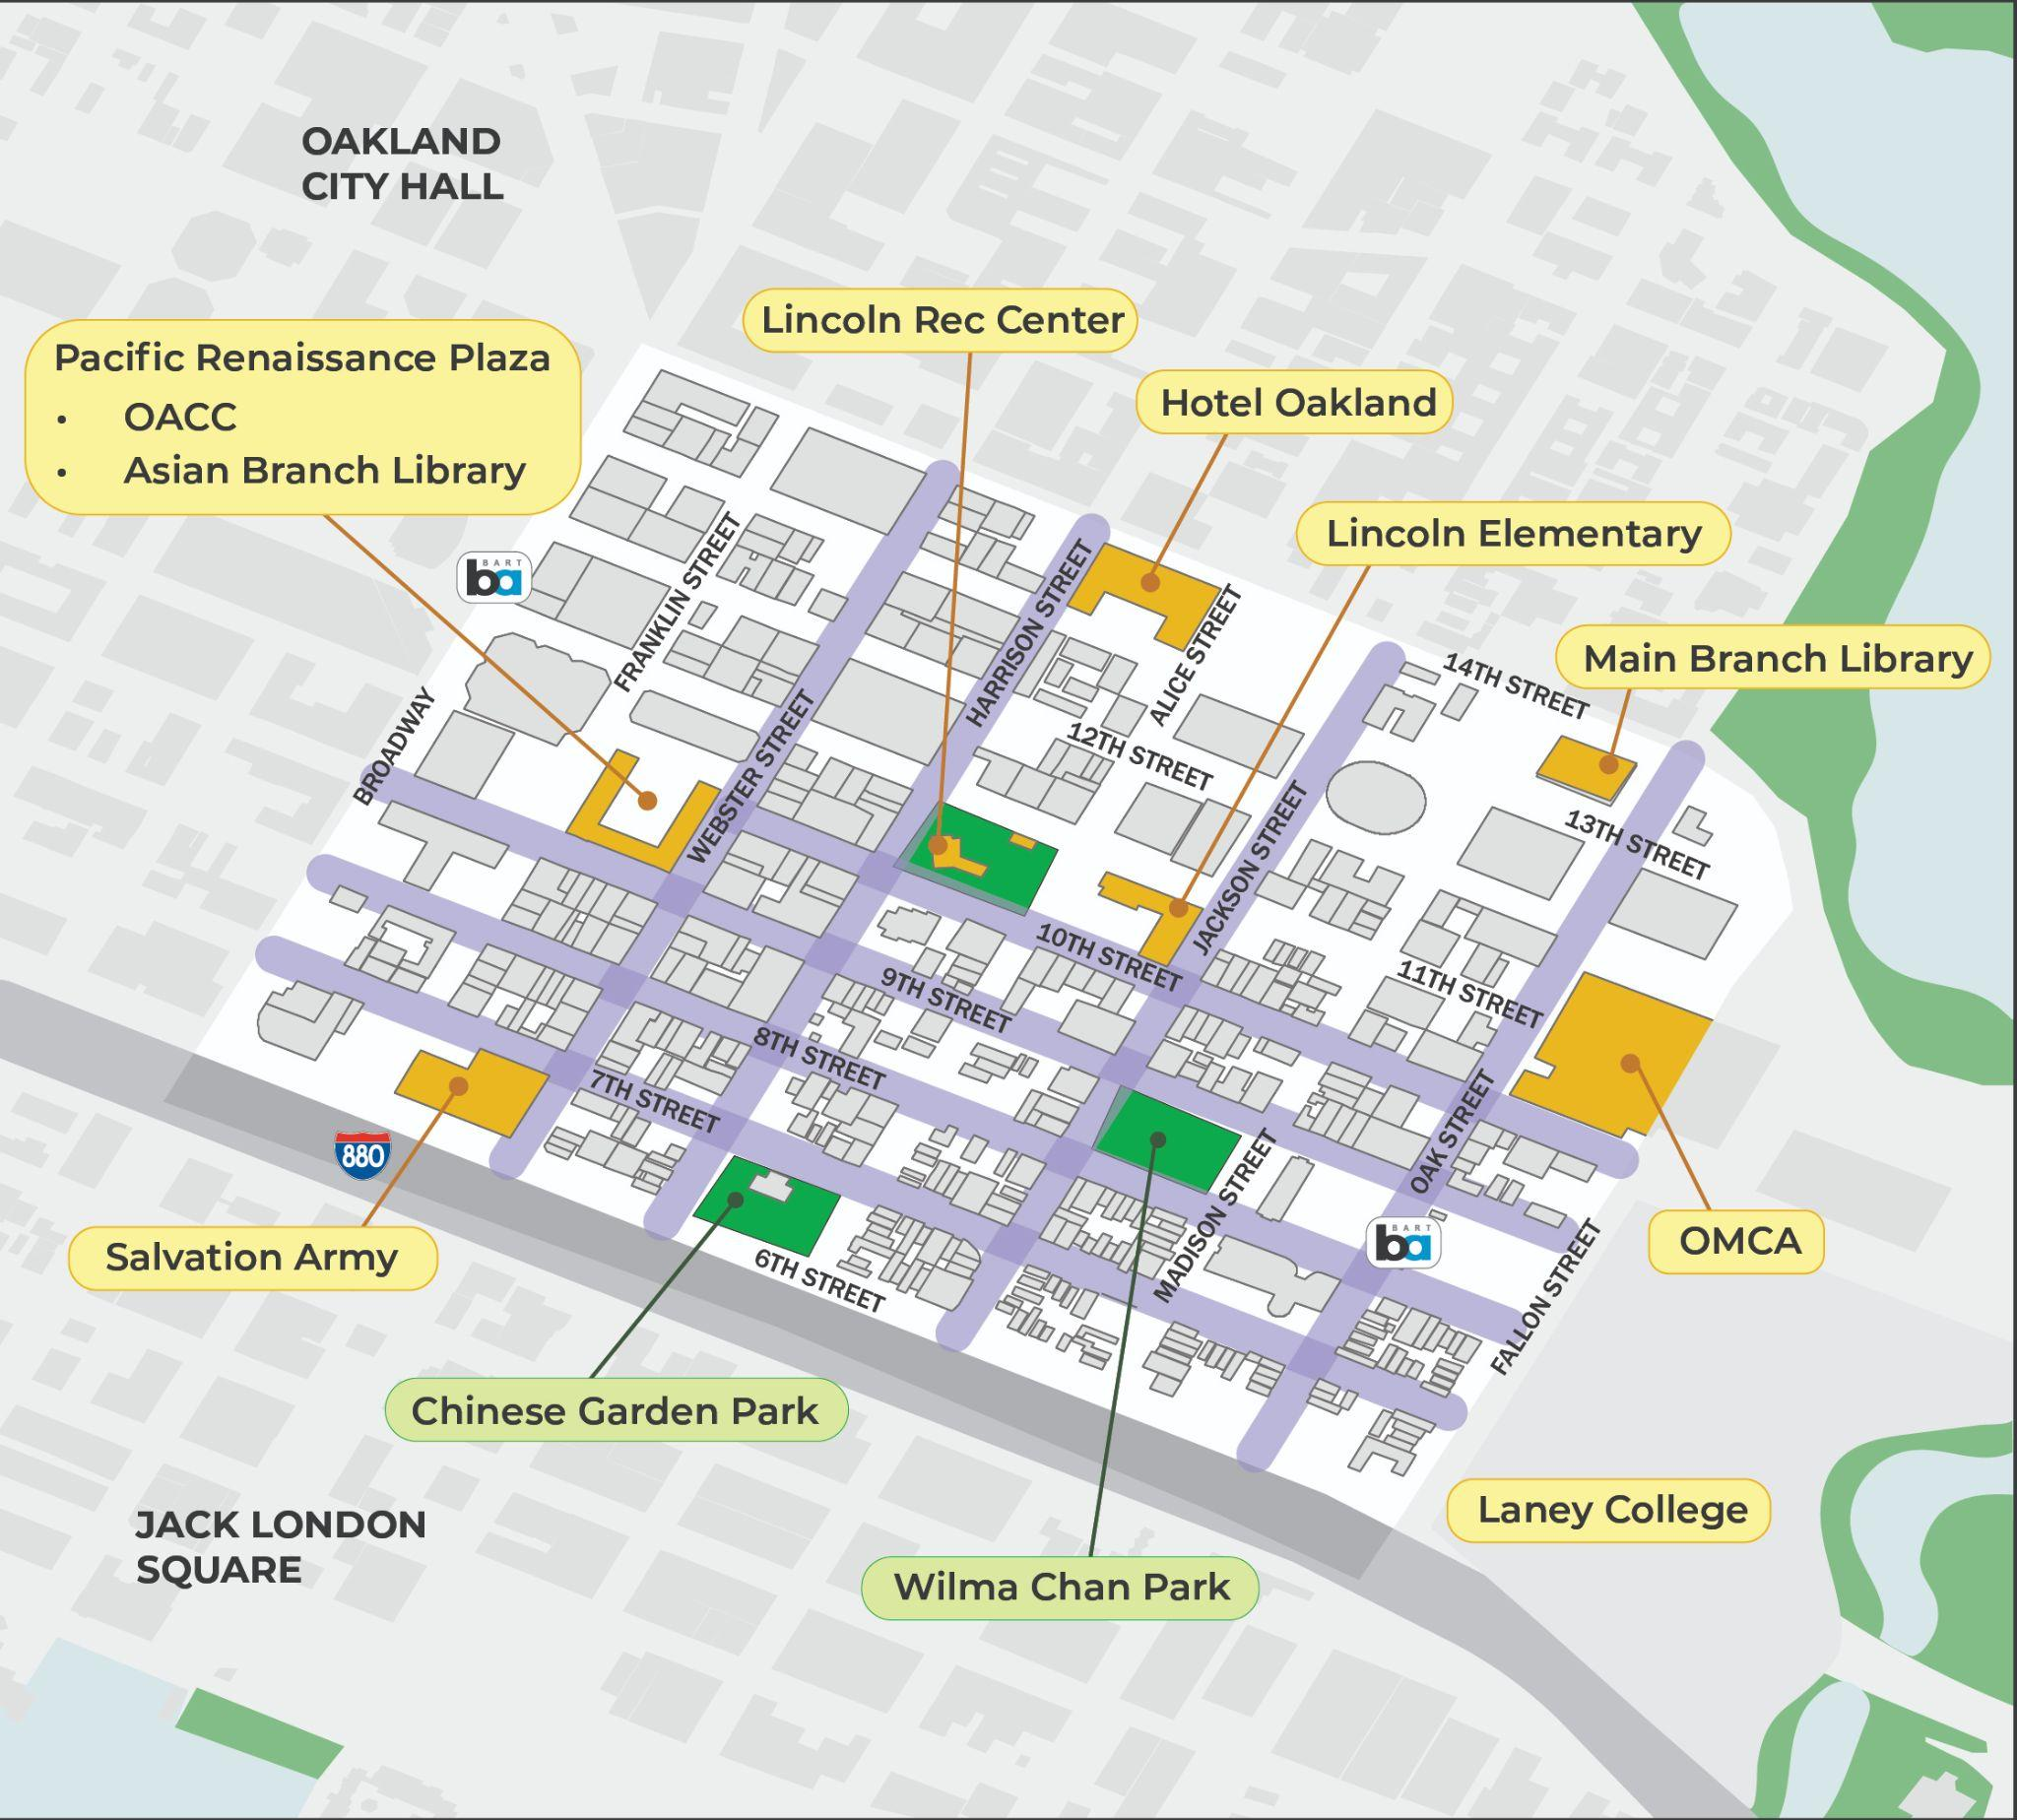
Plan Development
Corridor Selection
Proposed Top 6 Corridors
10th Street
Jackson Street
Oak Street
7th Street
8/9th Street Couplet
Webster/Harrison Street Couplet
Chinatown CCS Draft (arcgis.com)

Slide 14
Plan Development
Corridor Selection
How to Narrow to Top 4 Corridors?
Online TAC Voting
Each of the 6 TAC Committee members gets one vote, the City gets one vote
Goal is to be as close to consensus as possible
Online vote form – ranked choice, 2 weeks to vote
Present compiled results at TAC #2

Slide 15
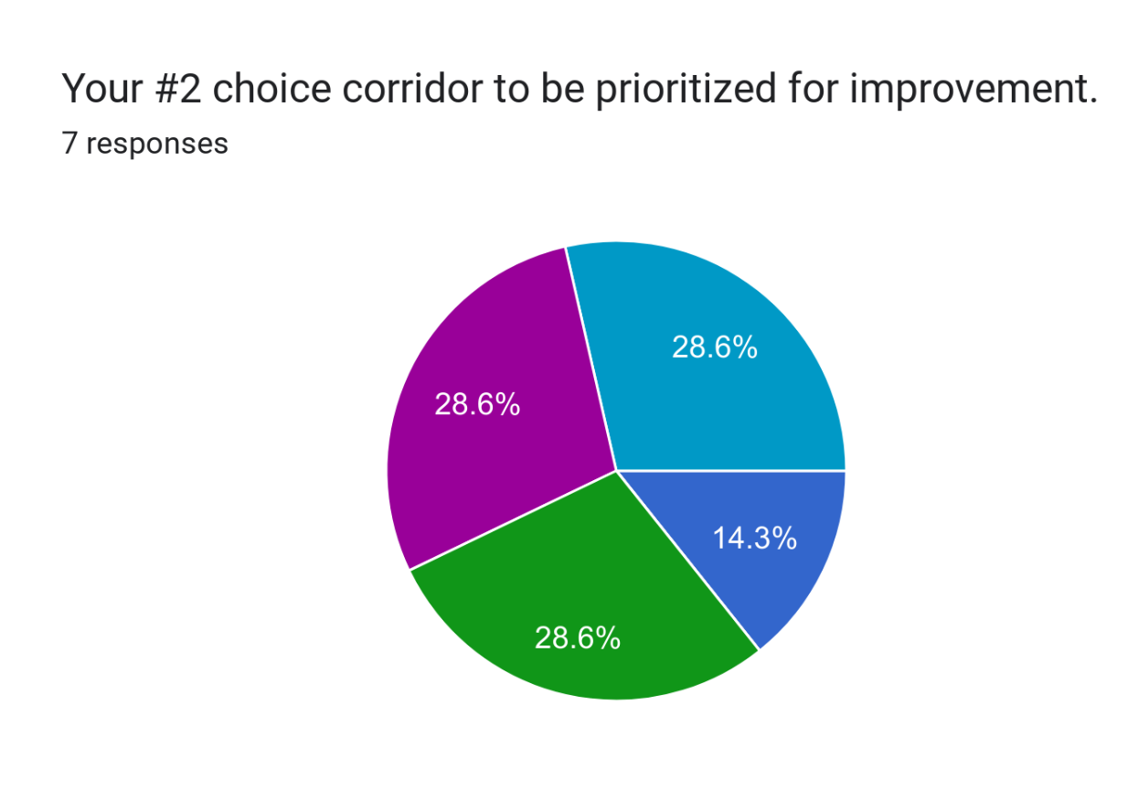
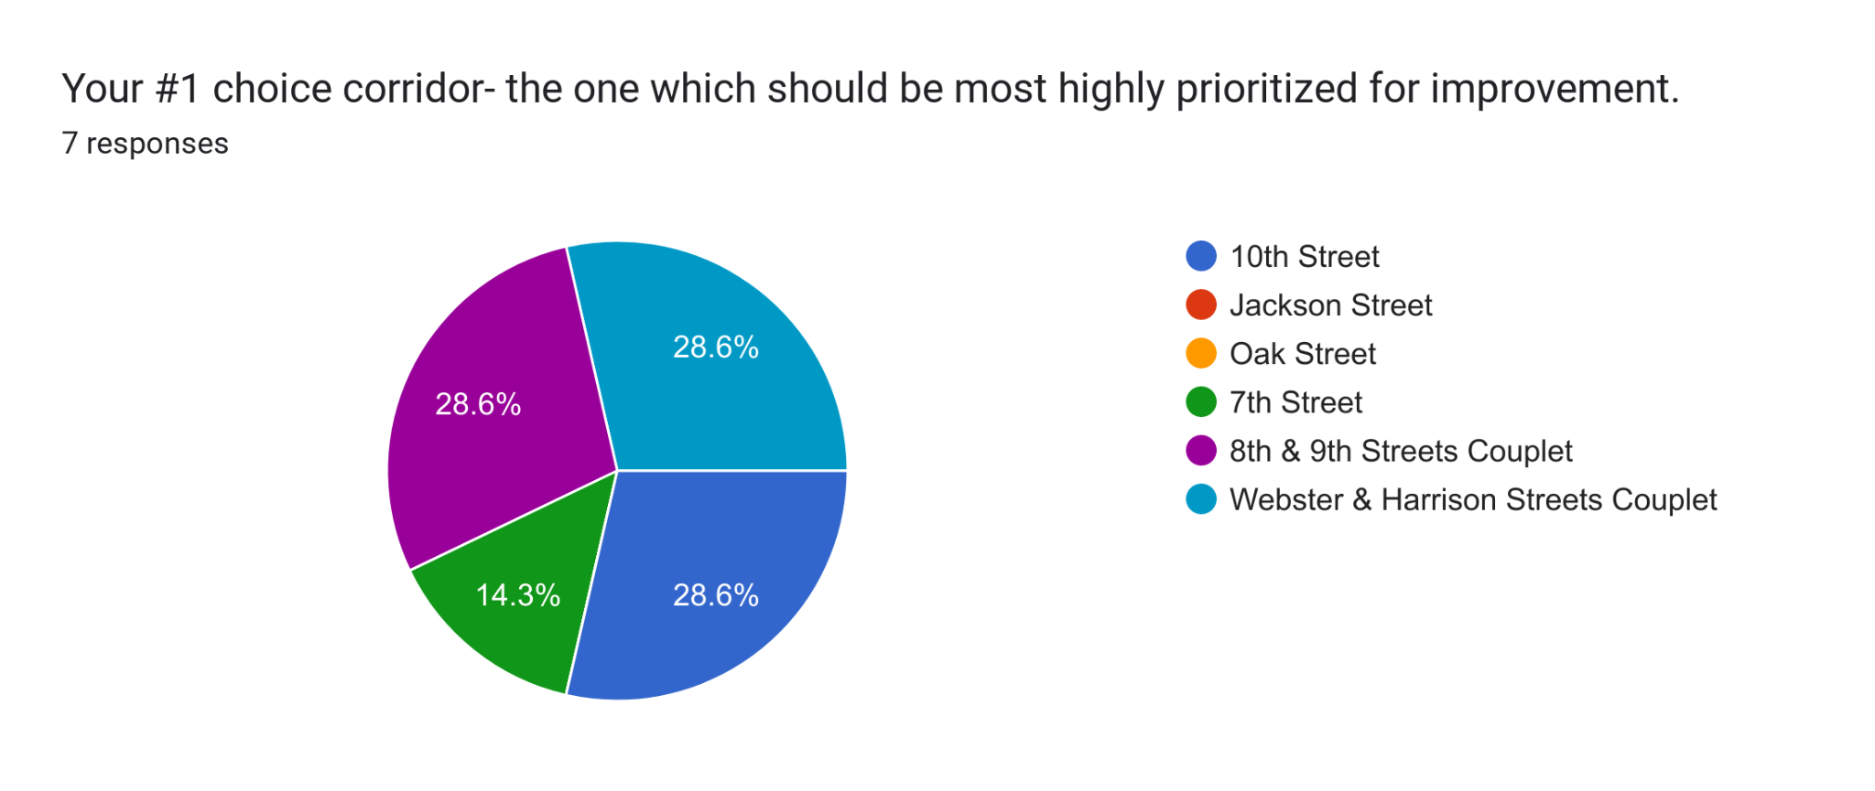
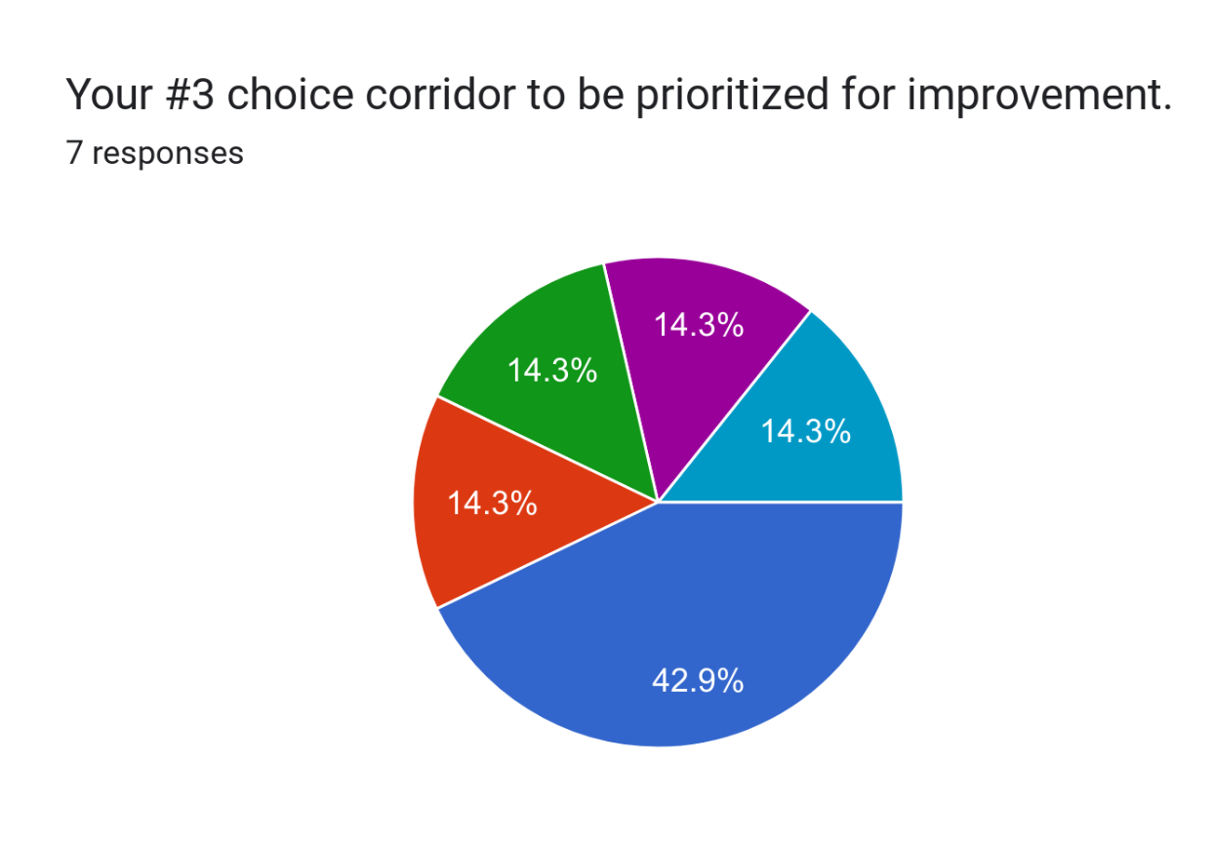
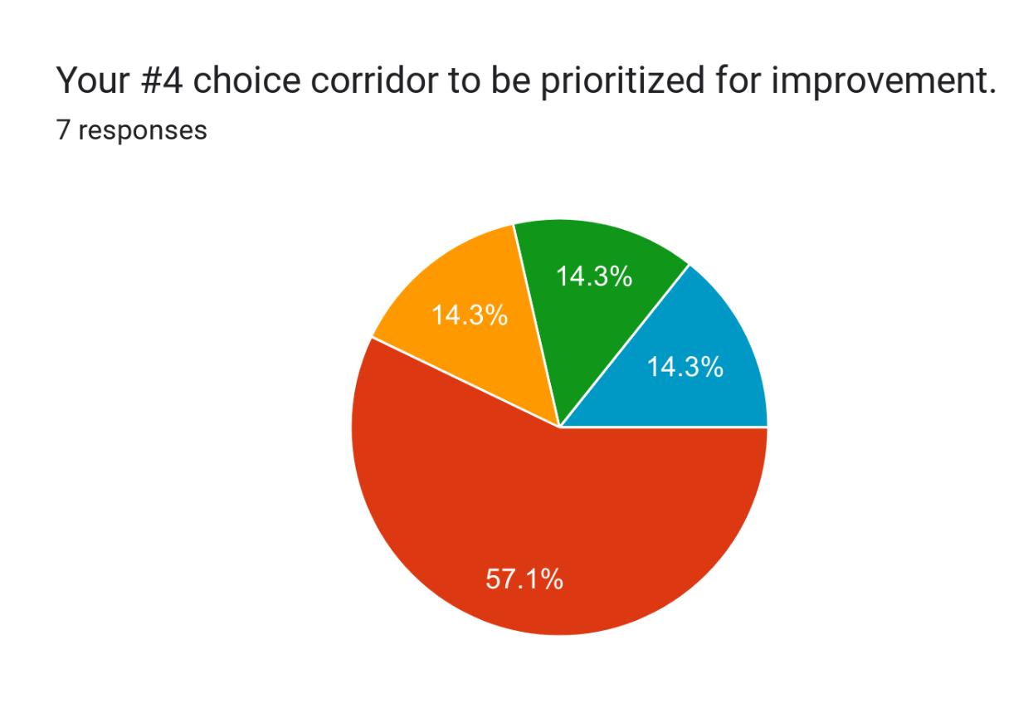
Plan Development
Corridor Selection

Slide 16
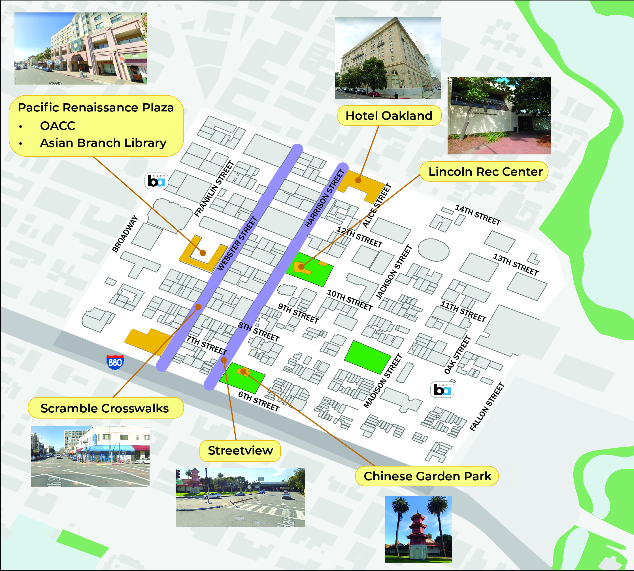
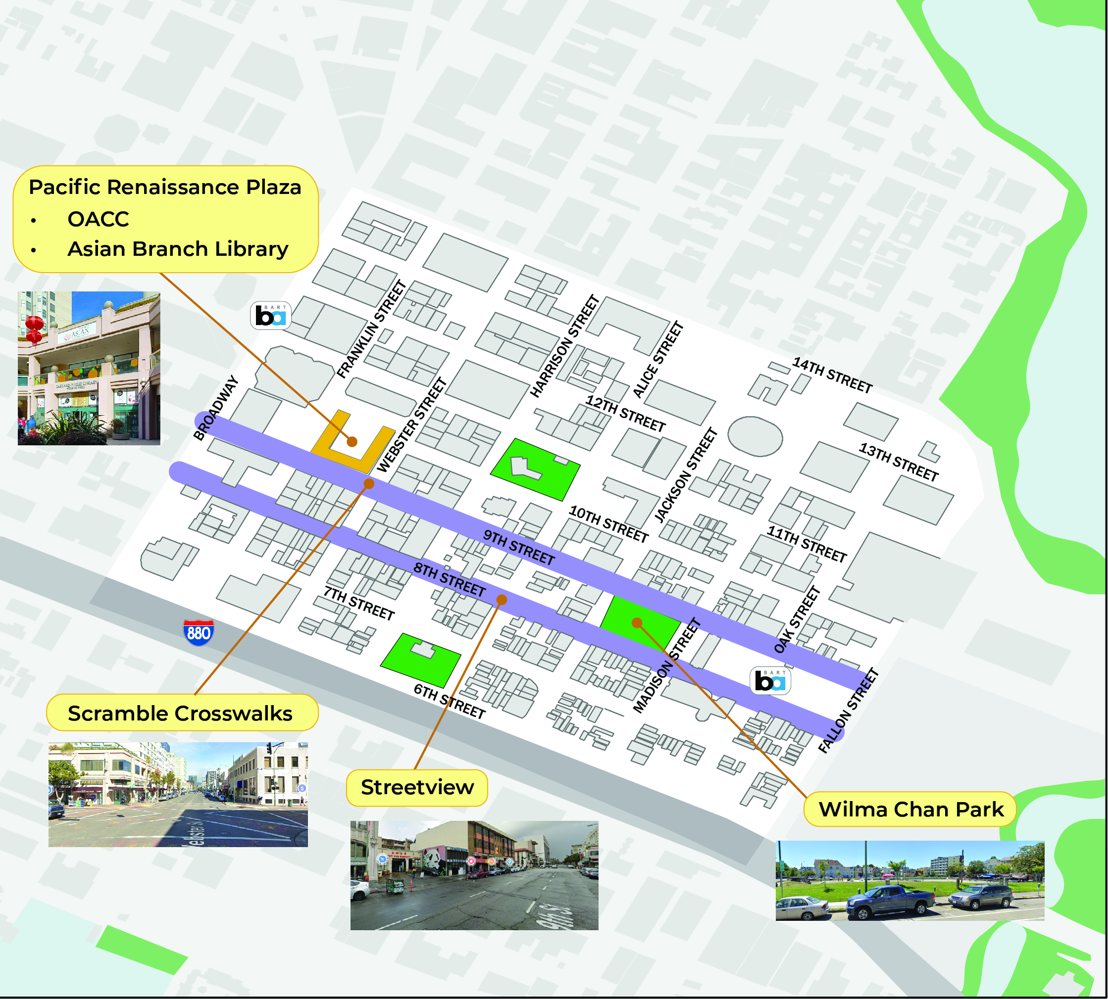
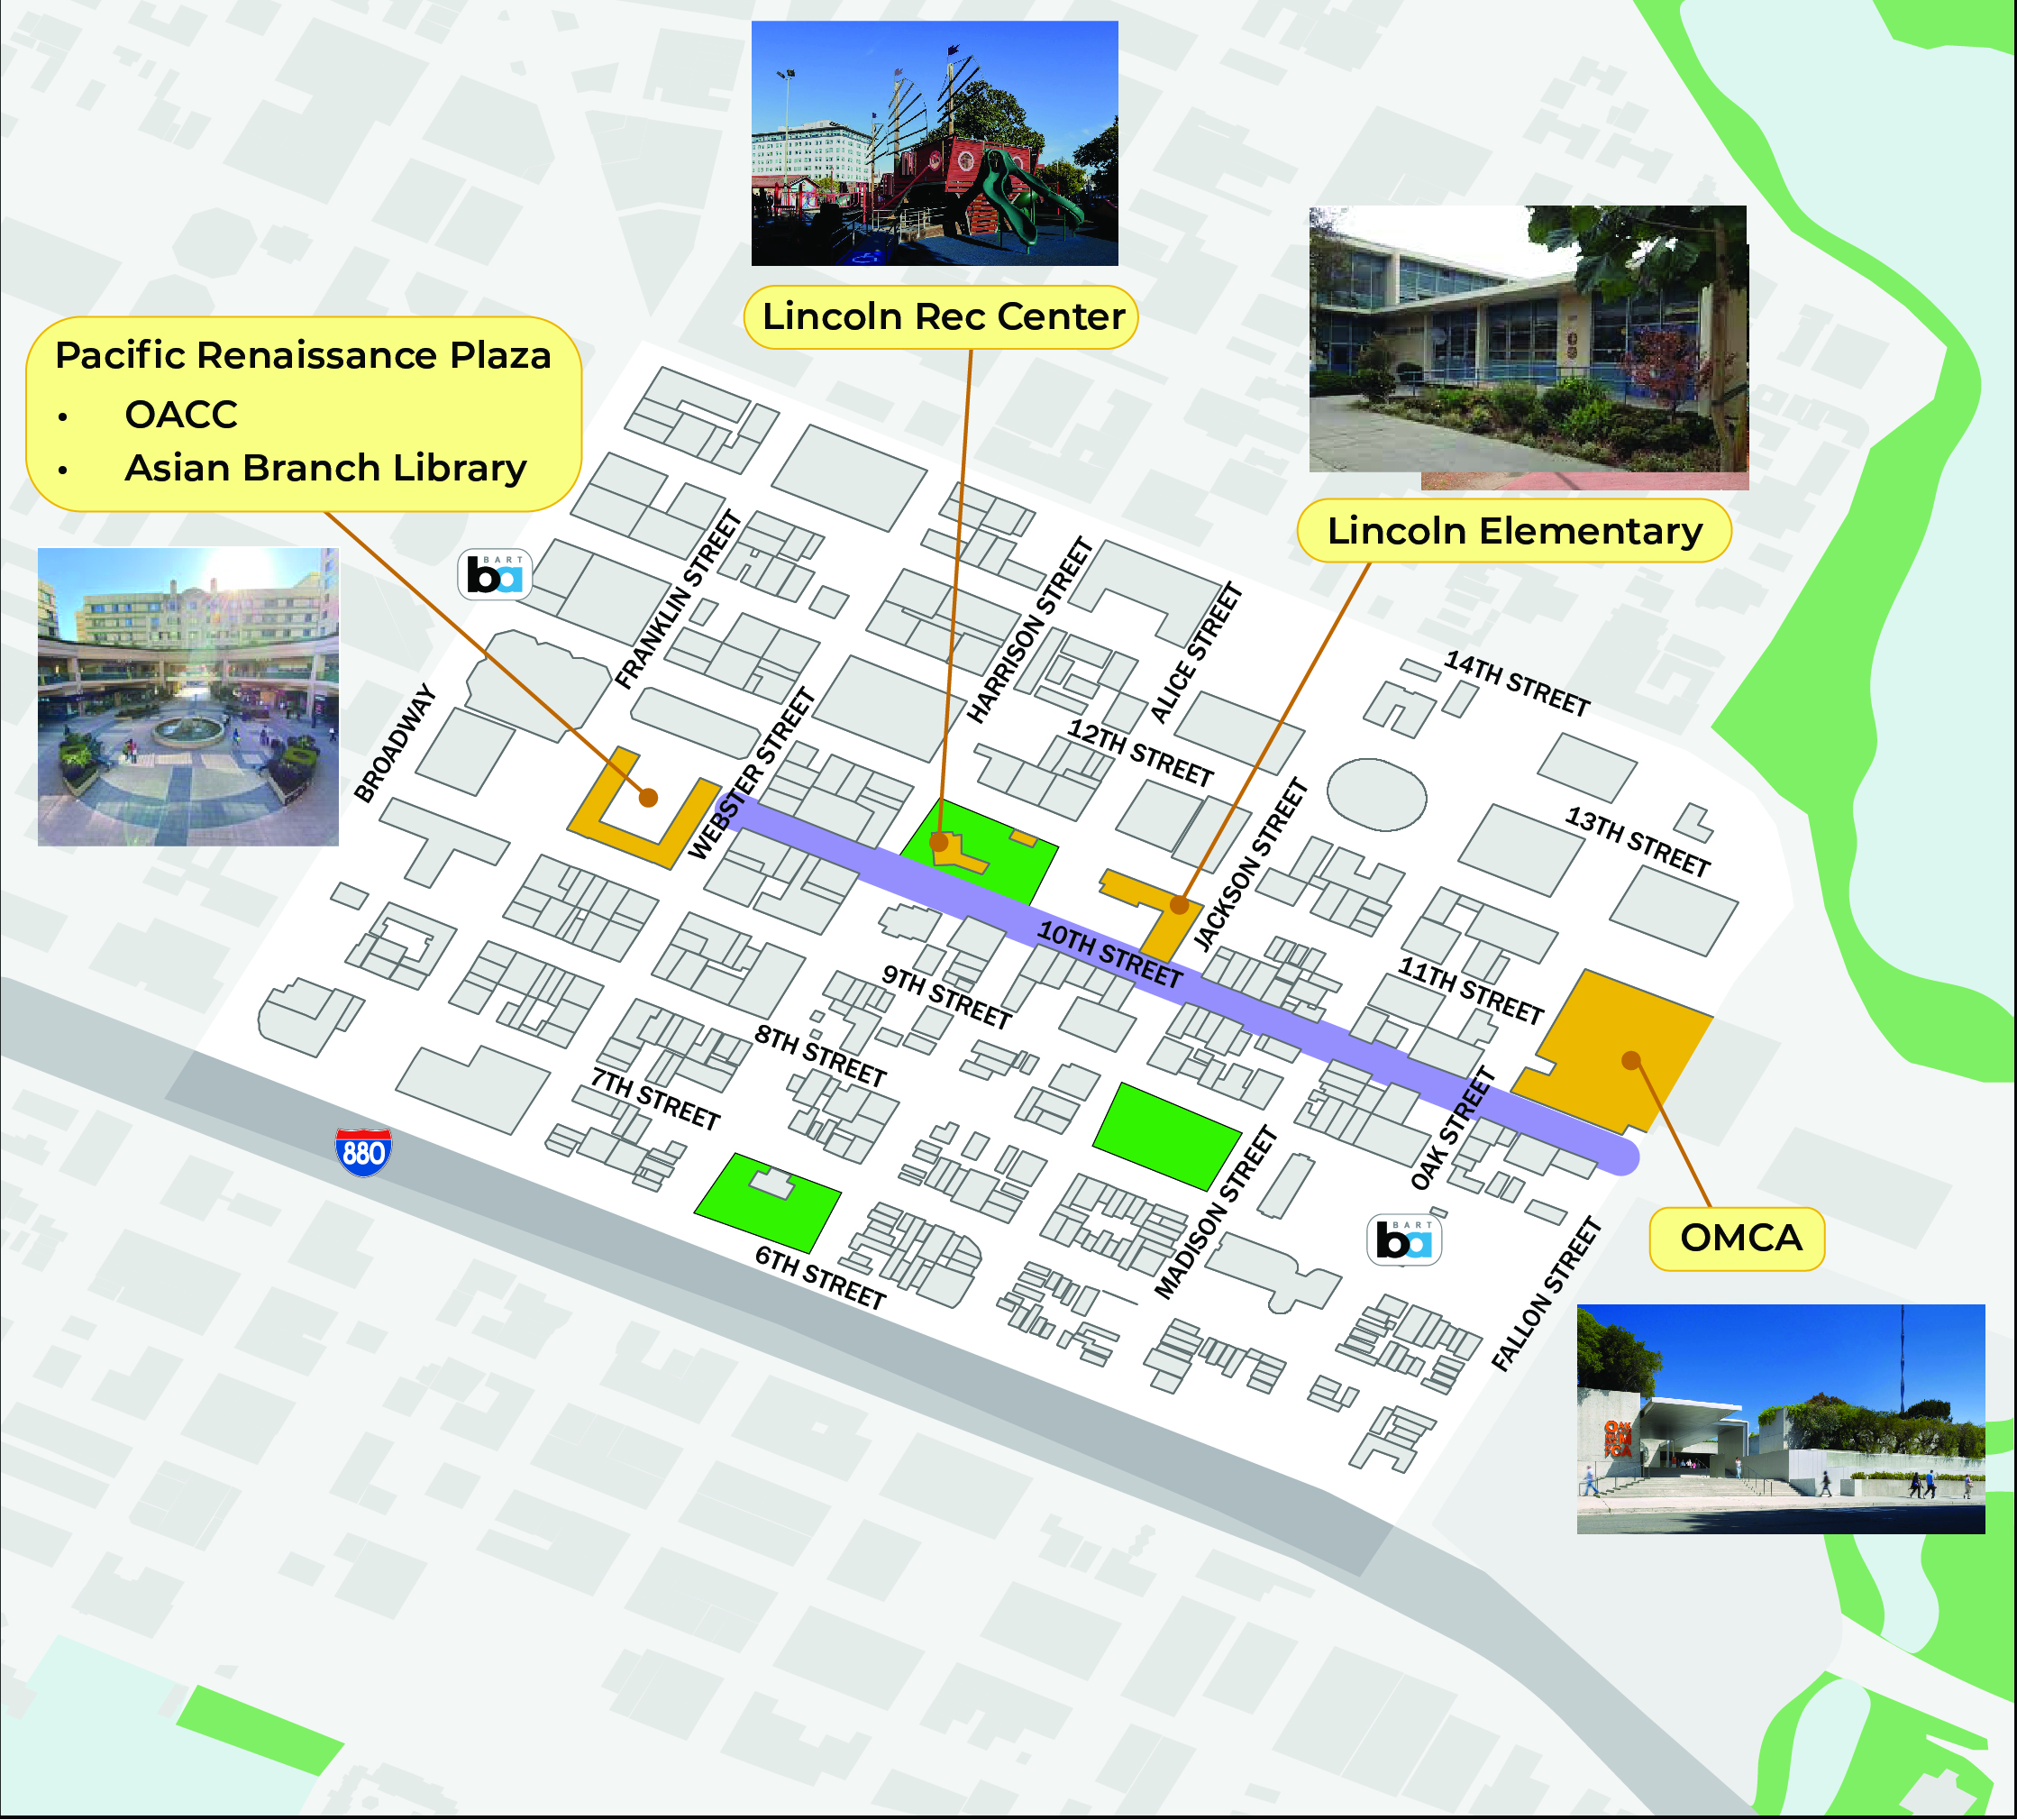
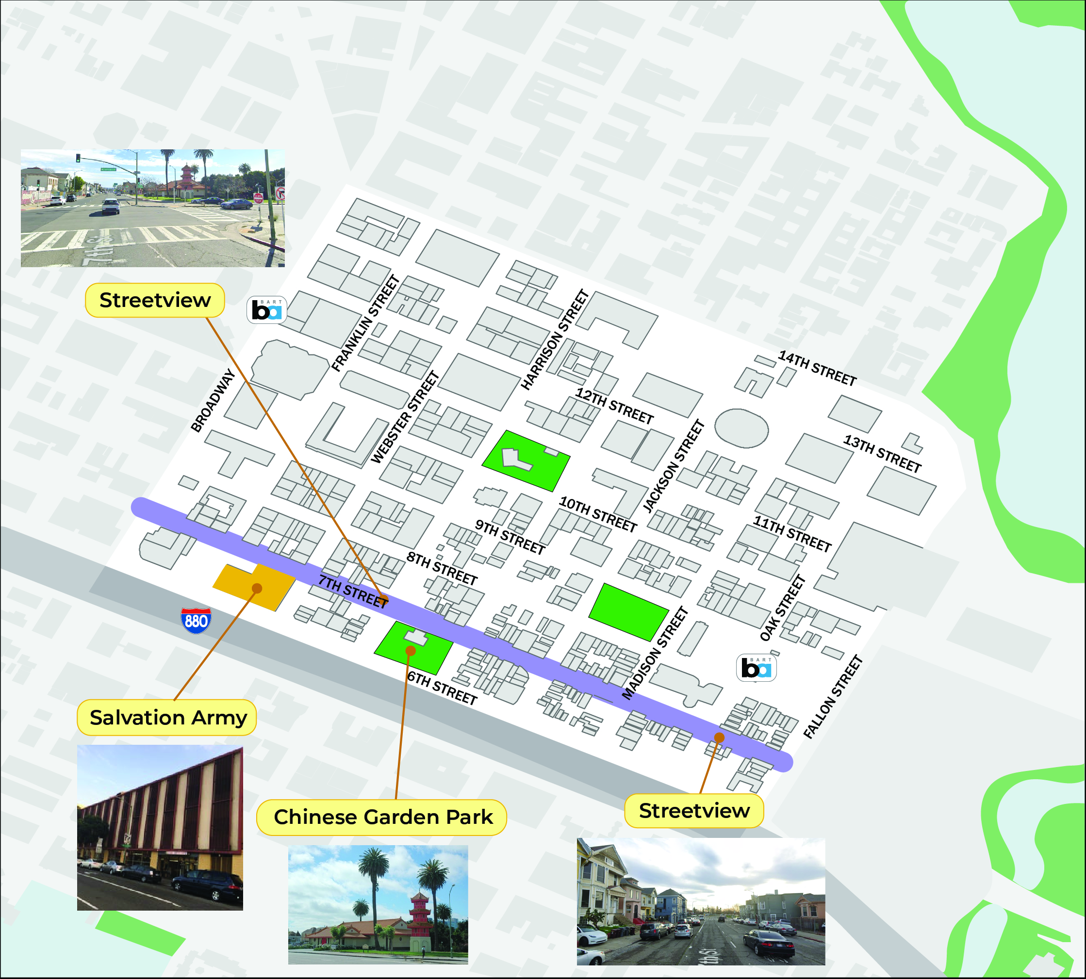
Plan Development
Corridor Selection
Webster/ Harrison couplet
10th Street
7th Street
8th/ 9th couplet
Notes:
Recommended Corridors
Webster/ Harrison couplet
8th/ 9th couplet
10th street
7th street

Slide 17
NEXT STEPS

Slide 18
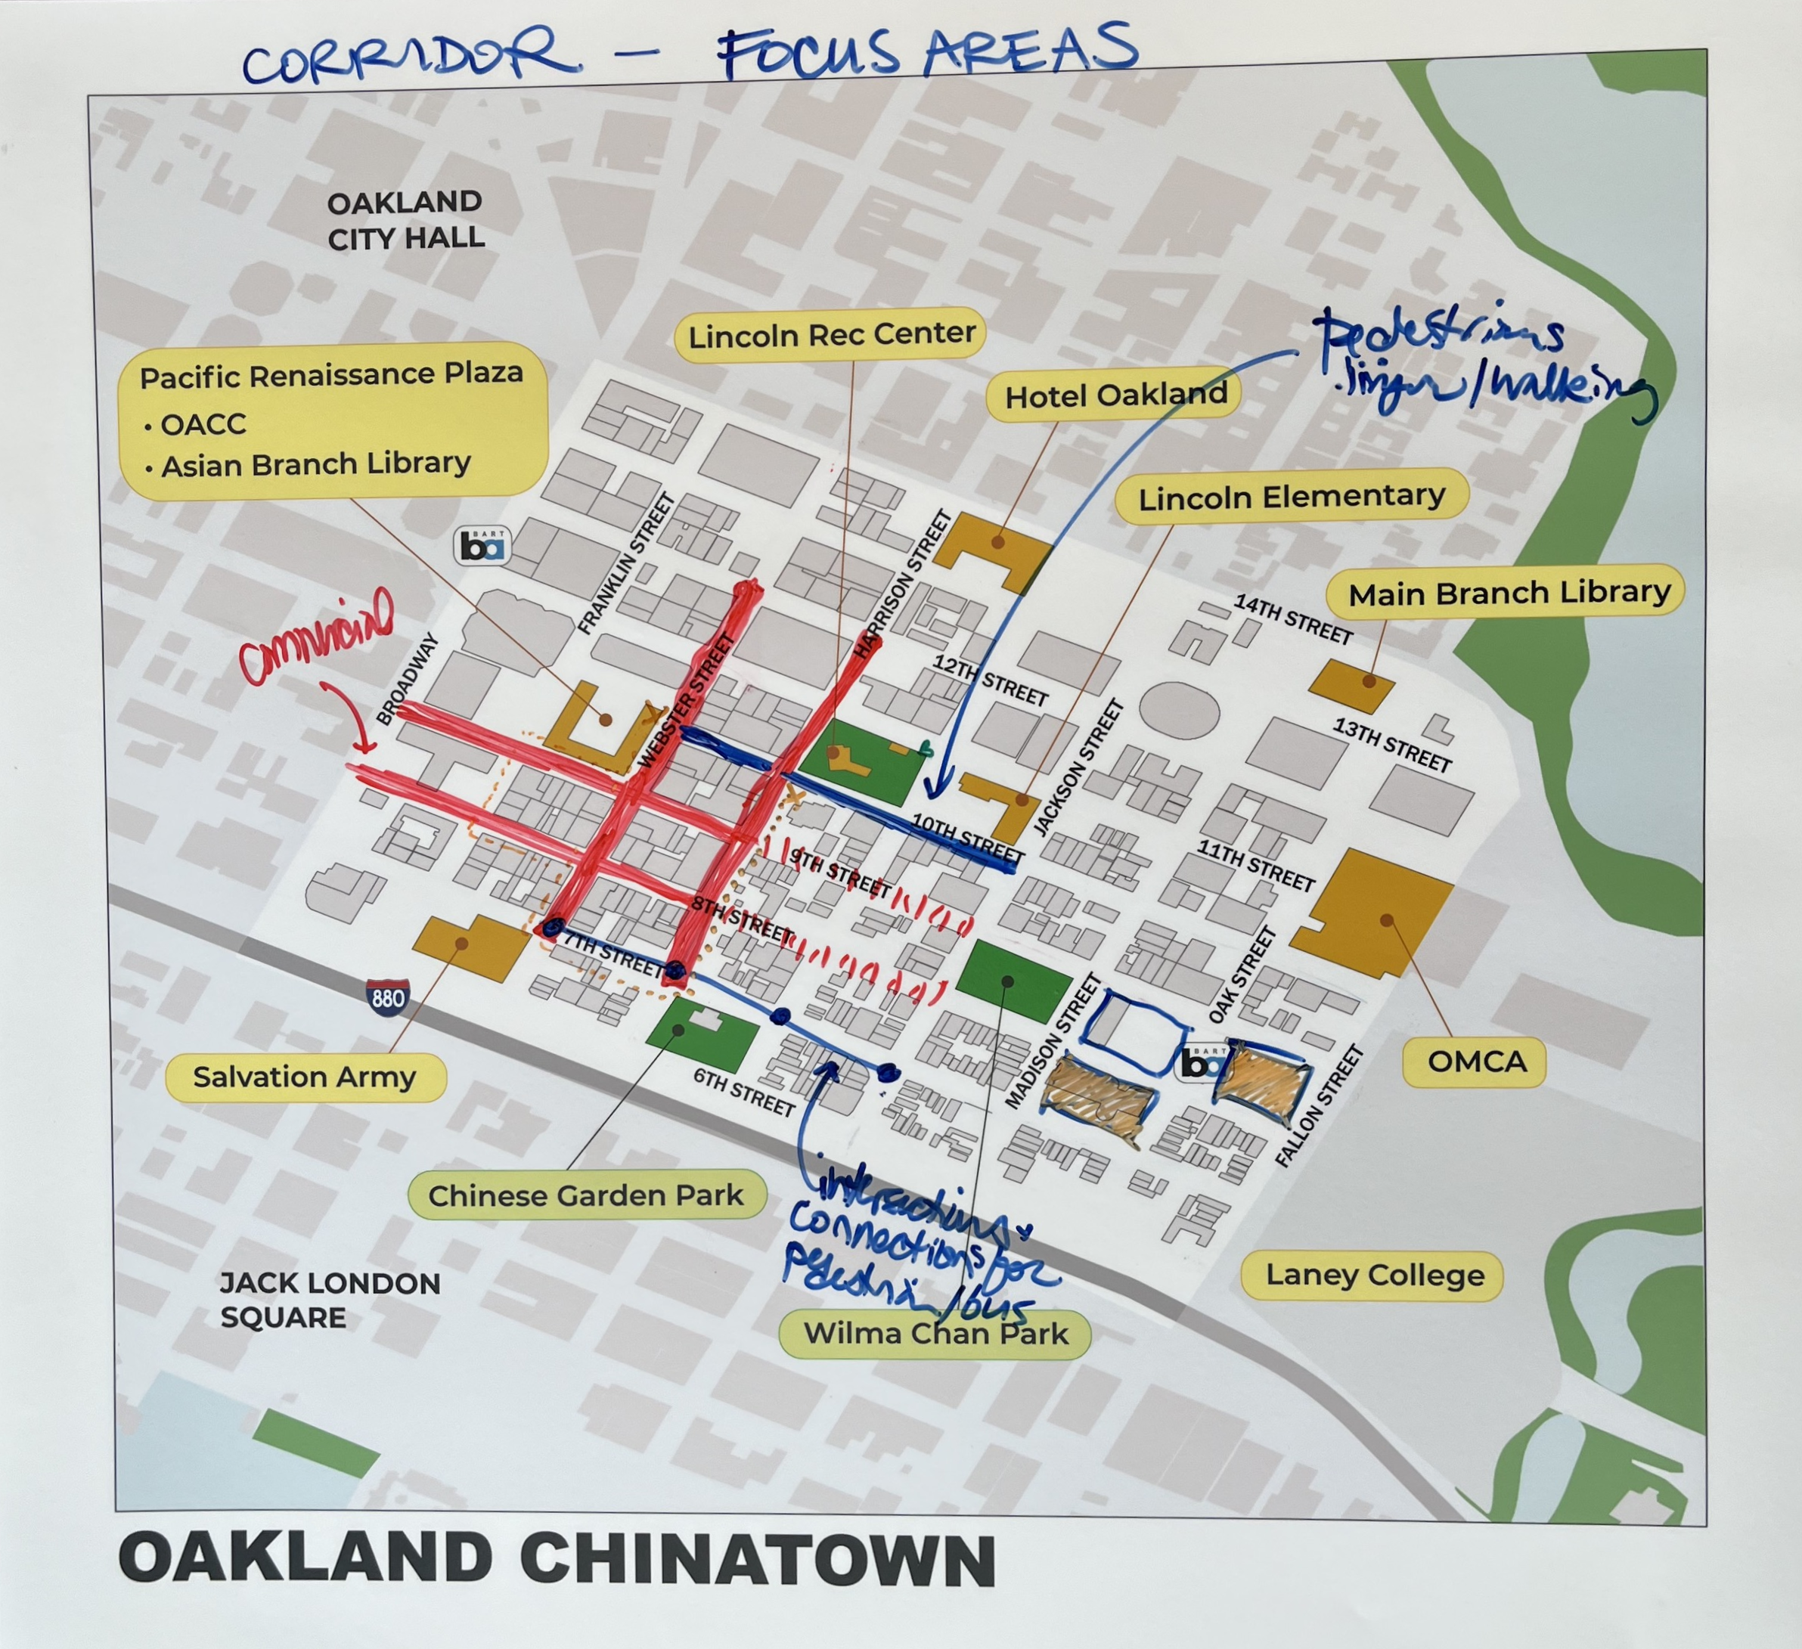
Next Steps
Engagement
Engagement
June 12th
TAC meeting #2
June 15th
Public survey https://bit.ly/ChinatownCSSurvey
June 24th
Sitewalk 10am-11:30am https://bit.ly/CCSwalk.
July 13th
Lincoln summer nights
Notes:
TAC meeting #2
Group reviews vote results, confirms top 4, refines project descriptions.
Recap what we’ve been hearing from broader engagement.
Begin discussion of design considerations.

Slide 19
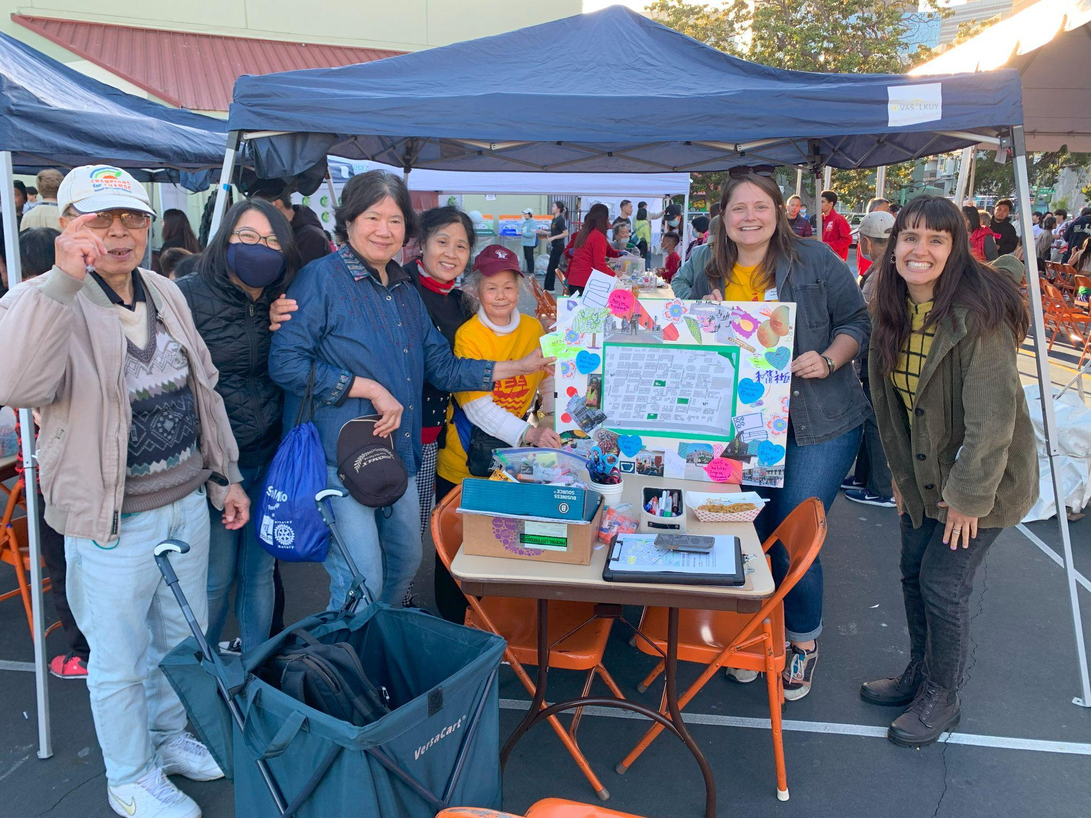
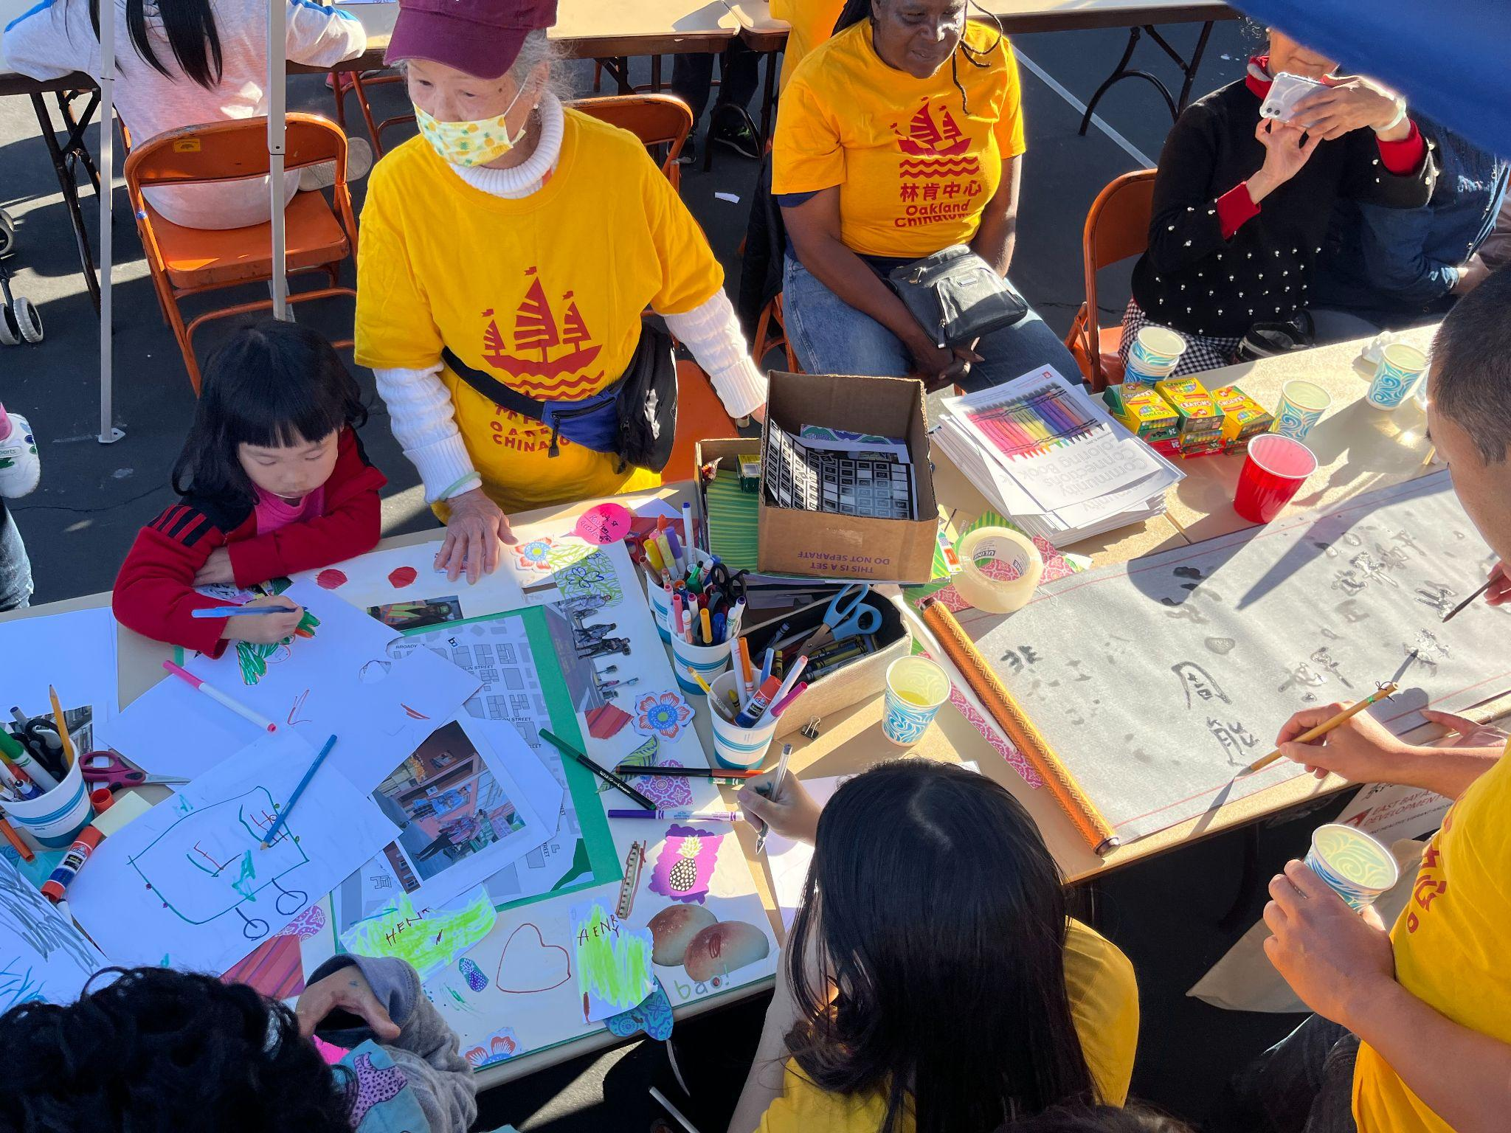
Next Steps
Design
Corridor Design
Issuing updated RFP for engineering services – July
Engage TAC during 15% -35% design plans
Notes:
TAC meeting #2
Group reviews vote results, confirms top 4, refines project descriptions.
Recap what we’ve been hearing from broader engagement.
Begin discussion of design considerations.

Slide 20
Thank You
June 15, 2023 | BPAC | Manuel Corona
Project Website:
www.oaklandca.gov/projects/chinatown-complete-streets-plan

